Slide 1
Pretty Documents Using R Markdown and Quarto
Katia Bulekova
Research Computing Services

Slide 2
Workshop Agenda
Setup
R Markdown Overview
Graphics
Tables
Document customization
Quarto

Slide 3
Setup
# Install from CRAN
install.packages( c(
'rmarkdown’,
'knitr'
))
Requirements:
R 4.0.1 or later
RStudio 2022.12.0+353 or later

Slide 4
Setup (optional)
# Install tinytex R package from CRAN
install.packages('tinytex')
# Install TinyTeX
tinytex:: install_tinytex()
If you want to generate PDF documents, install tinytex
TinyTeX is a lightweight, portable, cross-platform LaTeX distribution.

Slide 5
Regular R scripts
When R script is shared, the output is not included
Output is generated separately from the input – it takes some effort to find a line in the script that produced the output
Only simple comments (no formatting)
R Notebooks
Output is (can be) included with the code
Output (both text and graphics) is following the input lines of code that produced it
Advanced formatting
Can be exported to HTML, PDF, or DOC formats

Slide 6
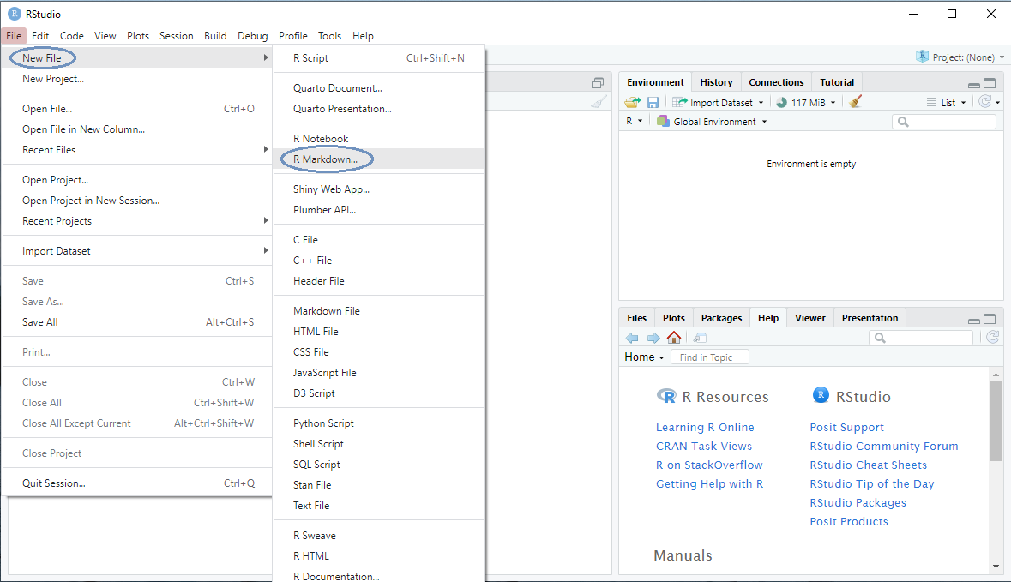
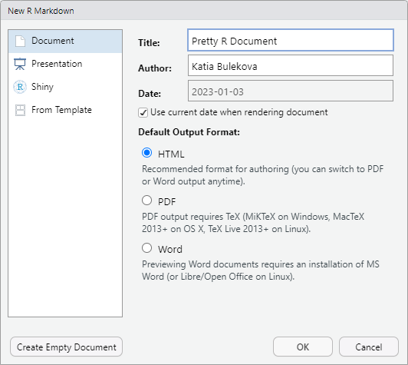
Getting Started
Using File menu, select
New File -> R Markdown
Fill out Title, Author and Date fields
Check "Use current date…" box

Slide 7
R Markdown Document Structure
YAML Header
Formatted Text
Code
Output
Formatted Text

Slide 8
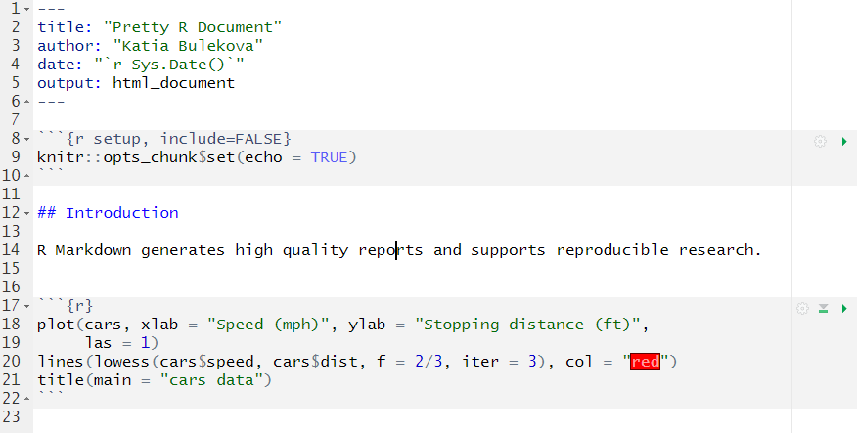
R Markdown Document Structure
YAML Header
Metadata of the document. Controls:
themes
fonts
output
table of content
etc.

Slide 9
R Markdown Document Structure
Formatted Text

Slide 10
R Markdown Document Structure
R code chunk
R code chunk

Slide 11
R Markdown Document Structure
R code chunk
R code chunk

Slide 12
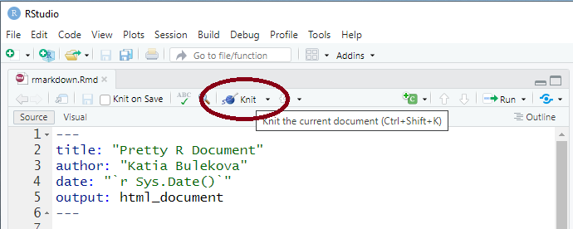
Render Document
Settings:
Preview in Window
Preview in Viewer Pane

Slide 13
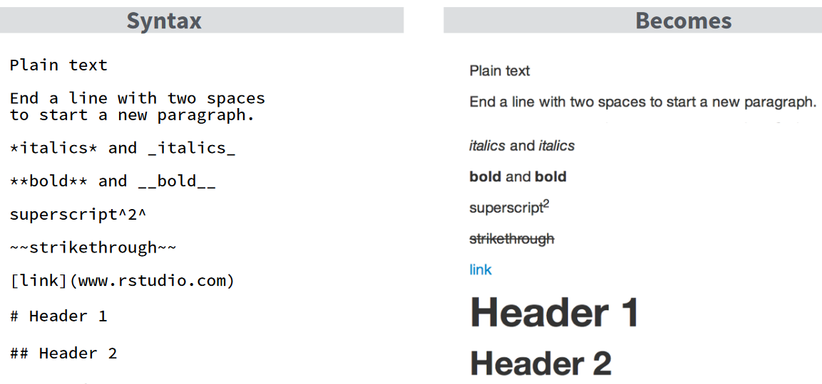
R Markdown Overview
Cheat sheet and Reference can be found on Posit's website or
rcs.bu.edu/examples/r/examples/RMarkdown/

Slide 14
Hands-on:
Notebook_1_Rmarkdown.Rmd

Slide 15
YAML Header
YAML: YAML Ain’t Markup Language
A YAML header contains YAML arguments, such as “title”, “author”, and “output”, demarcated by three dashes (—) on either end.

Slide 16
YAML Header
title: will appear at the head of the document with the largest font size
subtitle: will appear below the title with a smaller font
author: any text. It appears below the title (ad subtitle)
date: a plain text or an R function ("`r Sys.Date()`")

Slide 17
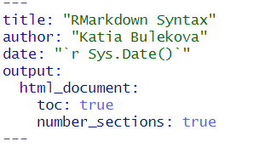
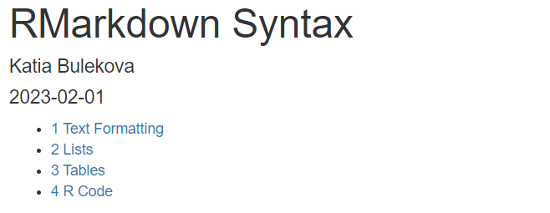
YAML Header
toc: Table of Content

Slide 18
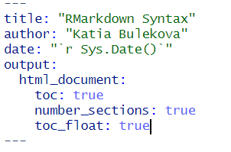
YAML Header
toc: Table of Content

Slide 19
YAML Header
theme: document styling (font, color, etc.)
https://www.datadreaming.org/post/r-markdown-theme-gallery/
code_folding: "show" or "hide" – controls whether code chunks are shown or hidden.
output: html_document
html_notebook
pdf_document
word_document

Slide 20
YAML Header
Comprehensive documentation of YAML field options:
https://cran.r-project.org/web/packages/ymlthis/vignettes/yaml-fieldguide.html

Slide 21
Tables
Notebook_2_Tables_HTML.Rmd
Notebook_3_Tables_PDF.Rmd

Slide 22
Graphics
Notebook_4_Graphics.Rmd

Slide 23
Quarto
https://quarto.org/docs/guide/
Quarto is a multi-language, next generation version of R Markdown from RStudio, with many new new features and capabilities. Like R Markdown, Quarto uses Knitr to execute R code, and is therefore able to render most existing Rmd files without modification.
Notebook_4_Quarto.Rmd

Slide 24
Questions?
Please fill out our evaluation form:
http://scv.bu.edu/survey/tutorial_evaluation.html

