Slide 1

Data visualization in Python
Research Computing Services
Scott Ladenheim, PhD

Slide 2
Please check your name on the attendance sheet

Slide 3
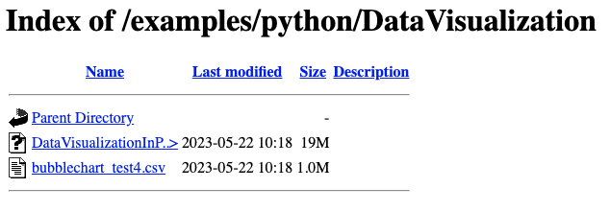
Course materials
The course materials can be found at this link: https://rcs.bu.edu/examples/python/DataVisualization/
If you have not already done so, download the Jupyter notebook DataVisualizationInPython.ipynb

Slide 4
After the tutorial
Navigate to http://rcs.bu.edu/eval
Tutorial feedback survey

