Slide 1
Introduction to the SCC and Linux
Dr. Kyle Kurkela
kkurkela@bu.edu
Research Computing Services
Information Services & Technology
Boston University
Notes:
Give a preview of what this is going to be: a bit of me lecturing/telling you about things. A bit of me actually showing you some things. A couple of exercises. A whole lot of stopping and answering specific questions you all may have.

Slide 2
Class poll
How many of you have used a Linux operating system?
How many of you have heard of/have used the SCC?
Computer programming experience?
  Know what a variable is?
  Know what a script is?
Notes:
Informal poll
A lot of what I have prepared is aimed for the novice SCC/linux/HPC user. Like brand new. I can skip over things if the audience would like.

Slide 3
Workshop Overview
Who am I?
What is the SCC?
How does the SCC work?
SCC On Demand
Connecting to a Desktop Session
The Linux Desktop Environment
The Linux Command Line
Customizing the Linux Command Line
The Linux File System
The Module System
How to submit jobs to the SCC
How to upload and download data/files to the SCC
Yaxil Demonstration
Notes:
This is what we will be covering today.
I will lecture a little bit and we will connect to the SCC together and we will be introduced to some basic linux commands.

Slide 4

Who am I?
Kyle Kurkela (kkurkela@bu.edu)
My title: Research Computing and Applications Specialist
My unofficial title: the SCC’s neuroimaging expert
My job is to help BU’s neuroimaging research community effectively use the SCC’s resources
Graduated in 2023 with PhD from Boston College in Psychology and Neuroscience
I have been doing neuroimaging research for over 10 years now
Notes:
Emphasizing that I will be explaining things “Explain like I am 5”/”The SCC for dummies”. I will avoid overly technical details. Others on my team are better suited for that.

Slide 5
Workshop Overview
Who am I?
What is the SCC?
How does the SCC work?
SCC On Demand
Connecting to a Desktop Session
The Linux Desktop Environment
The Linux Command Line
Customizing the Linux Command Line
The Linux File System
The Module System
How to submit jobs to the SCC
How to upload and download data/files to the SCC
Yaxil Demonstration

Slide 6
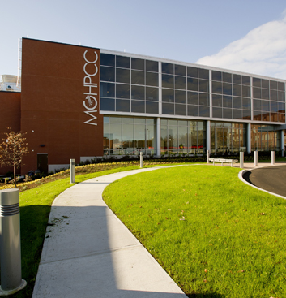
What is the SCC?
A linux cluster with over 1000 computers, 28000 processors, 400 GPUs and over 14 petabytes of storage.
Located in Holyoke, MA
A collaboration between 5 major universities in MA
Went into production in June, 2013
Has many of the most popular software packages for performing research – including many neuroimaging processing packages
Notes:
The SCC is a group of computers. They do not have monitors. They are not designed to have nice user interfaces – they are designed and optimized to compute heavy duty, usually scientific, computations.

Slide 7
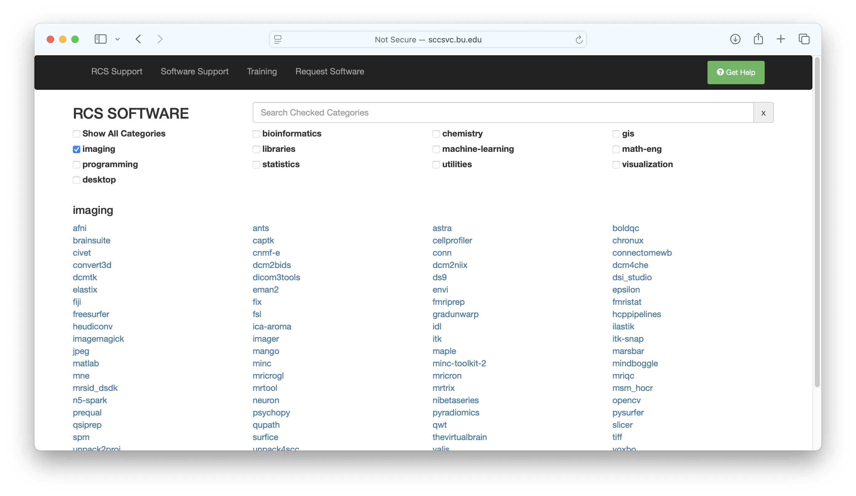
What is the SCC?
Notes:
The SCC is a group of computers. They do not have monitors. They are not designed to have nice user interfaces – they are designed and optimized to compute heavy duty, usually scientific, computations.

Slide 8
Workshop Overview
Who am I?
What is the SCC?
How does the SCC work?
SCC On Demand
Connecting to a Desktop Session
The Linux Desktop Environment
The Linux Command Line
Customizing the Linux Command Line
The Linux File System
The Module System
How to submit jobs to the SCC
How to upload and download data/files to the SCC
Yaxil Demonstration

Slide 9
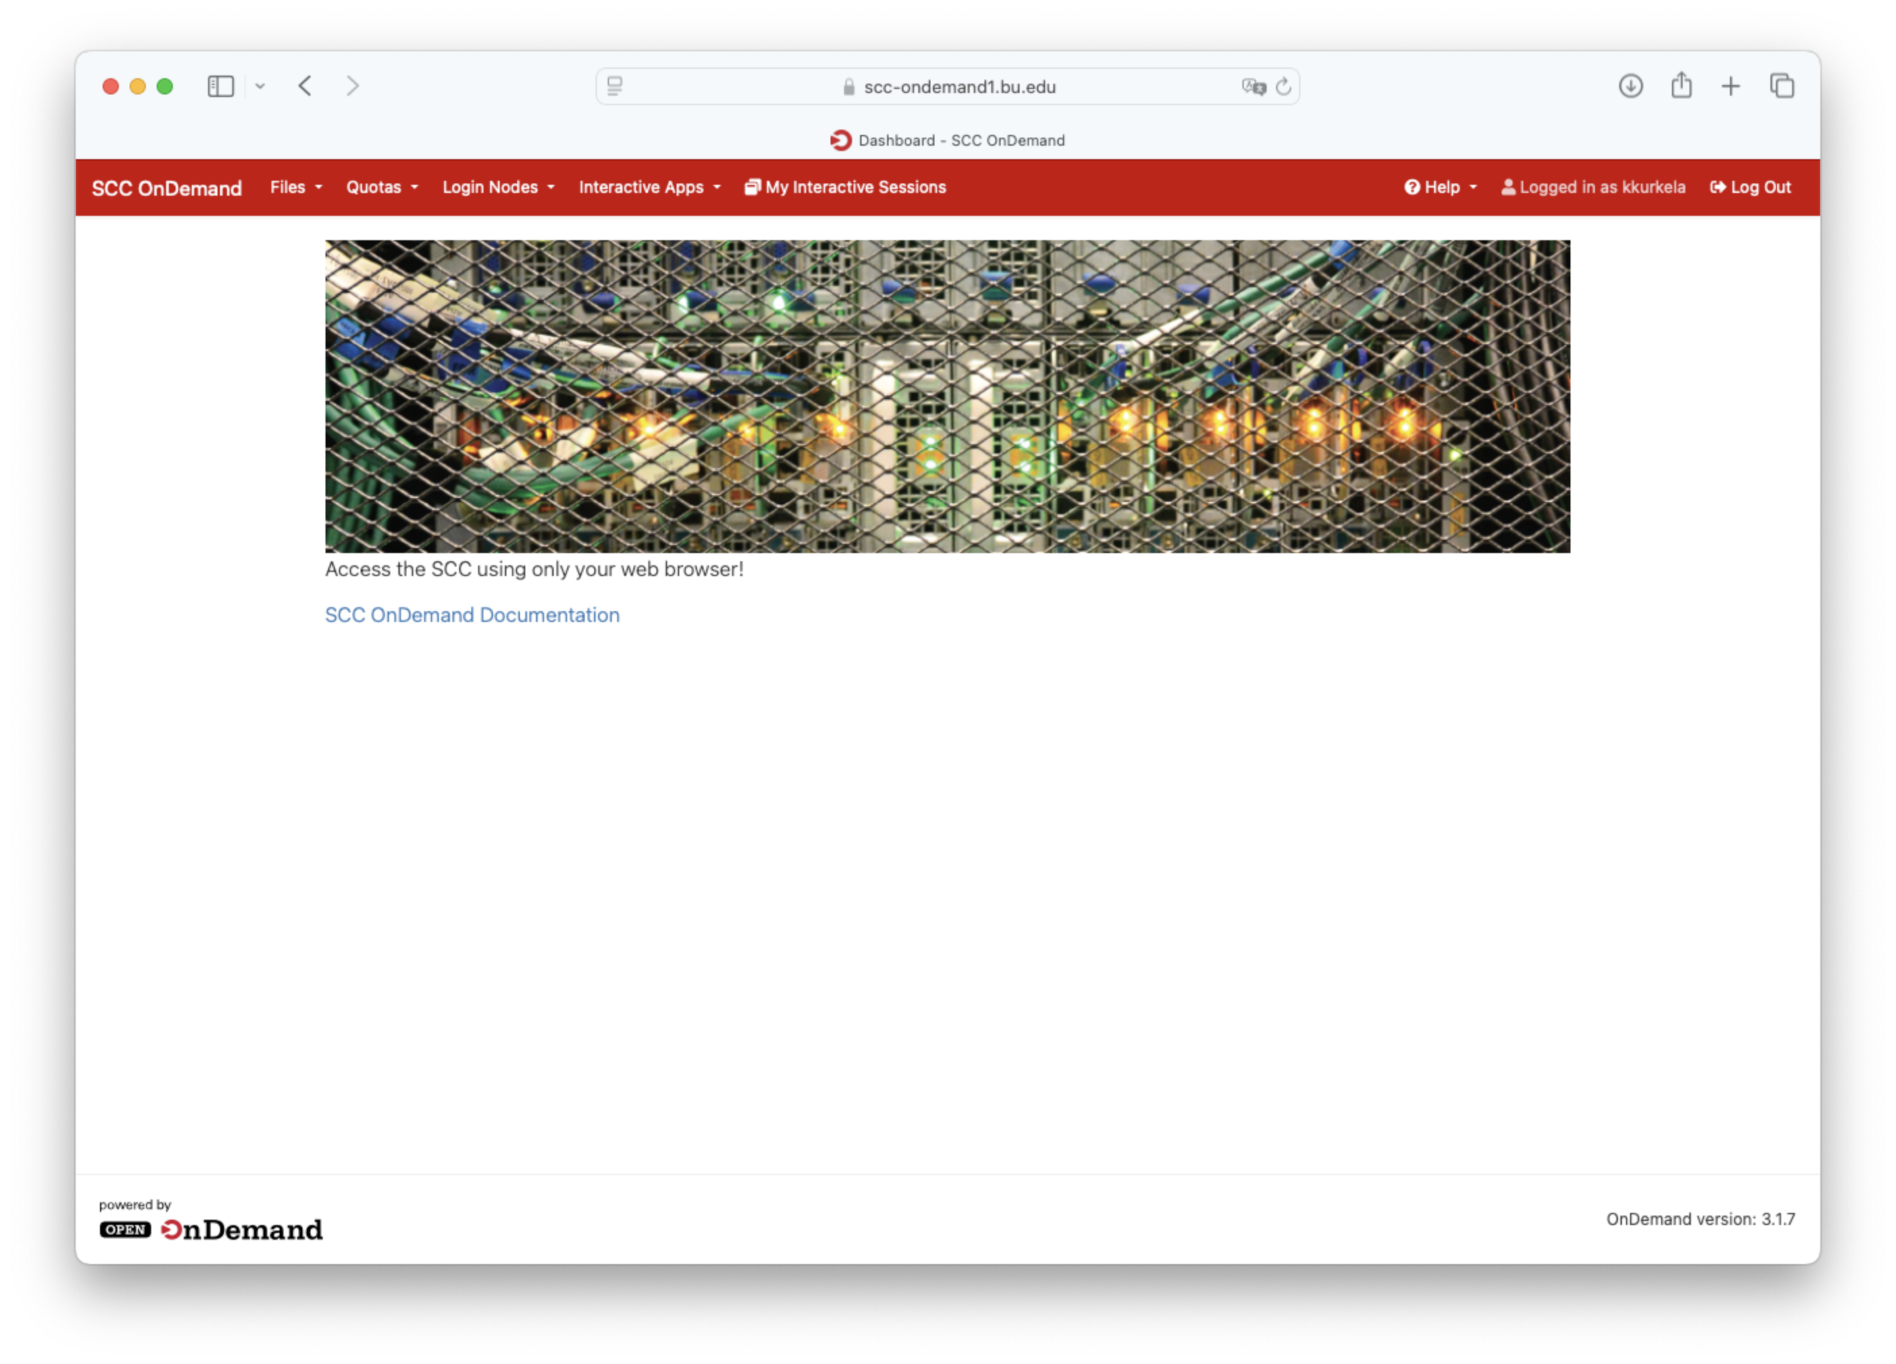
How does the SCC work?
Public Network (AKA the Internet)
Your Computer
SCC OnDemand
Login Nodes
Private Network
Compute Nodes
Job Scheduler
Notes:
DESIGN
Talk about SCC OnDemand
Talk about Login Nodes vs Compute Nodes
Talk about the job scheduler – think of it as a person. He/she takes your requests for a computer and follows a set of rules for allocation. Has built in rules for things like fairness – you cannot use all of the compute nodes, for example. Also considers supply and demand.

Slide 10
SCC Organization
The SCC is organized around a “projects” framework
  SCC “projects” are an organizational entity administered by a Principal Investigator typically devoted to a single laboratory, a single experiment, a single grant, etc.
  ”projects” can only be opened by BU faculty members.
  “projects” are assigned 1TB of storage space and more can be requested. Additional space may come at a cost.
  “projects” are also allotted a “computing” budget called SUs. Each project is given a 10000 SU budget by default and more can be requested.
    SUs are free. They are essentially imaginary dollars to help us account for who is using the SCC the most.
    1 SU = using 1 CPU/core for 1 hour.

Slide 11
Workshop Overview
Who am I?
What is the SCC?
How does the SCC work?
SCC On Demand
Connecting to a Desktop Session
The Linux Desktop Environment
The Linux Command Line
Customizing the Linux Command Line
The Linux File System
The Module System
How to submit jobs to the SCC
How to upload and download data/files to the SCC
Yaxil Demonstration

Slide 12
SCC OnDemand
This is our recommended user interface for interacting with the SCC
It is a web portal that facilitates access to SCC resources
Accessible via the webpage:
  scc-ondemand.bu.edu
Checkout our online documentation on SCC OnDemand here:
  https://www.bu.edu/tech/support/research/system-usage/connect-scc/scc-ondemand/

Slide 13
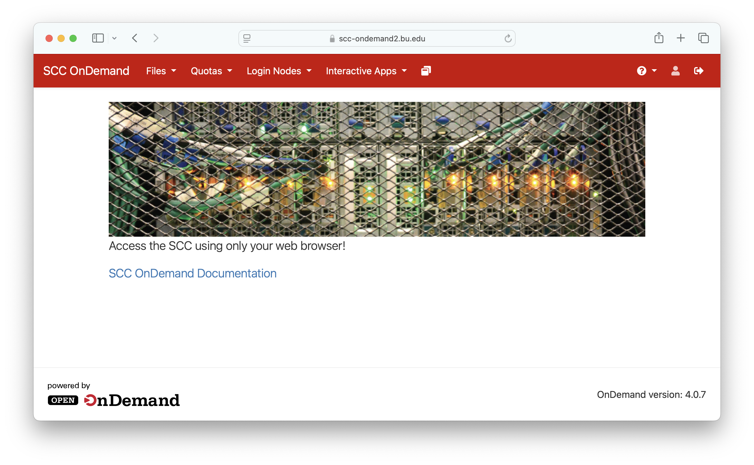
Notes:
File Manager
The SCC OnDemand version of the MacOS’s ”Finder” or Windows’ “File Explorer” applications
Allows you to look at, download, rename, move, copy, delete files that are on the SCC

Slide 14
File Manager
  The SCC OnDemand version of the MacOS’s ”Finder” or Windows’ “File Explorer” applications
  Allows you to look at, download, rename, move, copy, delete files that are on the SCC
  Opens a new tab
Notes:
File Manager
The SCC OnDemand version of the MacOS’s ”Finder” or Windows’ “File Explorer” applications
Allows you to look at, download, rename, move, copy, delete files that are on the SCC

Slide 15
Storage Quotas
  Shows details file storage reports for your home directory and any storage assigned to the projects you are a member of
  Opens up a new tab
Notes:
File Manager
The SCC OnDemand version of the MacOS’s ”Finder” or Windows’ “File Explorer” applications
Allows you to look at, download, rename, move, copy, delete files that are on the SCC

Slide 16
Login Nodes
  Opens up a Linux Terminal/Shell on one of four login nodes
  These nodes are NOT(!!) designed for heavy computation*
  They are designed for administrative tasks, like moving/renaming files, editing basic text files, etc.
  Opens up a new tab
Notes:
Login Nodes
This tab allows you to open up a “terminal” or “shell” or “command line” on one of the 4 nodes (aka computers) designed as “login”
“Login” nodes are computers that have low resources and are designed to be an initial landing place when accessing the SCC.
They are NOT designed for doing heavy computation
In fact, if you try to run a command that takes longer than 15 minutes, you will be automatically kicked off of the login node
Login nodes are designed for “light” computational tasks:
Moving/renaming files
Editing text files/code
Administrative tasks – changing file permissions, etc.

Slide 17
Interactive Applications
  This tab allows you to request interactive sessions on nodes designed for “heavy” computation.
  Allows you to open specific popular software packages on those compute nodes with specific resources configurations.
  The most basic “Application” is the Desktop app. It opens a Linux Desktop environment on a compute node.
Notes:
Interactive Applications
This tab allows you to request interactive sessions on nodes designed for “heavy” computation
Allows you to open up specific popular software packages on those compute nodes with specific resources
The most basic “Application” is the Desktop app. It opens a Linux Desktop environment on a compute node. This is where I suggest you start most your interactive compute sessions, unless you have need of specific software (like MATLAB for example)
Each interactive application asks you to specify a set of options for this session, including:
modules that you want loaded
the directory you want to start the session in
Any commands that you want run upon starting the session. The prefilled command “xfce4-terminal” automatically opens up a terminal upon starting the session.
The number of hours that you expect your session to last
The number of computational cores you expect your session to require
The project these computational hours will be “billed” to*
Extract options you send to the job scheduler for more specific resource requests
Examples: if you want to be placed on a node with a GPU, with at least a certain amount of RAM

Slide 18
Currently Active Interactive Sessions
Lists all your currently active interactive sessions
This is where you will go if you want to reconnect to a session after you close a window and reconnect

Slide 19
Help
Links to helpful SCC resources, including the IS&T help email address, our online documentation, the SCC Status Page, and the SCC Account Management Page

Slide 20
Workshop Overview
Who am I?
What is the SCC?
How does the SCC work?
SCC On Demand
Connecting to a Desktop Session
The Linux Desktop Environment
The Linux Command Line
Customizing the Linux Command Line
The Linux File System
The Module System
How to submit jobs to the SCC
How to upload and download data/files to the SCC
Yaxil Demonstration

Slide 21
Login to SCC OnDemand
Open a web browser
Go to scc-ondemand.bu.edu
Login with your Kubernetes credentials

Slide 22
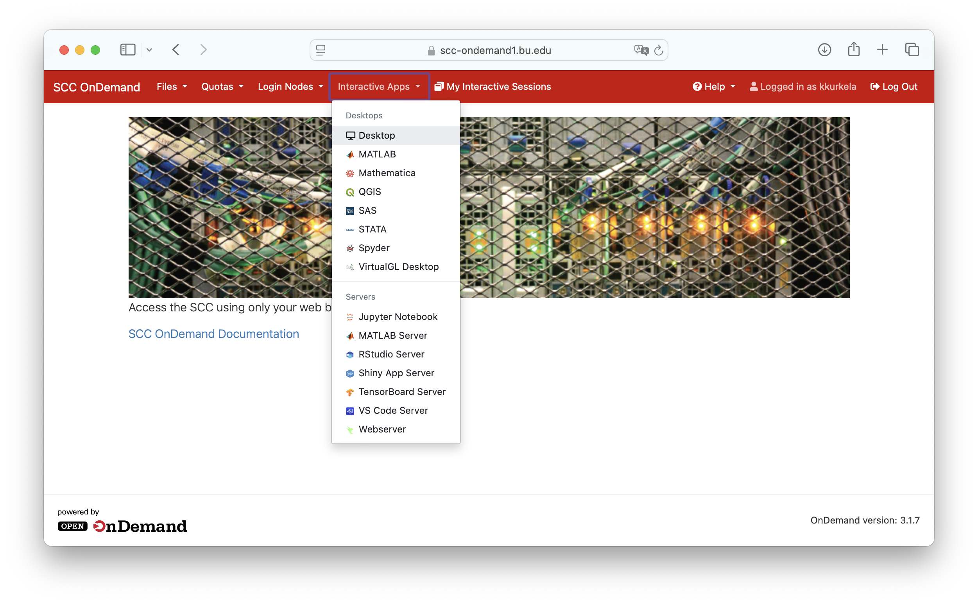
Request an interactive desktop session
Click the “Interactive Apps” dropdown menu
Select “Desktop”

Slide 23
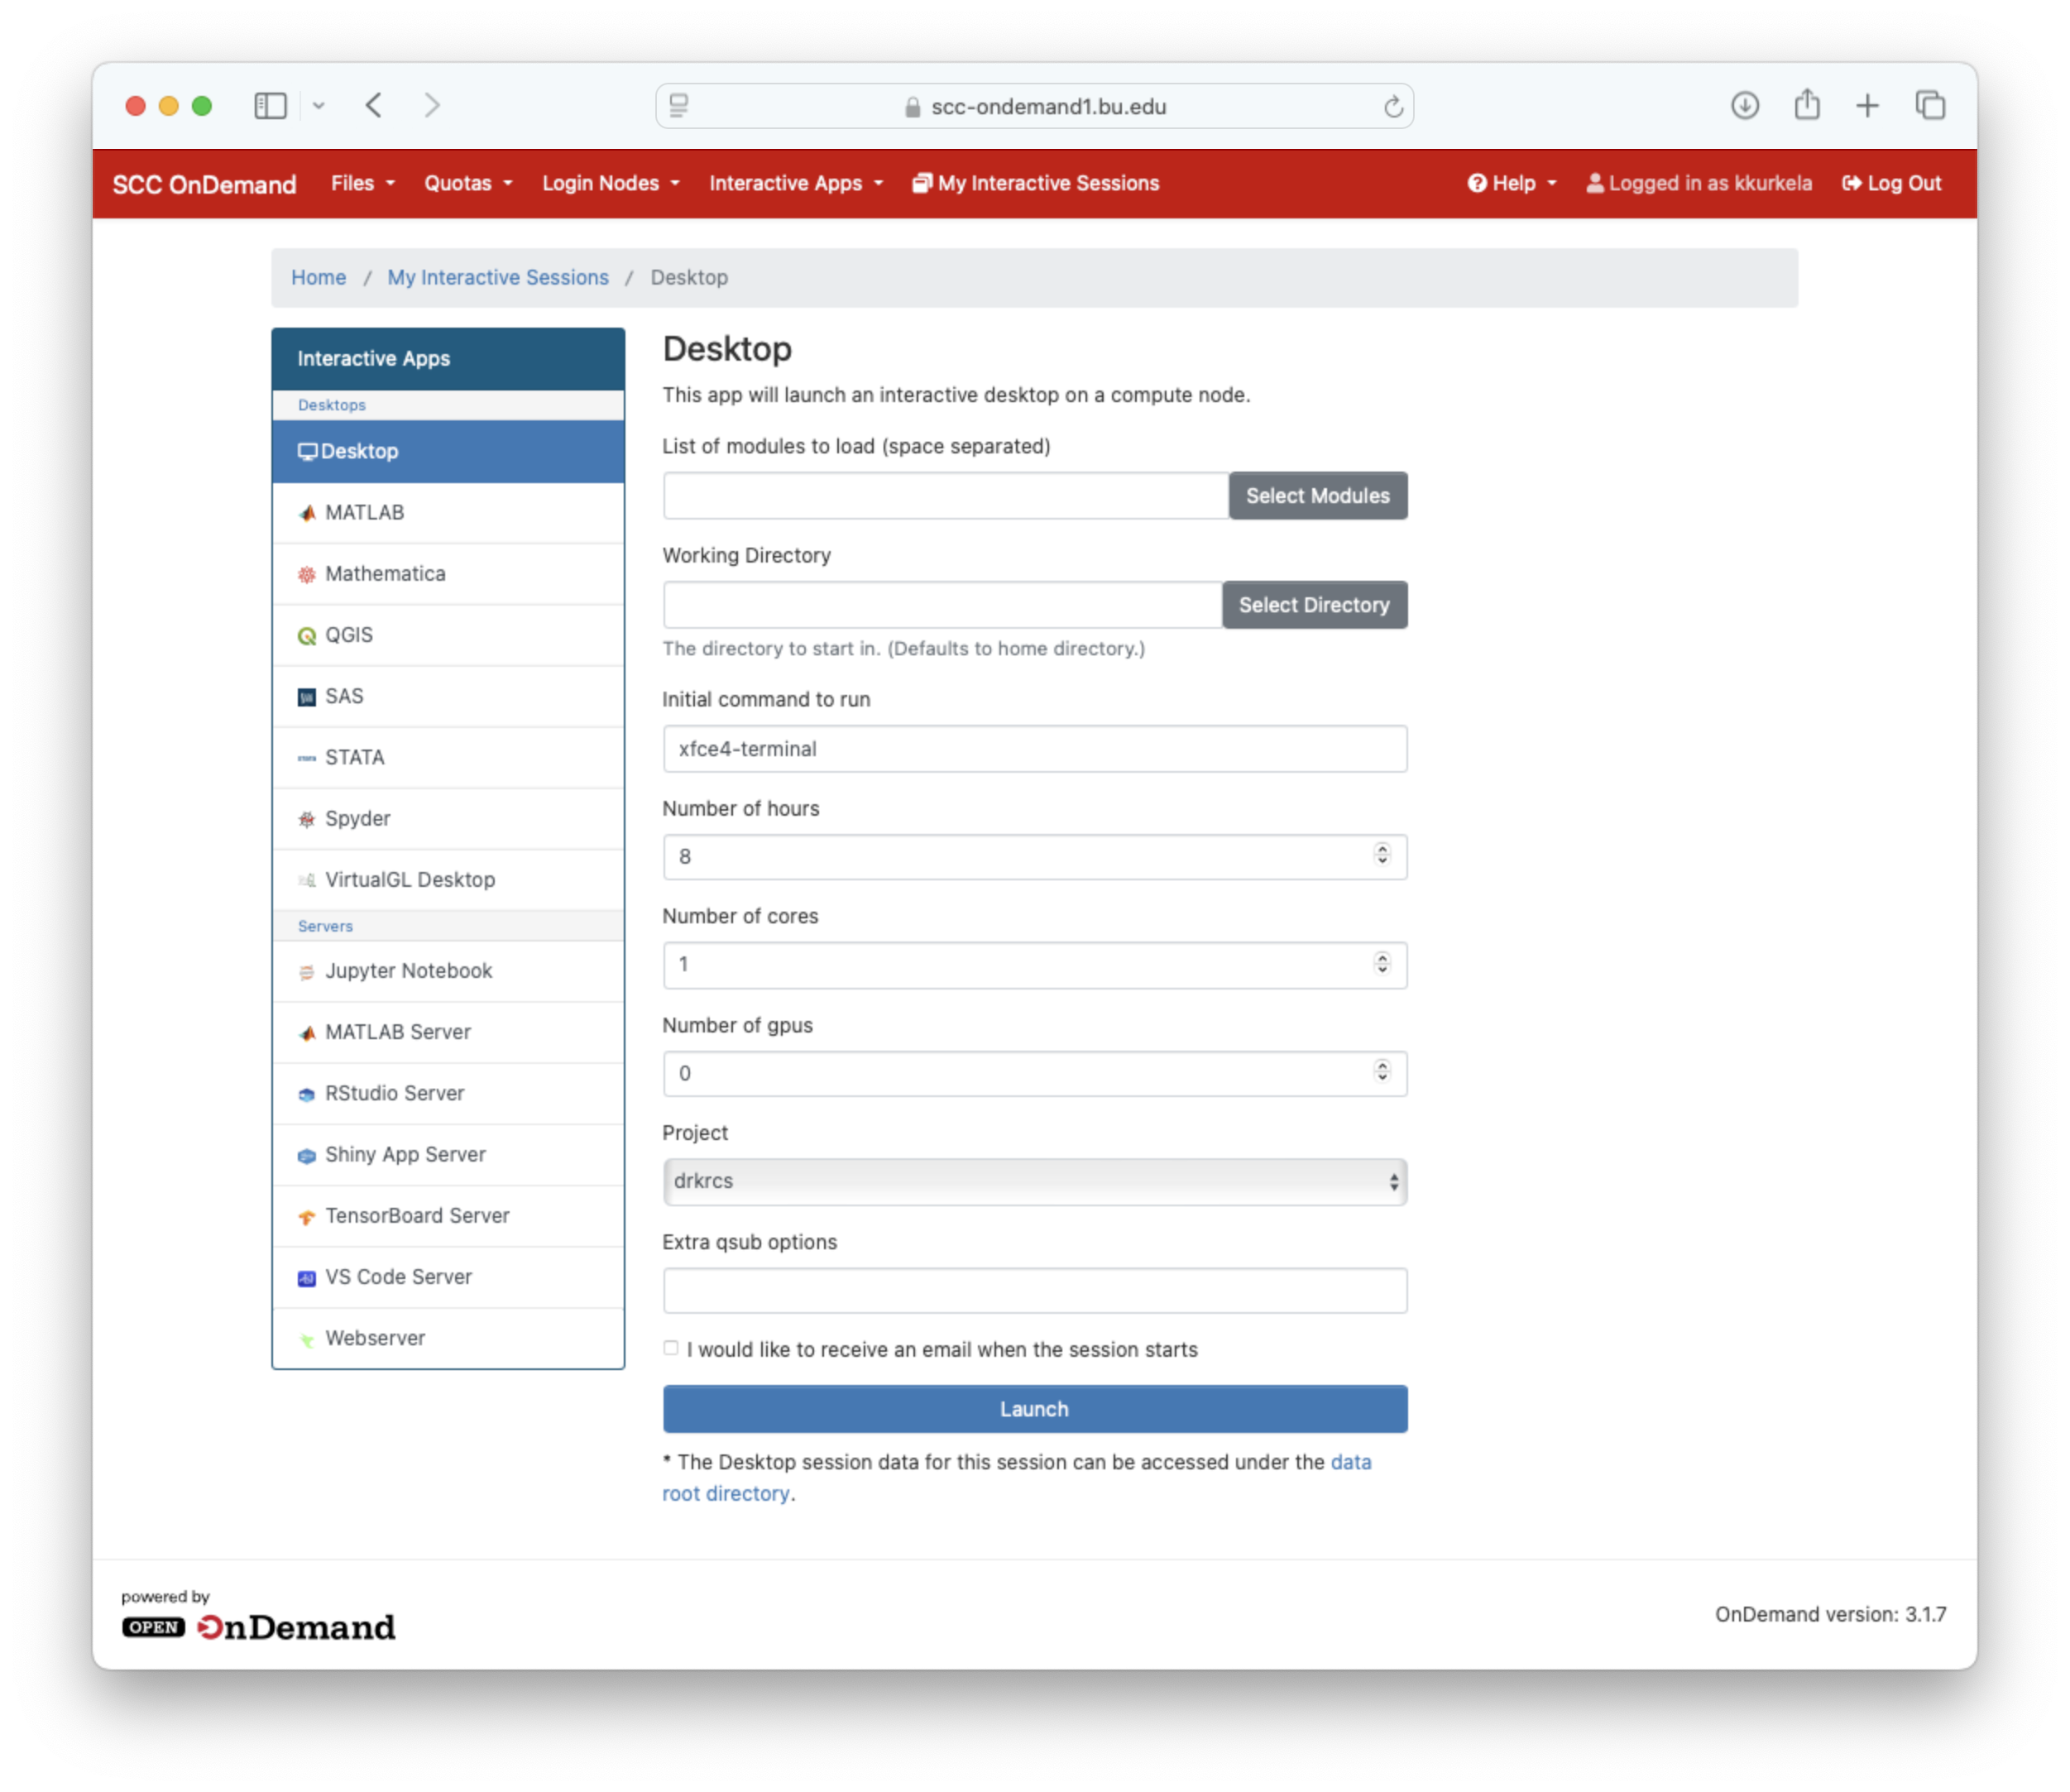
Request an interactive desktop session
Request an interactive desktop on a compute node by:
Filling in the appropriate options
Clicking blue “launch” button

Slide 24
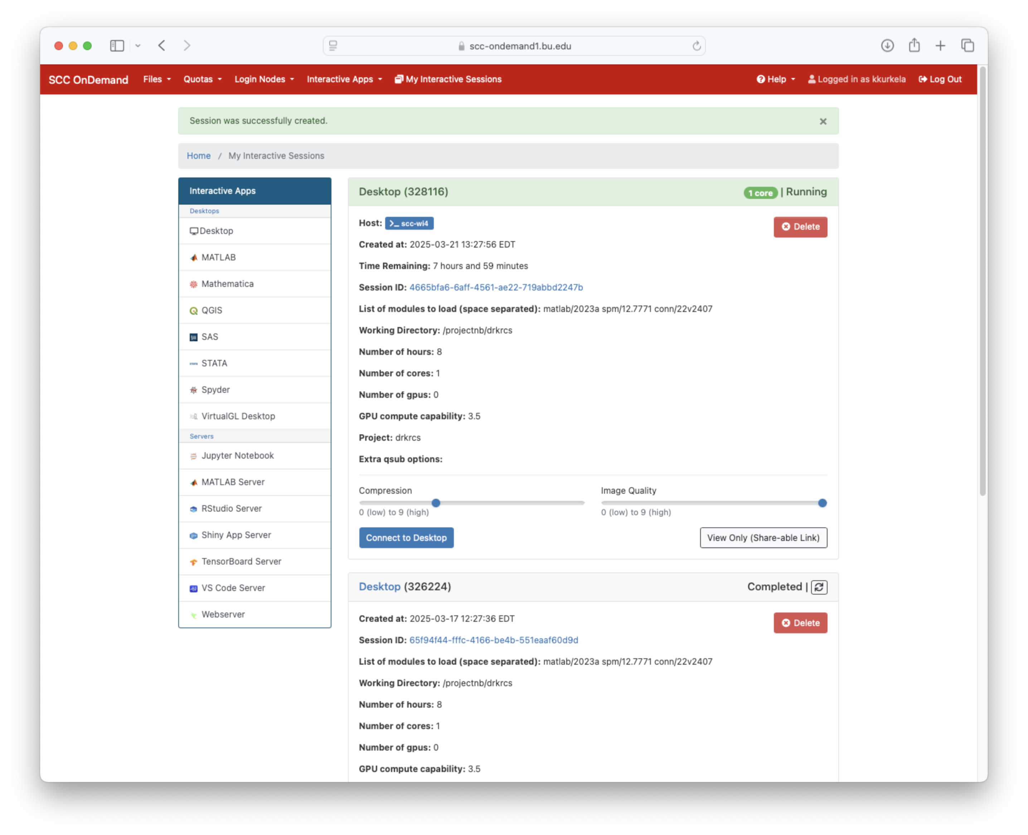
Request an interactive desktop session
The job scheduler will then begin searching for an available node for you to use. This may take a minute or two
Once you are assigned a node, click “Connect to Desktop”

Slide 25
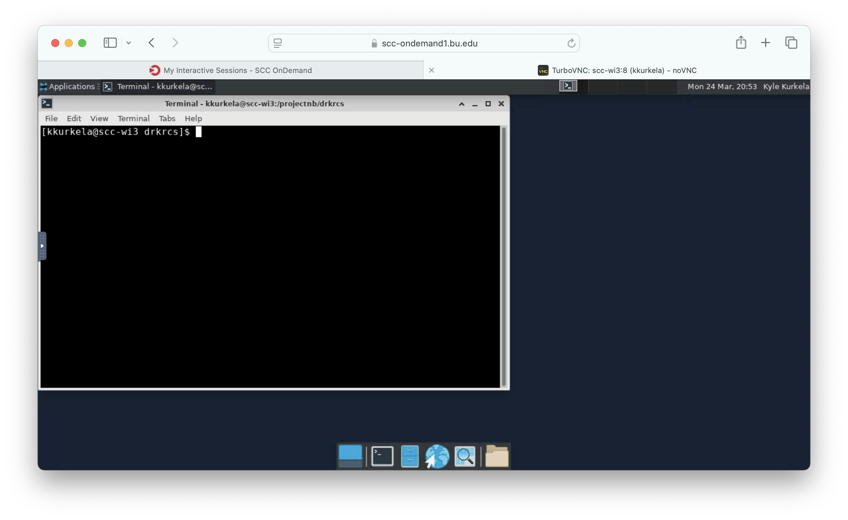
Request an interactive desktop session
A new tab will open and you will be connected to a compute node on the SCC
You will be presented with an interactive desktop interface running a Linux OS
A terminal should open automatically

Slide 26
Workshop Overview
Who am I?
What is the SCC?
How does the SCC work?
SCC On Demand
Connecting to a Desktop Session
The Linux Desktop Environment
The Linux Command Line
Customizing the Linux Command Line
The Linux File System
The Module System
How to submit jobs to the SCC
How to upload and download data/files to the SCC
Yaxil Demonstration
Notes:
Let's talk a little bit about Linux.
Linux is the third, much lessor none by the general public, sibling of the operating system family. You have probably heard of and have experience with Windows and Mac OSX operating systems. These operating systems are optimized for ease of use by the general public. Linux is made for computer programmers and is used in much more technical, scientific applications.
One of the things with linux is that it has a limited GUI (point and click) and you primarily interact with a linux computer using the command line.

Slide 27
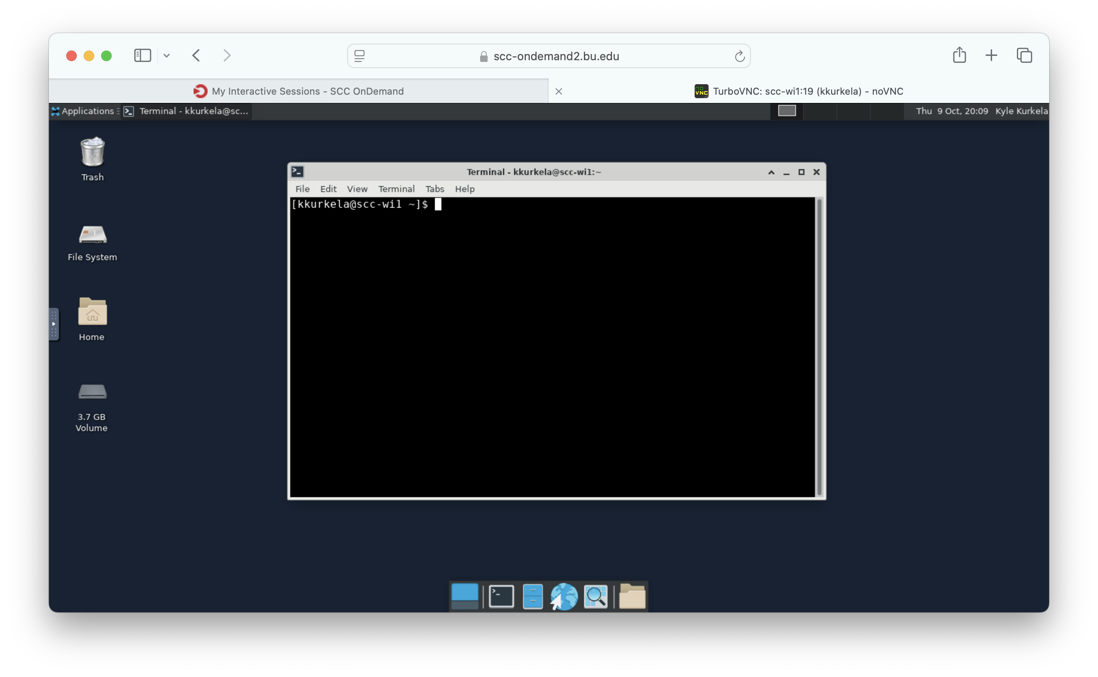
Notes:
The desktop application opens of a Linux Desktop
This is linux’s version of what many of you are sure are used to: MacOS or Windows
They all have a bunch of basic applications for operating the computer. Each one usually has their own “flavor” of the same basic applications. Examples:
File Explorer: Mac, Windows, Linux
Spreadsheet: Max, Windows, Linux

Slide 28
Applications Dropdown
Contains list of default linux flavored applications. Examples: linux’s file explorer, linux’s version of excel, etc.
NOTE: this list does NOT contain scientific applications that my team (RCS) install onto the system.
Notes:
The desktop application opens of a Linux Desktop
This is linux’s version of what many of you are sure are used to: MacOS or Windows
They all have a bunch of basic applications for operating the computer. Each one usually has their own “flavor” of the same basic applications. Examples:
File Explorer: Mac, Windows, Linux
Spreadsheet: Max, Windows, Linux

Slide 29
This area contains cards for all your currently running applications.
In this example scene, the only currently running application is the “terminal”
Notes:
The desktop application opens of a Linux Desktop
This is linux’s version of what many of you are sure are used to: MacOS or Windows
They all have a bunch of basic applications for operating the computer. Each one usually has their own “flavor” of the same basic applications. Examples:
File Explorer: Mac, Windows, Linux
Spreadsheet: Max, Windows, Linux

Slide 30
This area is where you access your different workspaces
They are essentially different “copies” of your desktop environment
You can have different application windows open in each one and quickly switch between them
Notes:
The desktop application opens of a Linux Desktop
This is linux’s version of what many of you are sure are used to: MacOS or Windows
They all have a bunch of basic applications for operating the computer. Each one usually has their own “flavor” of the same basic applications. Examples:
File Explorer: Mac, Windows, Linux
Spreadsheet: Max, Windows, Linux

Slide 31
Desktop shortcut to the trash can.
Where deleted files go.
Notes:
The desktop application opens of a Linux Desktop
This is linux’s version of what many of you are sure are used to: MacOS or Windows
They all have a bunch of basic applications for operating the computer. Each one usually has their own “flavor” of the same basic applications. Examples:
File Explorer: Mac, Windows, Linux
Spreadsheet: Max, Windows, Linux

Slide 32
Desktop shortcut to the File Manager application opened at the root of the file system
Notes:
The desktop application opens of a Linux Desktop
This is linux’s version of what many of you are sure are used to: MacOS or Windows
They all have a bunch of basic applications for operating the computer. Each one usually has their own “flavor” of the same basic applications. Examples:
File Explorer: Mac, Windows, Linux
Spreadsheet: Max, Windows, Linux

Slide 33
Desktop shortcut to the File Manager application opened at your home directory
Notes:
The desktop application opens of a Linux Desktop
This is linux’s version of what many of you are sure are used to: MacOS or Windows
They all have a bunch of basic applications for operating the computer. Each one usually has their own “flavor” of the same basic applications. Examples:
File Explorer: Mac, Windows, Linux
Spreadsheet: Max, Windows, Linux

Slide 34
Shortcuts to some common linux applications, including the Terminal, the File Manager, and a Web Browser
Notes:
The desktop application opens of a Linux Desktop
This is linux’s version of what many of you are sure are used to: MacOS or Windows
They all have a bunch of basic applications for operating the computer. Each one usually has their own “flavor” of the same basic applications. Examples:
File Explorer: Mac, Windows, Linux
Spreadsheet: Max, Windows, Linux

Slide 35
A note on Copy and Paste
Please note: the clipboard is NOT universal. You will get weird behavior when trying to copy and paste things between your SCC Desktop and your Local Computer
https://www.bu.edu/tech/support/research/system-usage/connect-scc/scc-ondemand/faq/copy-paste-ondemand/

Slide 36
Workshop Overview
Who am I?
What is the SCC?
How does the SCC work?
SCC On Demand
Connecting to a Desktop Session
The Linux Desktop Environment
The Linux Command Line
Customizing the Linux Command Line
The Linux File System
The Module System
How to submit jobs to the SCC
How to upload and download data/files to the SCC
Yaxil Demonstration
Notes:
Let's talk a little bit about Linux.
Linux is the third, much lessor none by the general public, sibling of the operating system family. You have probably heard of and have experience with Windows and Mac OSX operating systems. These operating systems are optimized for ease of use by the general public. Linux is made for computer programmers and is used in much more technical, scientific applications.
One of the things with linux is that it has a limited GUI (point and click) and you primarily interact with a linux computer using the command line.

Slide 37
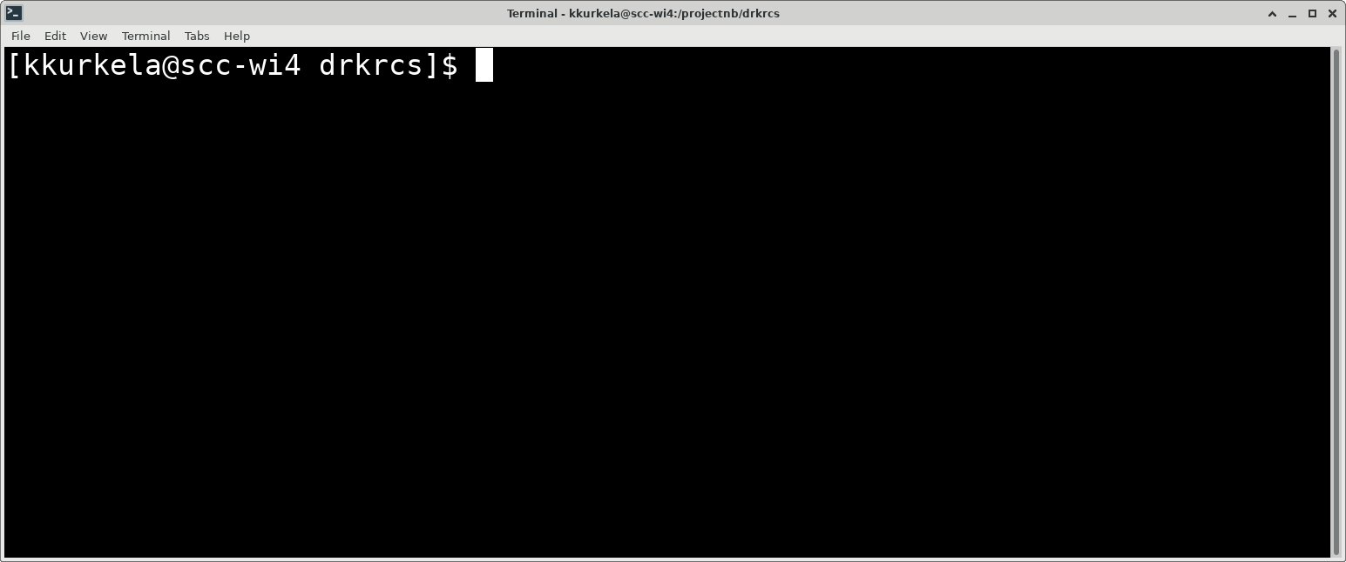
The linux command line
Where you begin typing commands
username
computer name
working directory name
This is referred to as the “command line” or “terminal”. It is how you primarily interact with a linux operating system

Slide 38
The linux command line
Where you begin typing commands
username
computer name
working directory name
Let’s break down what we are looking at.

Slide 39
The linux command line
Username

Slide 40
The linux command line
Computer Name

Slide 41
The linux command line
Name of Working Directory

Slide 42
The linux command line
A cursor waiting for new commands.

Slide 43
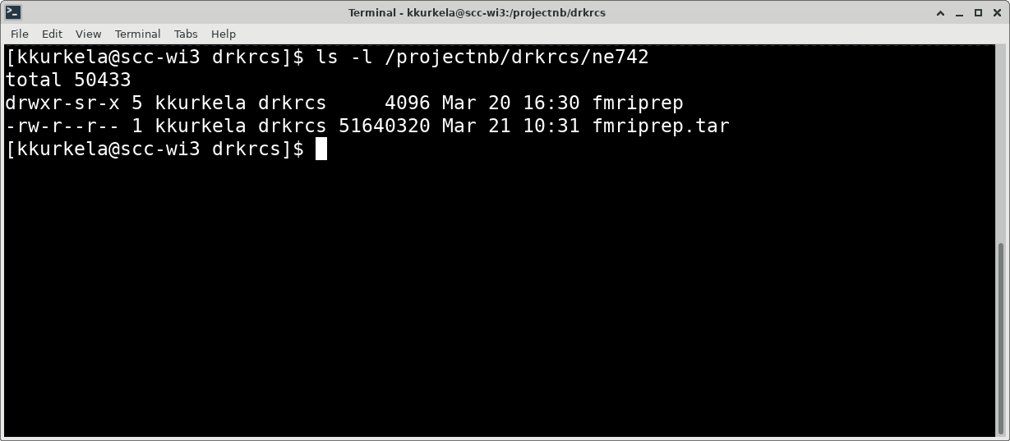
The linux command line
Where you begin typing commands
username
computer name
working directory name
This is what the command line looks like when you type in a command. Let’s break down what we are looking at.

Slide 44
The linux command line
This is a command. A command performs some action on your machine.
Where you begin typing commands
username
computer name
working directory name

Slide 45
The linux command line
This is a flag. Flags start with ”-” and change how a command works. They are typically optional.
Where you begin typing commands
username
computer name
working directory name
Notes:
.

Slide 46
The linux command line
This is an input argument. It is an object that gets acted on by the command.
Where you begin typing commands
username
computer name
working directory name

Slide 47
The linux command line
Where you begin typing commands
username
This is an example of the output of a command. Not all commands have output.
computer name
working directory name

Slide 48
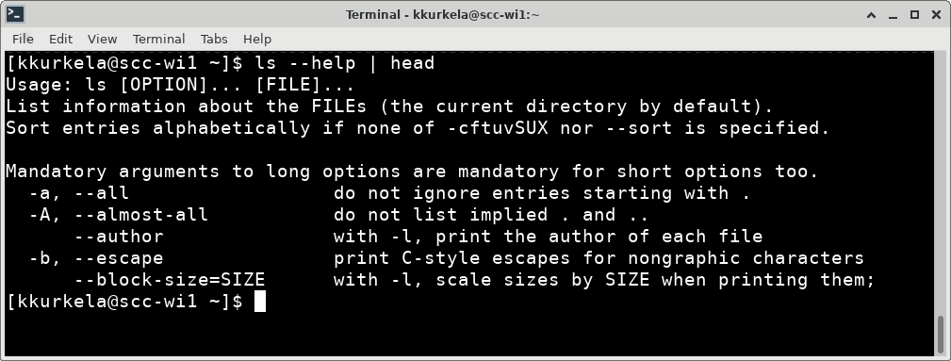
The linux command line
Where you begin typing commands
username
computer name
working directory name
You can see what other options are available using the --help flag.
Most linux command have a --help flag to assist you with identifying options you may want to use.

Slide 49
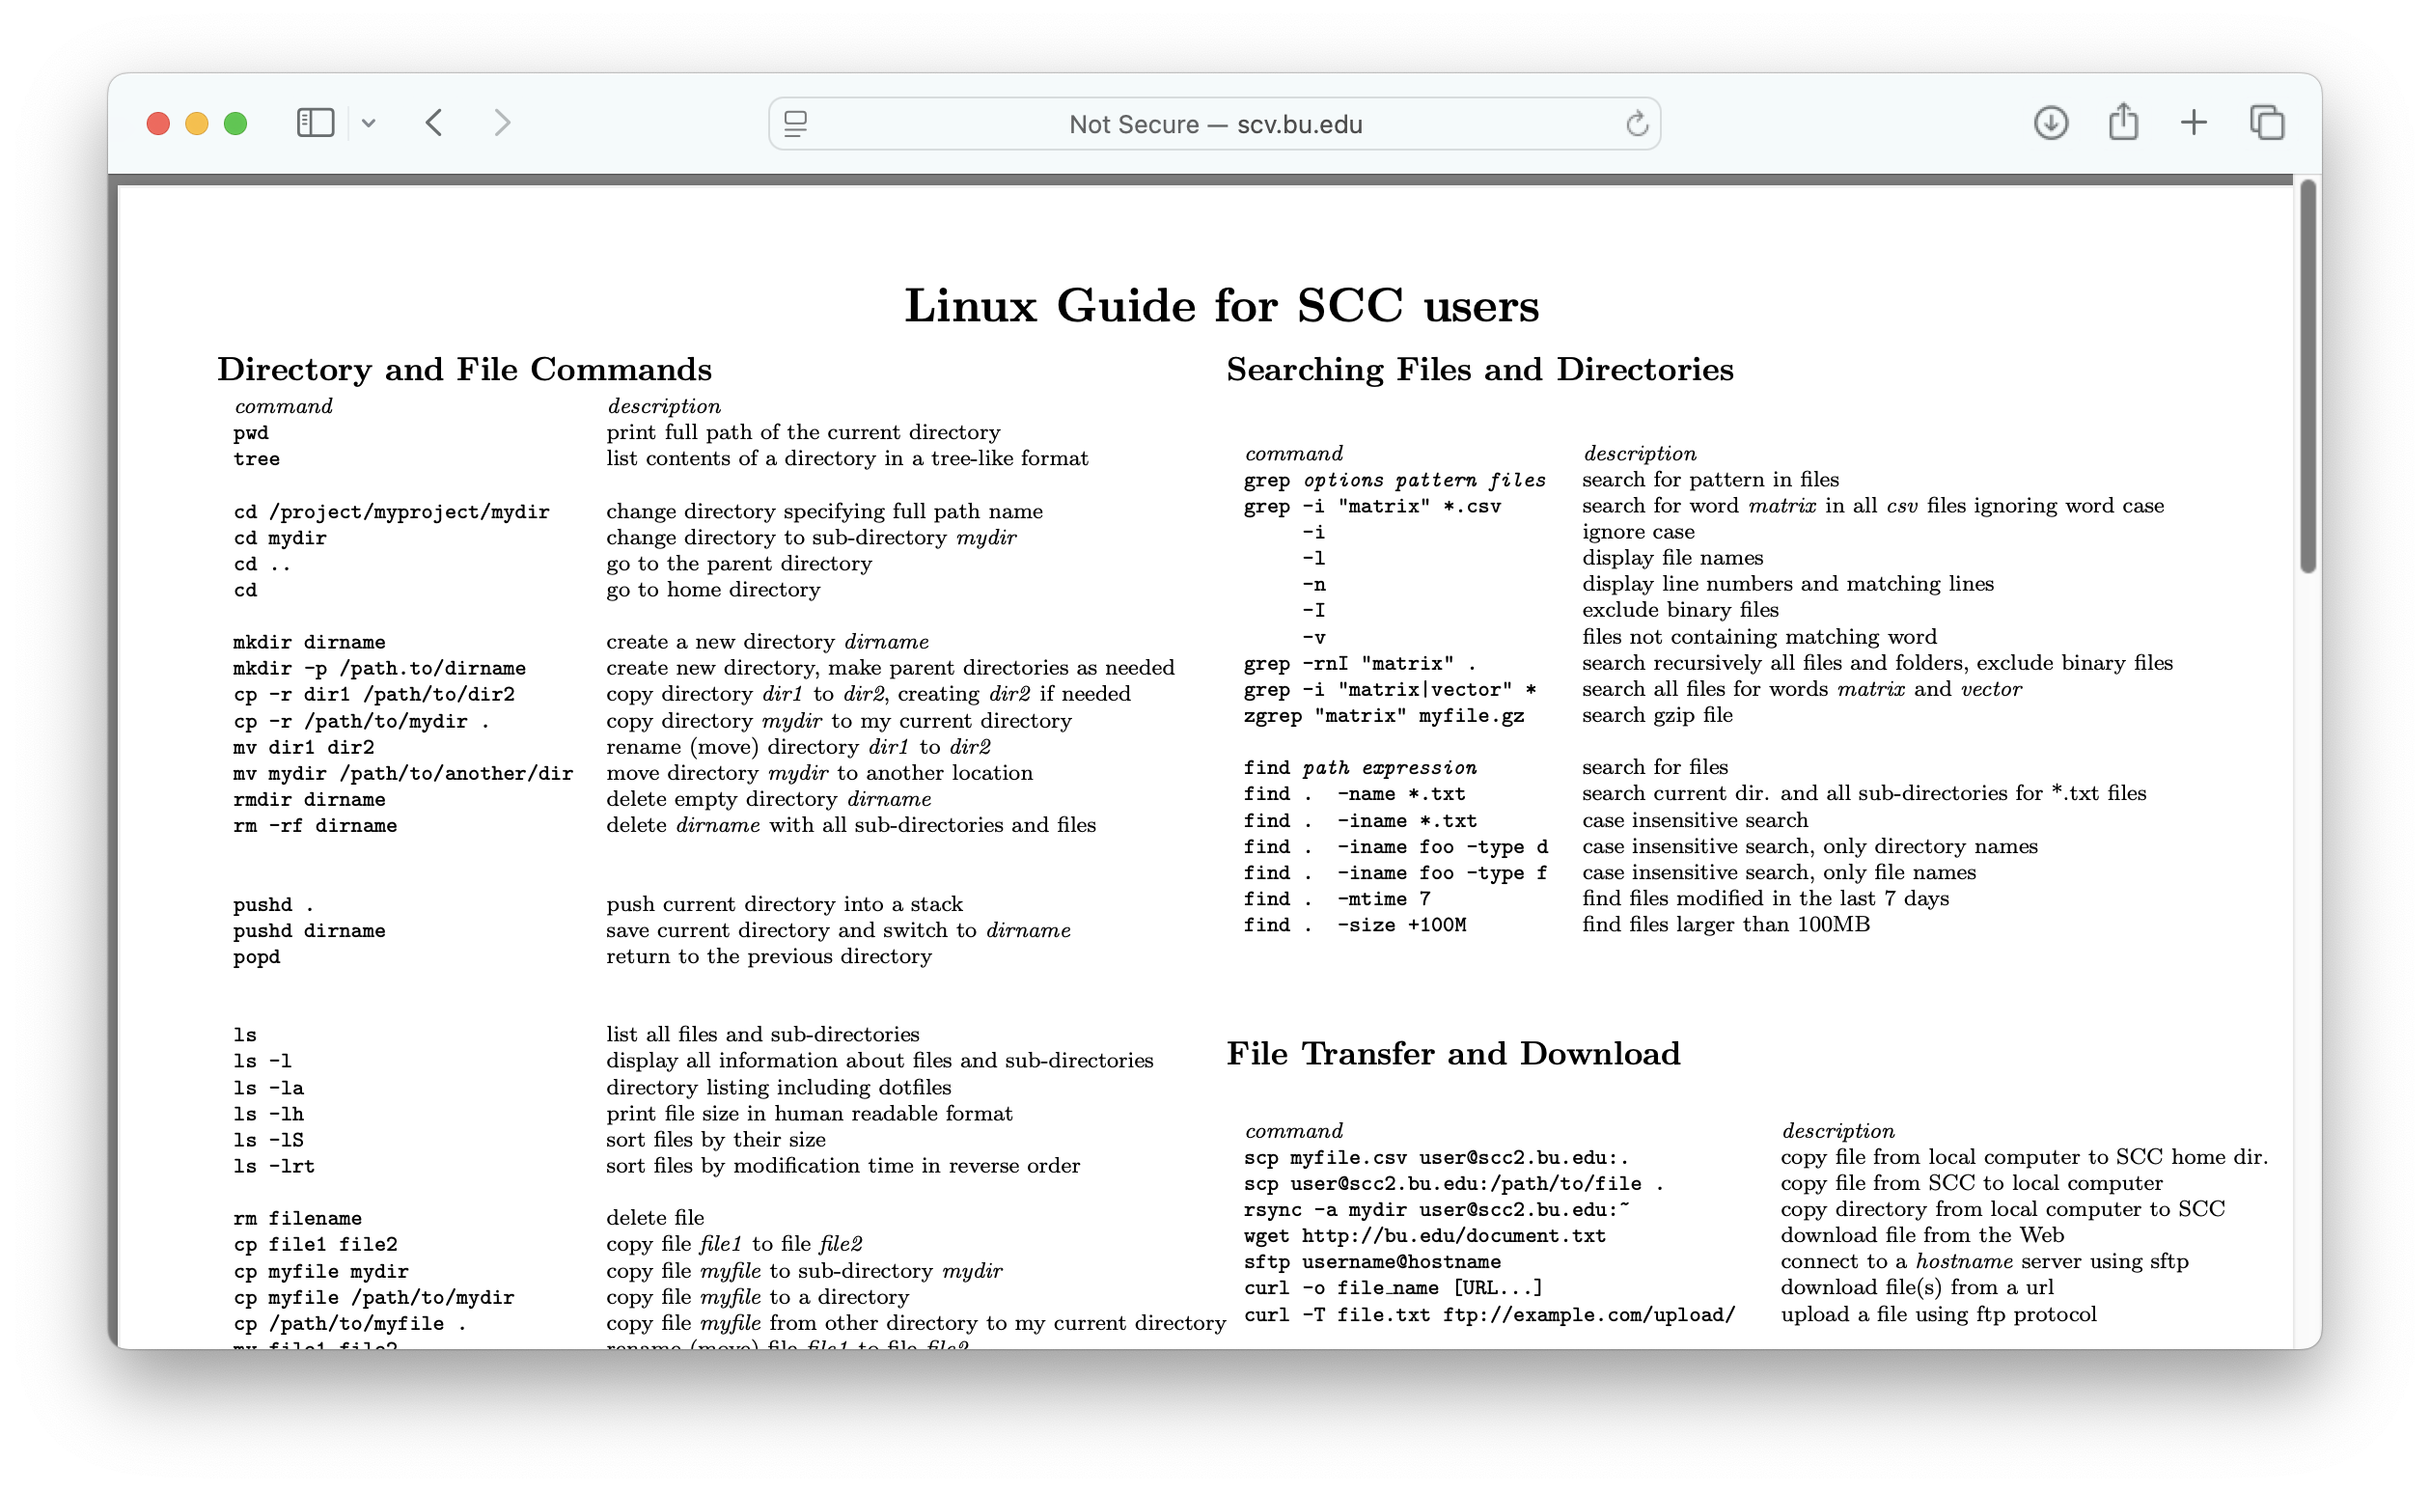
SCC Linux Cheat Sheet
The BU RCS Linux Cheat Sheet contains a list of the most used Linux commands.
http://scv.bu.edu/documents/Linux_SCC_CheatSheet.pdf
Notes:
Where else can you get help with linux commands?
The internet, chatgpt are both wonderful resources for learning

Slide 50
Workshop Overview
Who am I?
What is the SCC?
How does the SCC work?
SCC On Demand
Connecting to a Desktop Session
The Linux Desktop Environment
The Linux Command Line
Customizing the Linux Command Line
The Linux File System
The Module System
How to submit jobs to the SCC
How to upload and download data/files to the SCC
Yaxil Demonstration
Notes:
Let's talk a little bit about Linux.
Linux is the third, much lessor none by the general public, sibling of the operating system family. You have probably heard of and have experience with Windows and Mac OSX operating systems. These operating systems are optimized for ease of use by the general public. Linux is made for computer programmers and is used in much more technical, scientific applications.
One of the things with linux is that it has a limited GUI (point and click) and you primarily interact with a linux computer using the command line.

Slide 51
Recommended Setup: the .bashrc
On linux machines, every user’s home directory has a small hidden text file called .bashrc
This file contains commands that will be run every time you start a new terminal on a linux machine
This text file is a good place to customize your terminal environment
We will begin today by making the following additions to our .bashrc files:
  Add the command “unmask 022” to change the default file permissions of newly created files
  Add a command that changes your terminal prompt

Slide 52
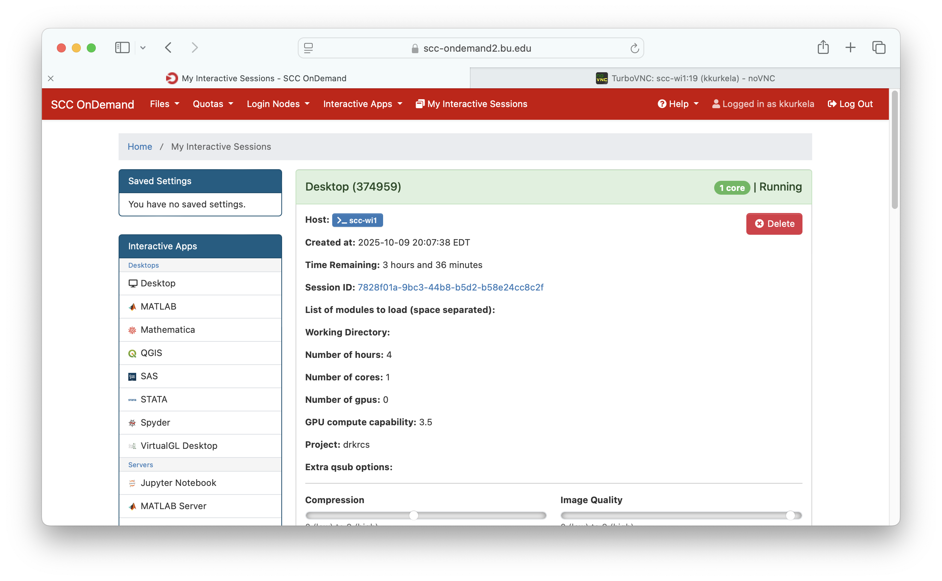
Notes:
The SCC, by default, uses linux keyboard shortcuts which are (annoyingly) different from those used by the Mac and Windows machines we are all used to using. For example:
Copy keyboard shortcut
On Windows/Mac: CTR+C, CMD+C
In Linux’s Terminal: CTR+SHIFT+C
Paste keyboard shortcut
On Windows/Mac: CTR+V, CMD+V
In Linux’s Terminal: CTR+SHIFT+V

Slide 53
Notes:
The SCC, by default, uses linux keyboard shortcuts which are (annoyingly) different from those used by the Mac and Windows machines we are all used to using. For example:
Copy keyboard shortcut
On Windows/Mac: CTR+C, CMD+C
In Linux’s Terminal: CTR+SHIFT+C
Paste keyboard shortcut
On Windows/Mac: CTR+V, CMD+V
In Linux’s Terminal: CTR+SHIFT+V

Slide 54
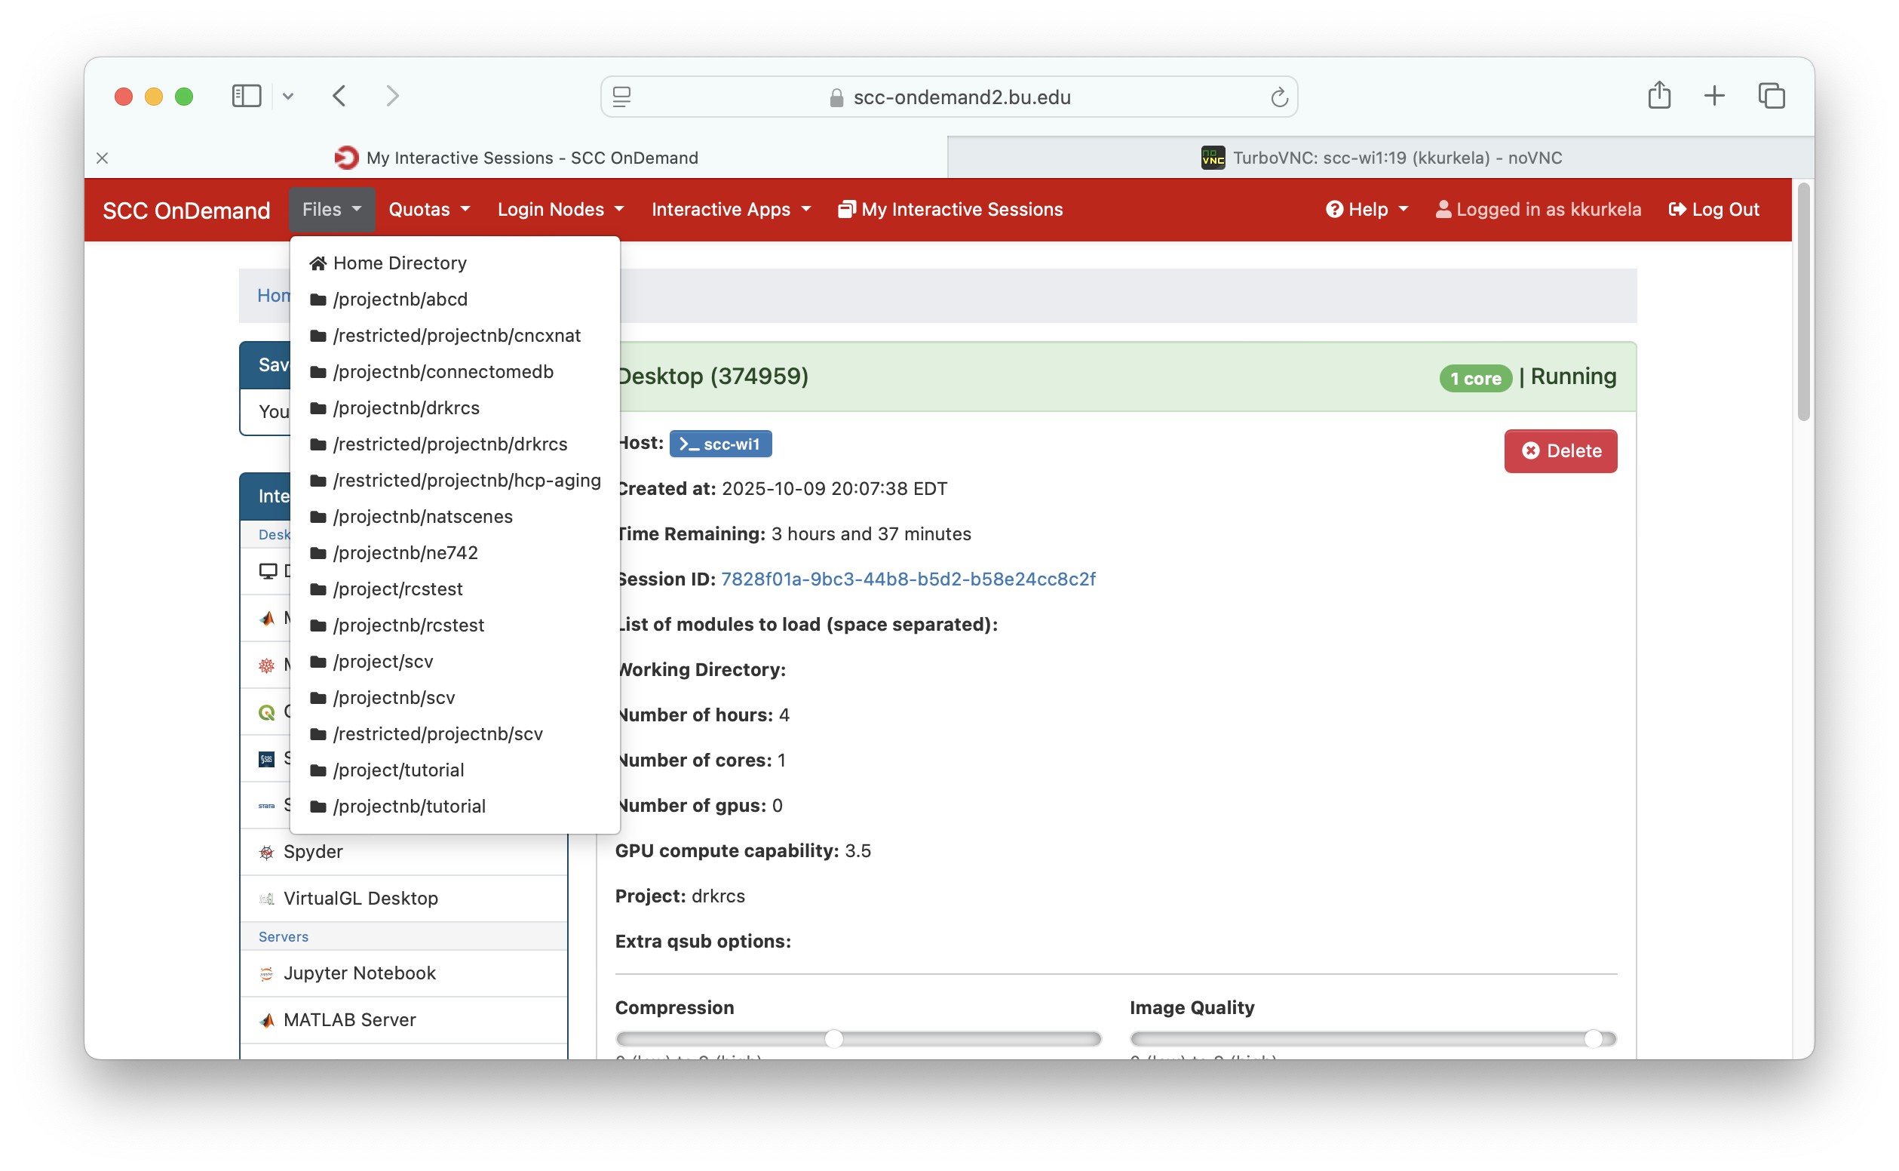
Notes:
The SCC, by default, uses linux keyboard shortcuts which are (annoyingly) different from those used by the Mac and Windows machines we are all used to using. For example:
Copy keyboard shortcut
On Windows/Mac: CTR+C, CMD+C
In Linux’s Terminal: CTR+SHIFT+C
Paste keyboard shortcut
On Windows/Mac: CTR+V, CMD+V
In Linux’s Terminal: CTR+SHIFT+V

Slide 55
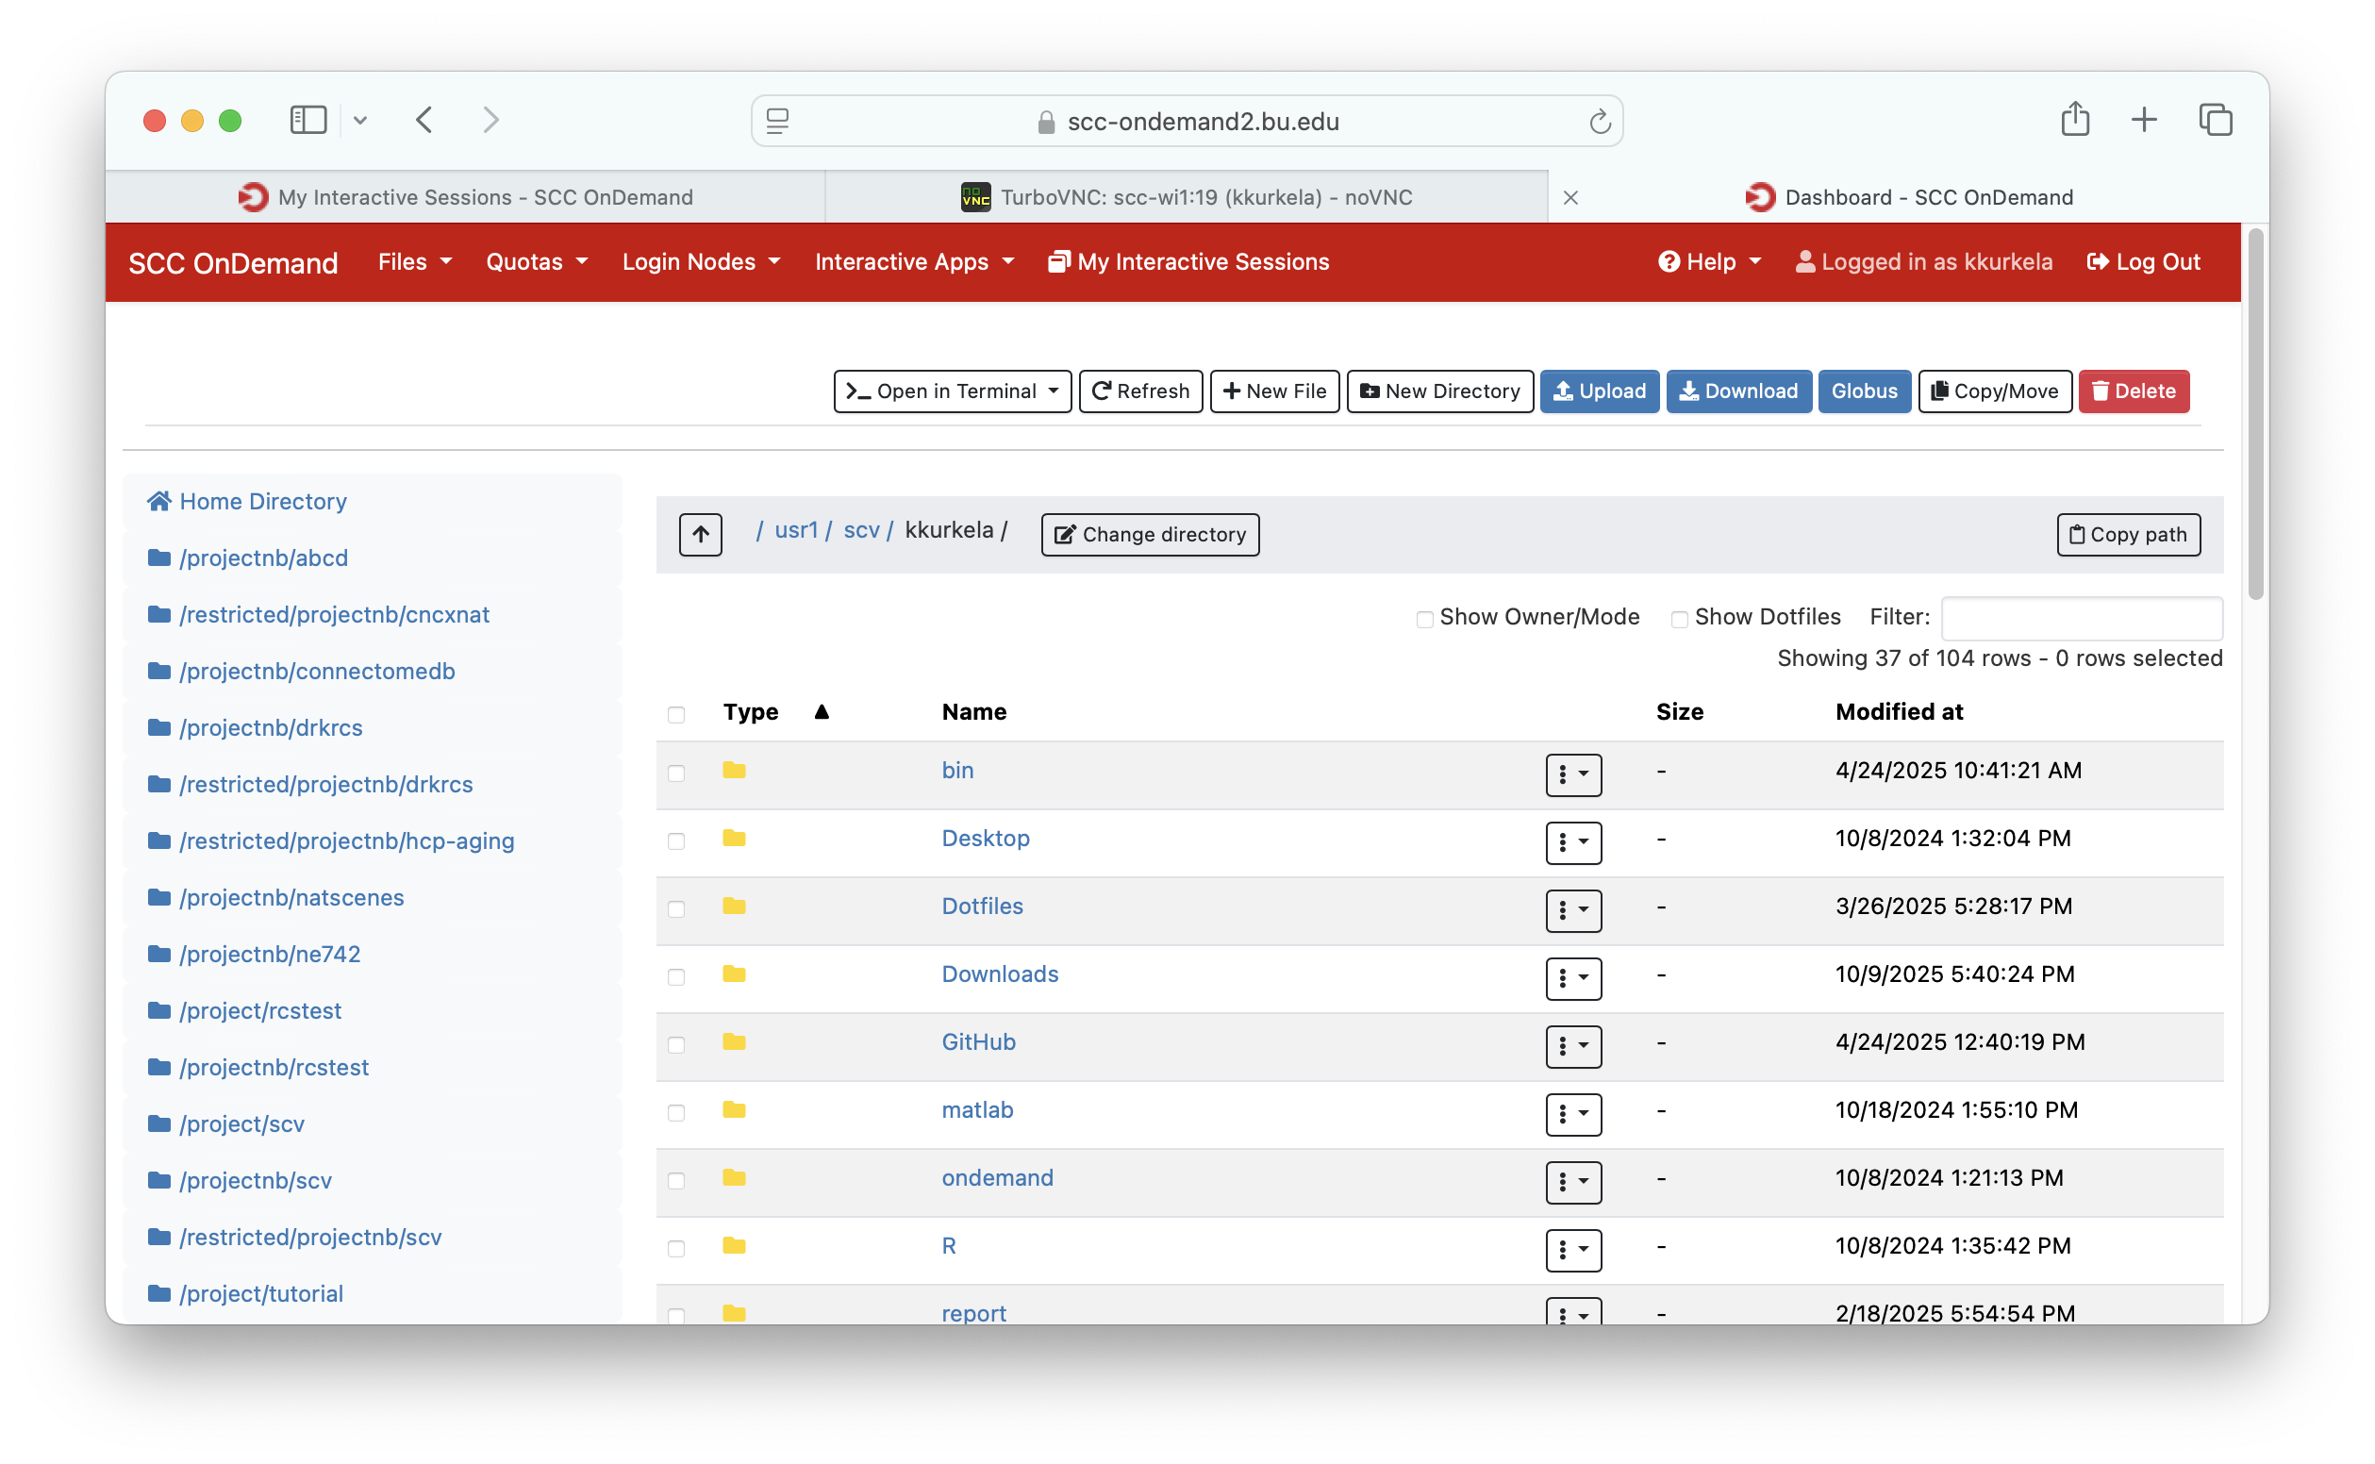
Notes:
The SCC, by default, uses linux keyboard shortcuts which are (annoyingly) different from those used by the Mac and Windows machines we are all used to using. For example:
Copy keyboard shortcut
On Windows/Mac: CTR+C, CMD+C
In Linux’s Terminal: CTR+SHIFT+C
Paste keyboard shortcut
On Windows/Mac: CTR+V, CMD+V
In Linux’s Terminal: CTR+SHIFT+V

Slide 56
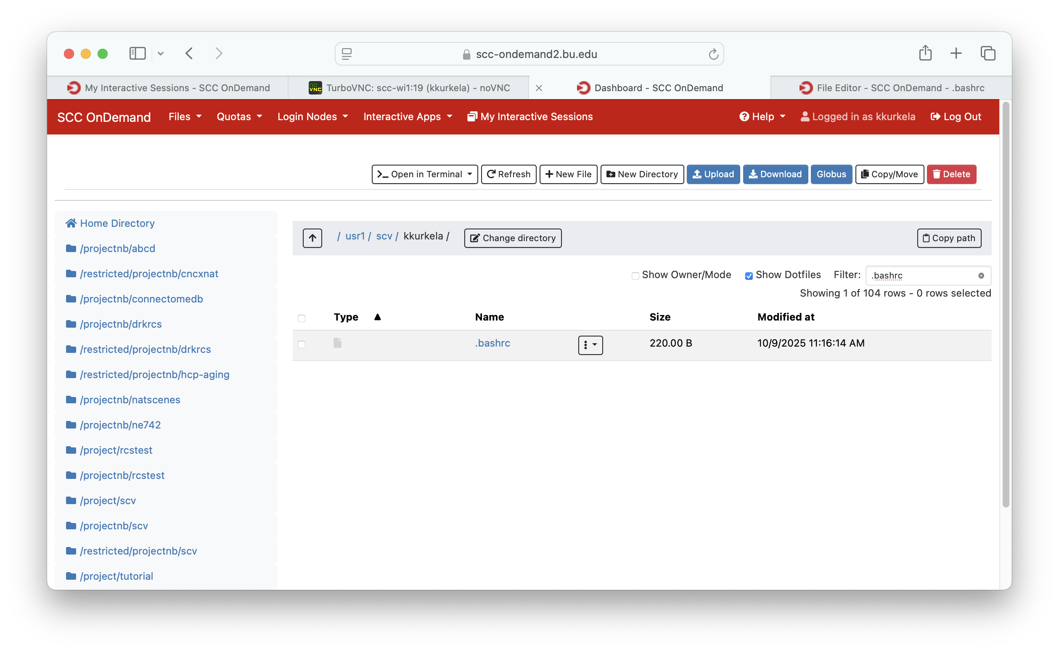
Notes:
The SCC, by default, uses linux keyboard shortcuts which are (annoyingly) different from those used by the Mac and Windows machines we are all used to using. For example:
Copy keyboard shortcut
On Windows/Mac: CTR+C, CMD+C
In Linux’s Terminal: CTR+SHIFT+C
Paste keyboard shortcut
On Windows/Mac: CTR+V, CMD+V
In Linux’s Terminal: CTR+SHIFT+V

Slide 57
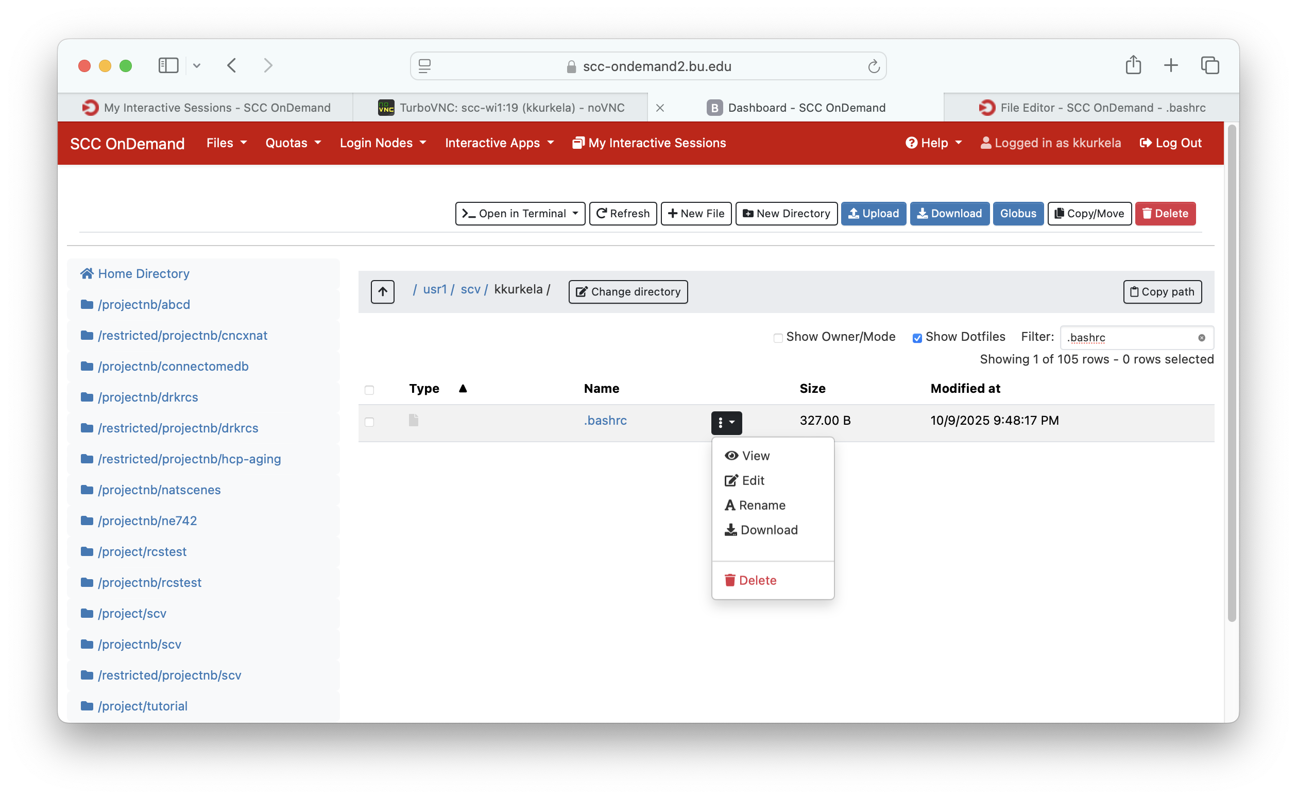
Notes:
The SCC, by default, uses linux keyboard shortcuts which are (annoyingly) different from those used by the Mac and Windows machines we are all used to using. For example:
Copy keyboard shortcut
On Windows/Mac: CTR+C, CMD+C
In Linux’s Terminal: CTR+SHIFT+C
Paste keyboard shortcut
On Windows/Mac: CTR+V, CMD+V
In Linux’s Terminal: CTR+SHIFT+V

Slide 58
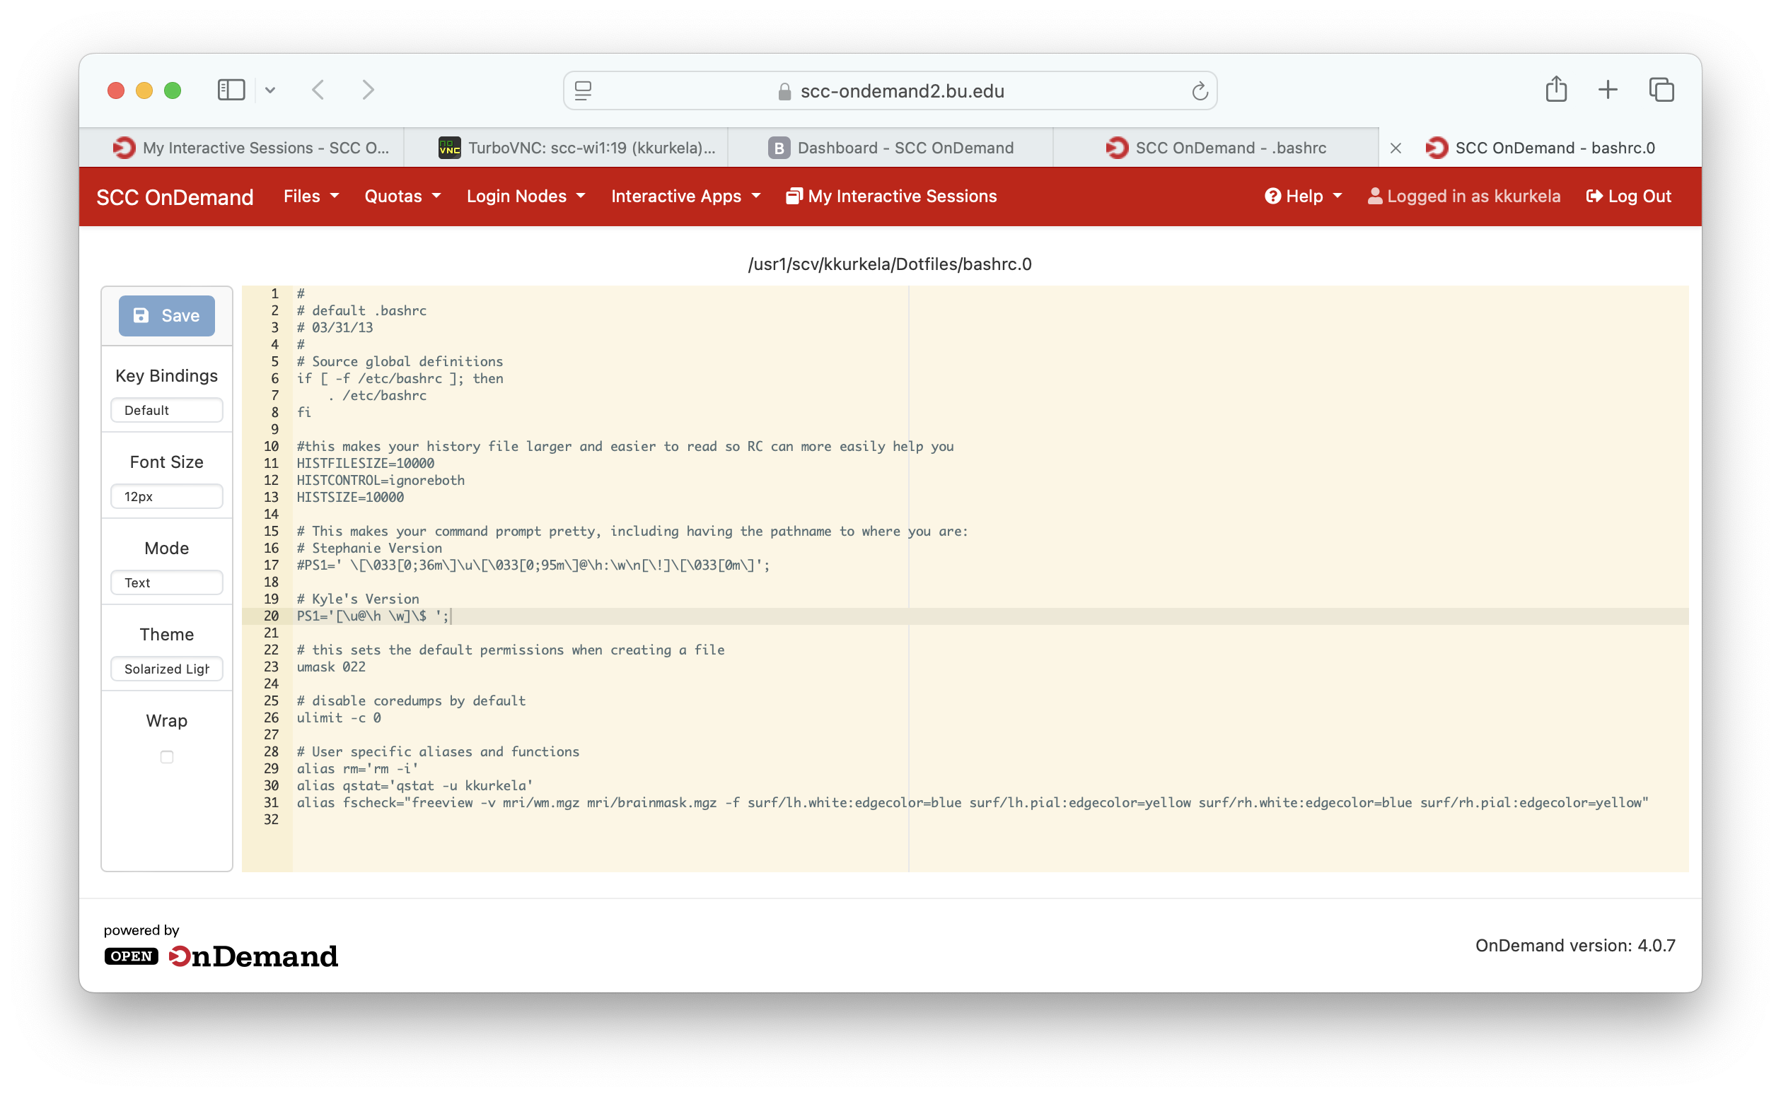
Notes:
The SCC, by default, uses Linux keyboard shortcuts which are (annoyingly) different from those used by the Mac and Windows machines we are all used to using. For example:
Copy keyboard shortcut
On Windows/Mac: CTR+C, CMD+C
In Linux’s Terminal: CTR+SHIFT+C
Paste keyboard shortcut
On Windows/Mac: CTR+V, CMD+V
In Linux’s Terminal: CTR+SHIFT+V

Slide 59
Recommended Setup: keyboard shortcuts
The SCC, by default, uses linux keyboard shortcuts which are (annoyingly) different from those used by the Mac and Windows machines we are all used to using.
To change these shortcuts, we need to edit/create a file with this name at this location:
  ~/.config/xfce4/terminal/accels.scm
We will paste the following commands to change the default key binding for “copy” from CTRL+SHIFT+C → CTRL+C:
  (gtk_accel_path "<Actions>/terminal-window/copy" "<Primary>C")
And the following commands to change the default key binding for “paste” from CRTL+SHIFT+V → CTR+V:
  (gtk_accel_path "<Actions>/terminal-window/paste" "<Primary>V")
Notes:
To do so, we need to edit/create a file with this name at this location:
~/.config/xfce4/terminal/accels.scm
We will paste the following commands to change the default key binding for “copy” from CTRL+SHIFT+C → CTRL+C:
(gtk_accel_path "<Actions>/terminal-window/copy" "<Primary>C")
And the following commands to change the default key binding for “paste” from CRTL+SHIFT+V → CTR+V:
(gtk_accel_path "<Actions>/terminal-window/copy" "<Primary>V")

Slide 60
Notes:
The SCC, by default, uses linux keyboard shortcuts which are (annoyingly) different from those used by the Mac and Windows machines we are all used to using. For example:
Copy keyboard shortcut
On Windows/Mac: CTR+C, CMD+C
In Linux’s Terminal: CTR+SHIFT+C
Paste keyboard shortcut
On Windows/Mac: CTR+V, CMD+V
In Linux’s Terminal: CTR+SHIFT+V

Slide 61
Notes:
The SCC, by default, uses linux keyboard shortcuts which are (annoyingly) different from those used by the Mac and Windows machines we are all used to using. For example:
Copy keyboard shortcut
On Windows/Mac: CTR+C, CMD+C
In Linux’s Terminal: CTR+SHIFT+C
Paste keyboard shortcut
On Windows/Mac: CTR+V, CMD+V
In Linux’s Terminal: CTR+SHIFT+V

Slide 62
Notes:
The SCC, by default, uses linux keyboard shortcuts which are (annoyingly) different from those used by the Mac and Windows machines we are all used to using. For example:
Copy keyboard shortcut
On Windows/Mac: CTR+C, CMD+C
In Linux’s Terminal: CTR+SHIFT+C
Paste keyboard shortcut
On Windows/Mac: CTR+V, CMD+V
In Linux’s Terminal: CTR+SHIFT+V

Slide 63
Notes:
The SCC, by default, uses linux keyboard shortcuts which are (annoyingly) different from those used by the Mac and Windows machines we are all used to using. For example:
Copy keyboard shortcut
On Windows/Mac: CTR+C, CMD+C
In Linux’s Terminal: CTR+SHIFT+C
Paste keyboard shortcut
On Windows/Mac: CTR+V, CMD+V
In Linux’s Terminal: CTR+SHIFT+V

Slide 64
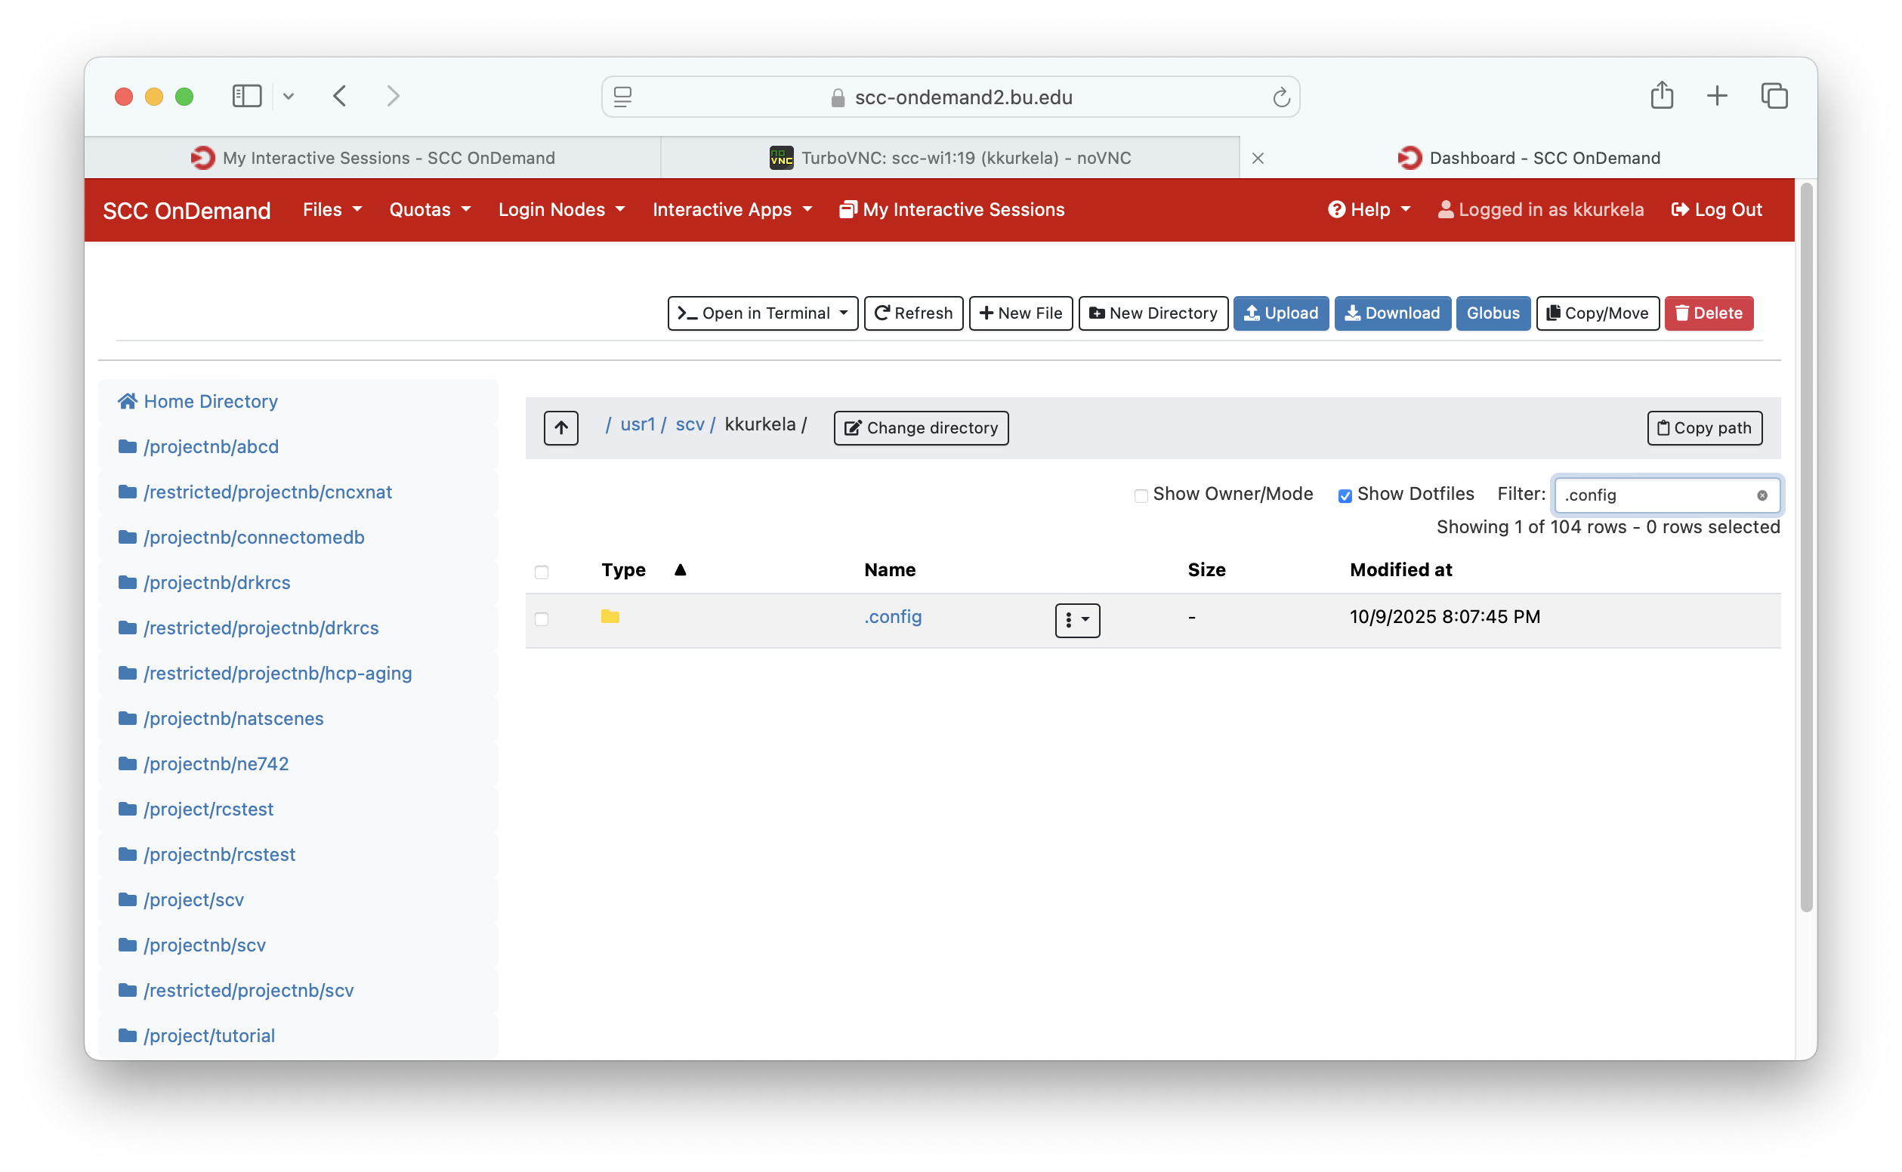
Notes:
The SCC, by default, uses linux keyboard shortcuts which are (annoyingly) different from those used by the Mac and Windows machines we are all used to using. For example:
Copy keyboard shortcut
On Windows/Mac: CTR+C, CMD+C
In Linux’s Terminal: CTR+SHIFT+C
Paste keyboard shortcut
On Windows/Mac: CTR+V, CMD+V
In Linux’s Terminal: CTR+SHIFT+V

Slide 65
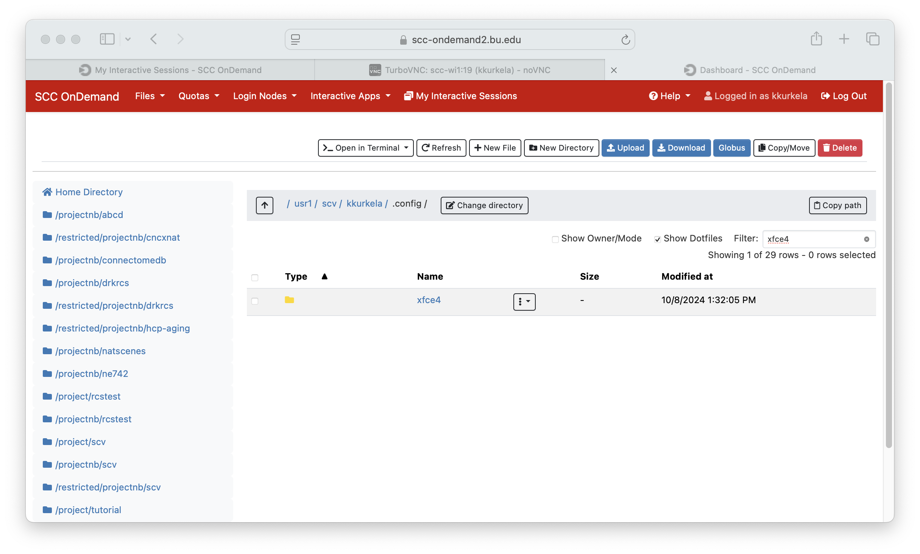
Notes:
The SCC, by default, uses linux keyboard shortcuts which are (annoyingly) different from those used by the Mac and Windows machines we are all used to using. For example:
Copy keyboard shortcut
On Windows/Mac: CTR+C, CMD+C
In Linux’s Terminal: CTR+SHIFT+C
Paste keyboard shortcut
On Windows/Mac: CTR+V, CMD+V
In Linux’s Terminal: CTR+SHIFT+V

Slide 66
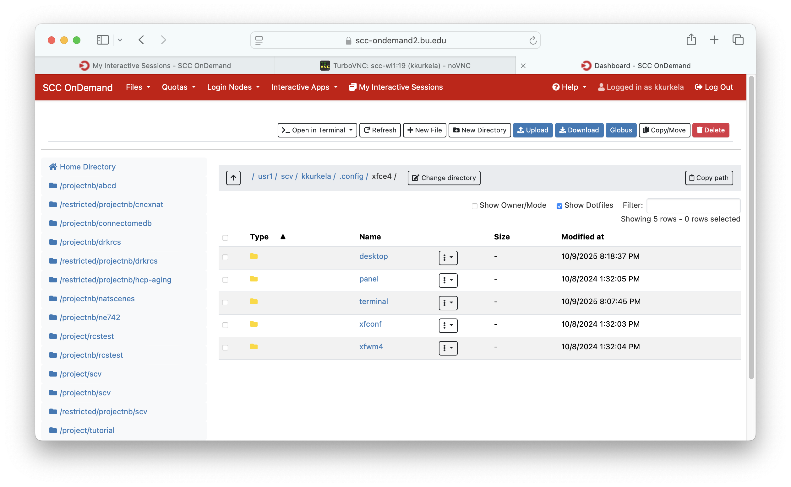
Notes:
The SCC, by default, uses linux keyboard shortcuts which are (annoyingly) different from those used by the Mac and Windows machines we are all used to using. For example:
Copy keyboard shortcut
On Windows/Mac: CTR+C, CMD+C
In Linux’s Terminal: CTR+SHIFT+C
Paste keyboard shortcut
On Windows/Mac: CTR+V, CMD+V
In Linux’s Terminal: CTR+SHIFT+V

Slide 67
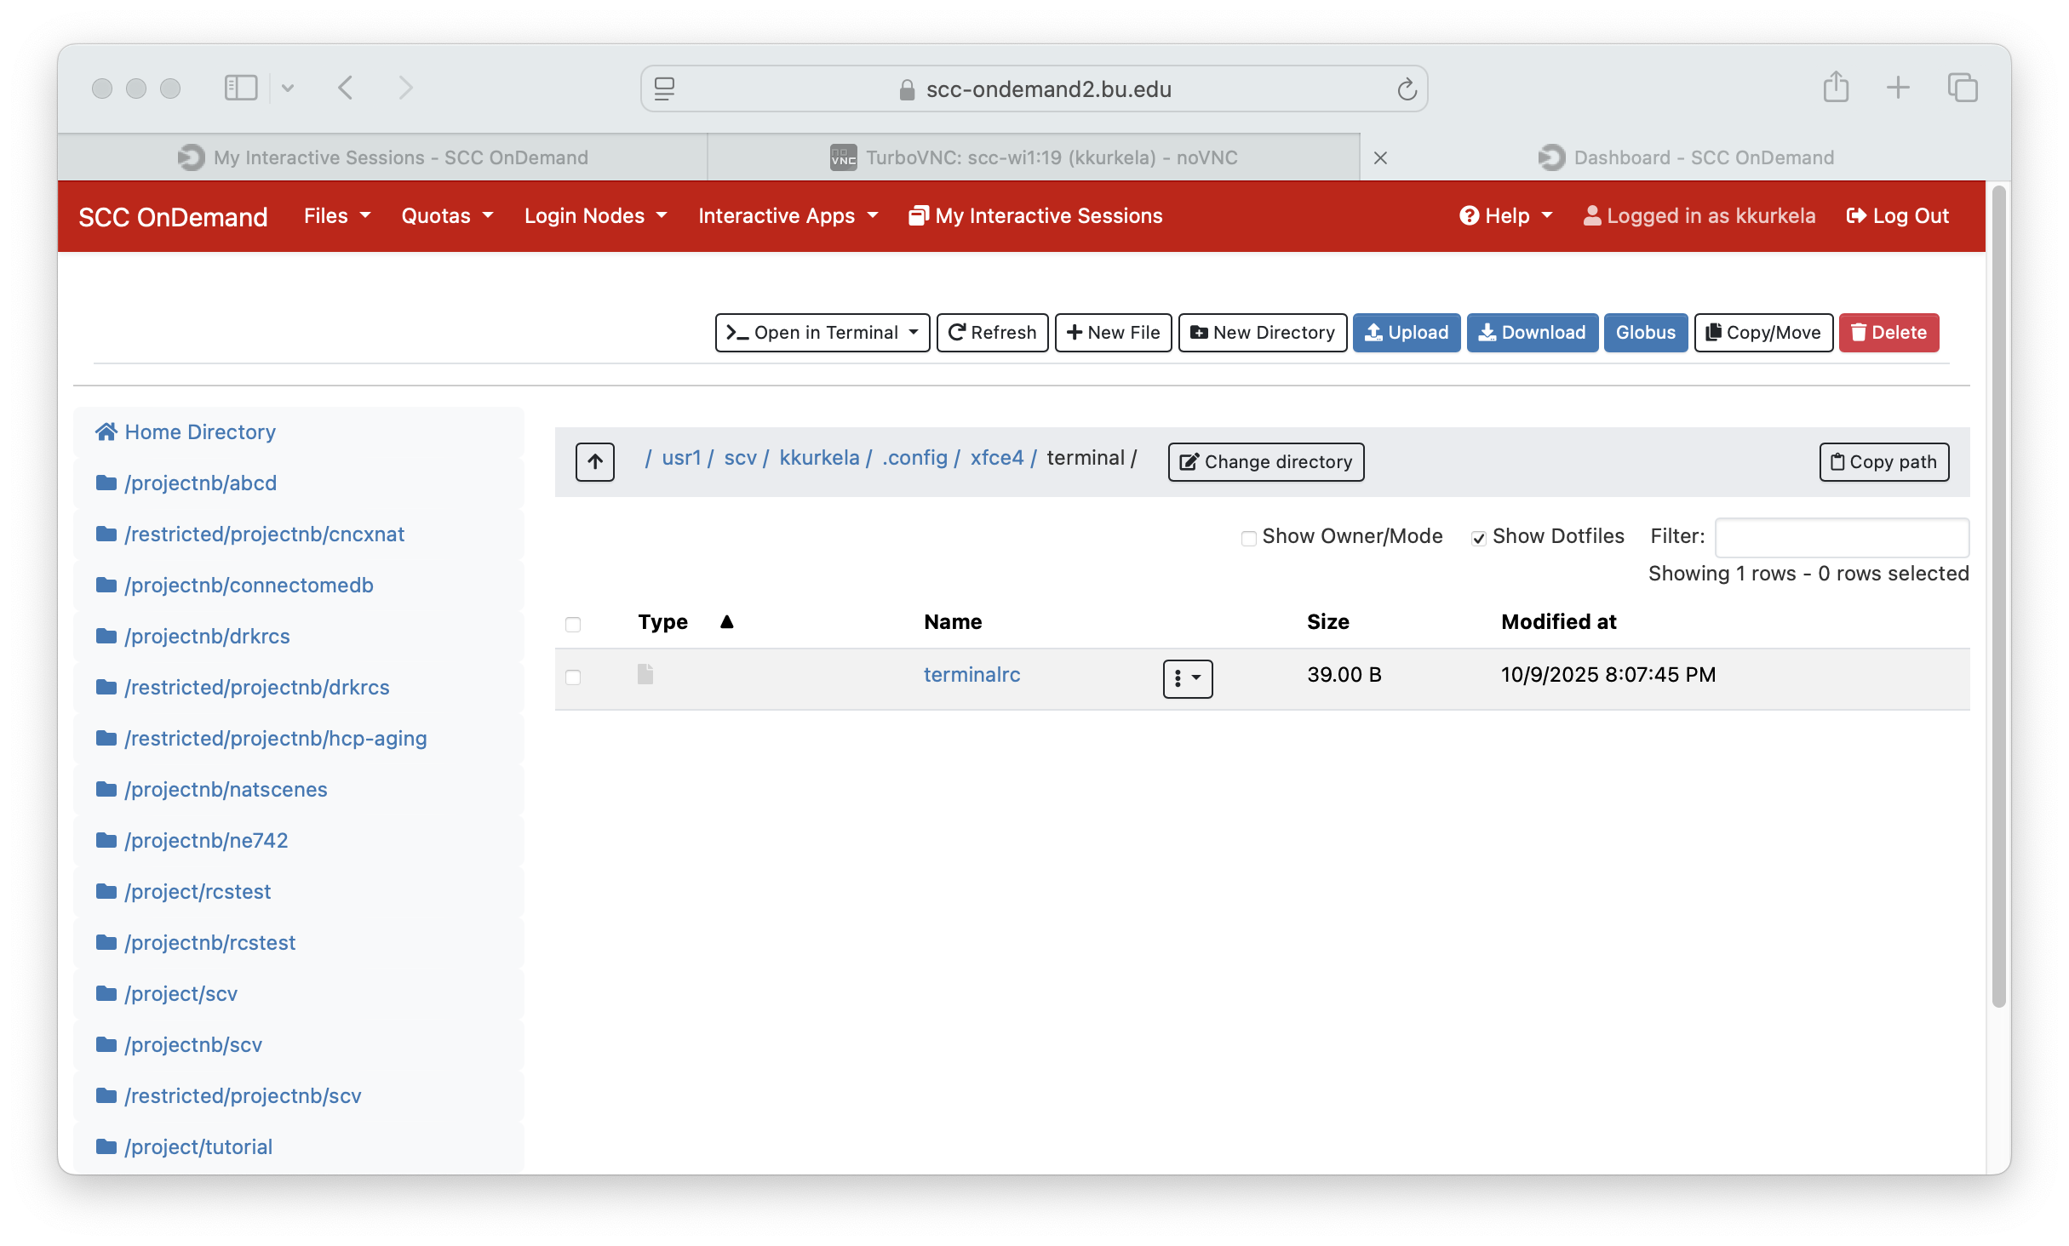
Notes:
The SCC, by default, uses linux keyboard shortcuts which are (annoyingly) different from those used by the Mac and Windows machines we are all used to using. For example:
Copy keyboard shortcut
On Windows/Mac: CTR+C, CMD+C
In Linux’s Terminal: CTR+SHIFT+C
Paste keyboard shortcut
On Windows/Mac: CTR+V, CMD+V
In Linux’s Terminal: CTR+SHIFT+V

Slide 68
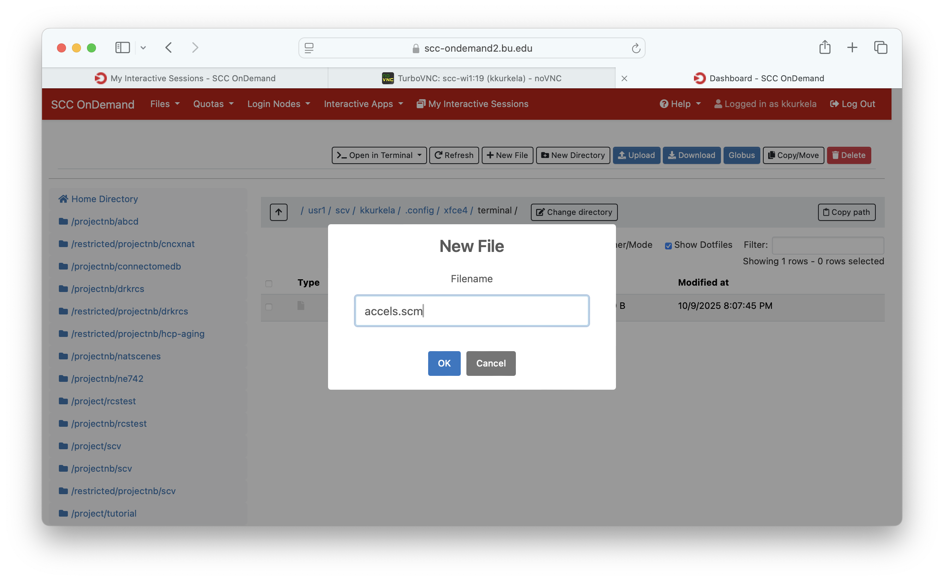
Notes:
The SCC, by default, uses linux keyboard shortcuts which are (annoyingly) different from those used by the Mac and Windows machines we are all used to using. For example:
Copy keyboard shortcut
On Windows/Mac: CTR+C, CMD+C
In Linux’s Terminal: CTR+SHIFT+C
Paste keyboard shortcut
On Windows/Mac: CTR+V, CMD+V
In Linux’s Terminal: CTR+SHIFT+V

Slide 69
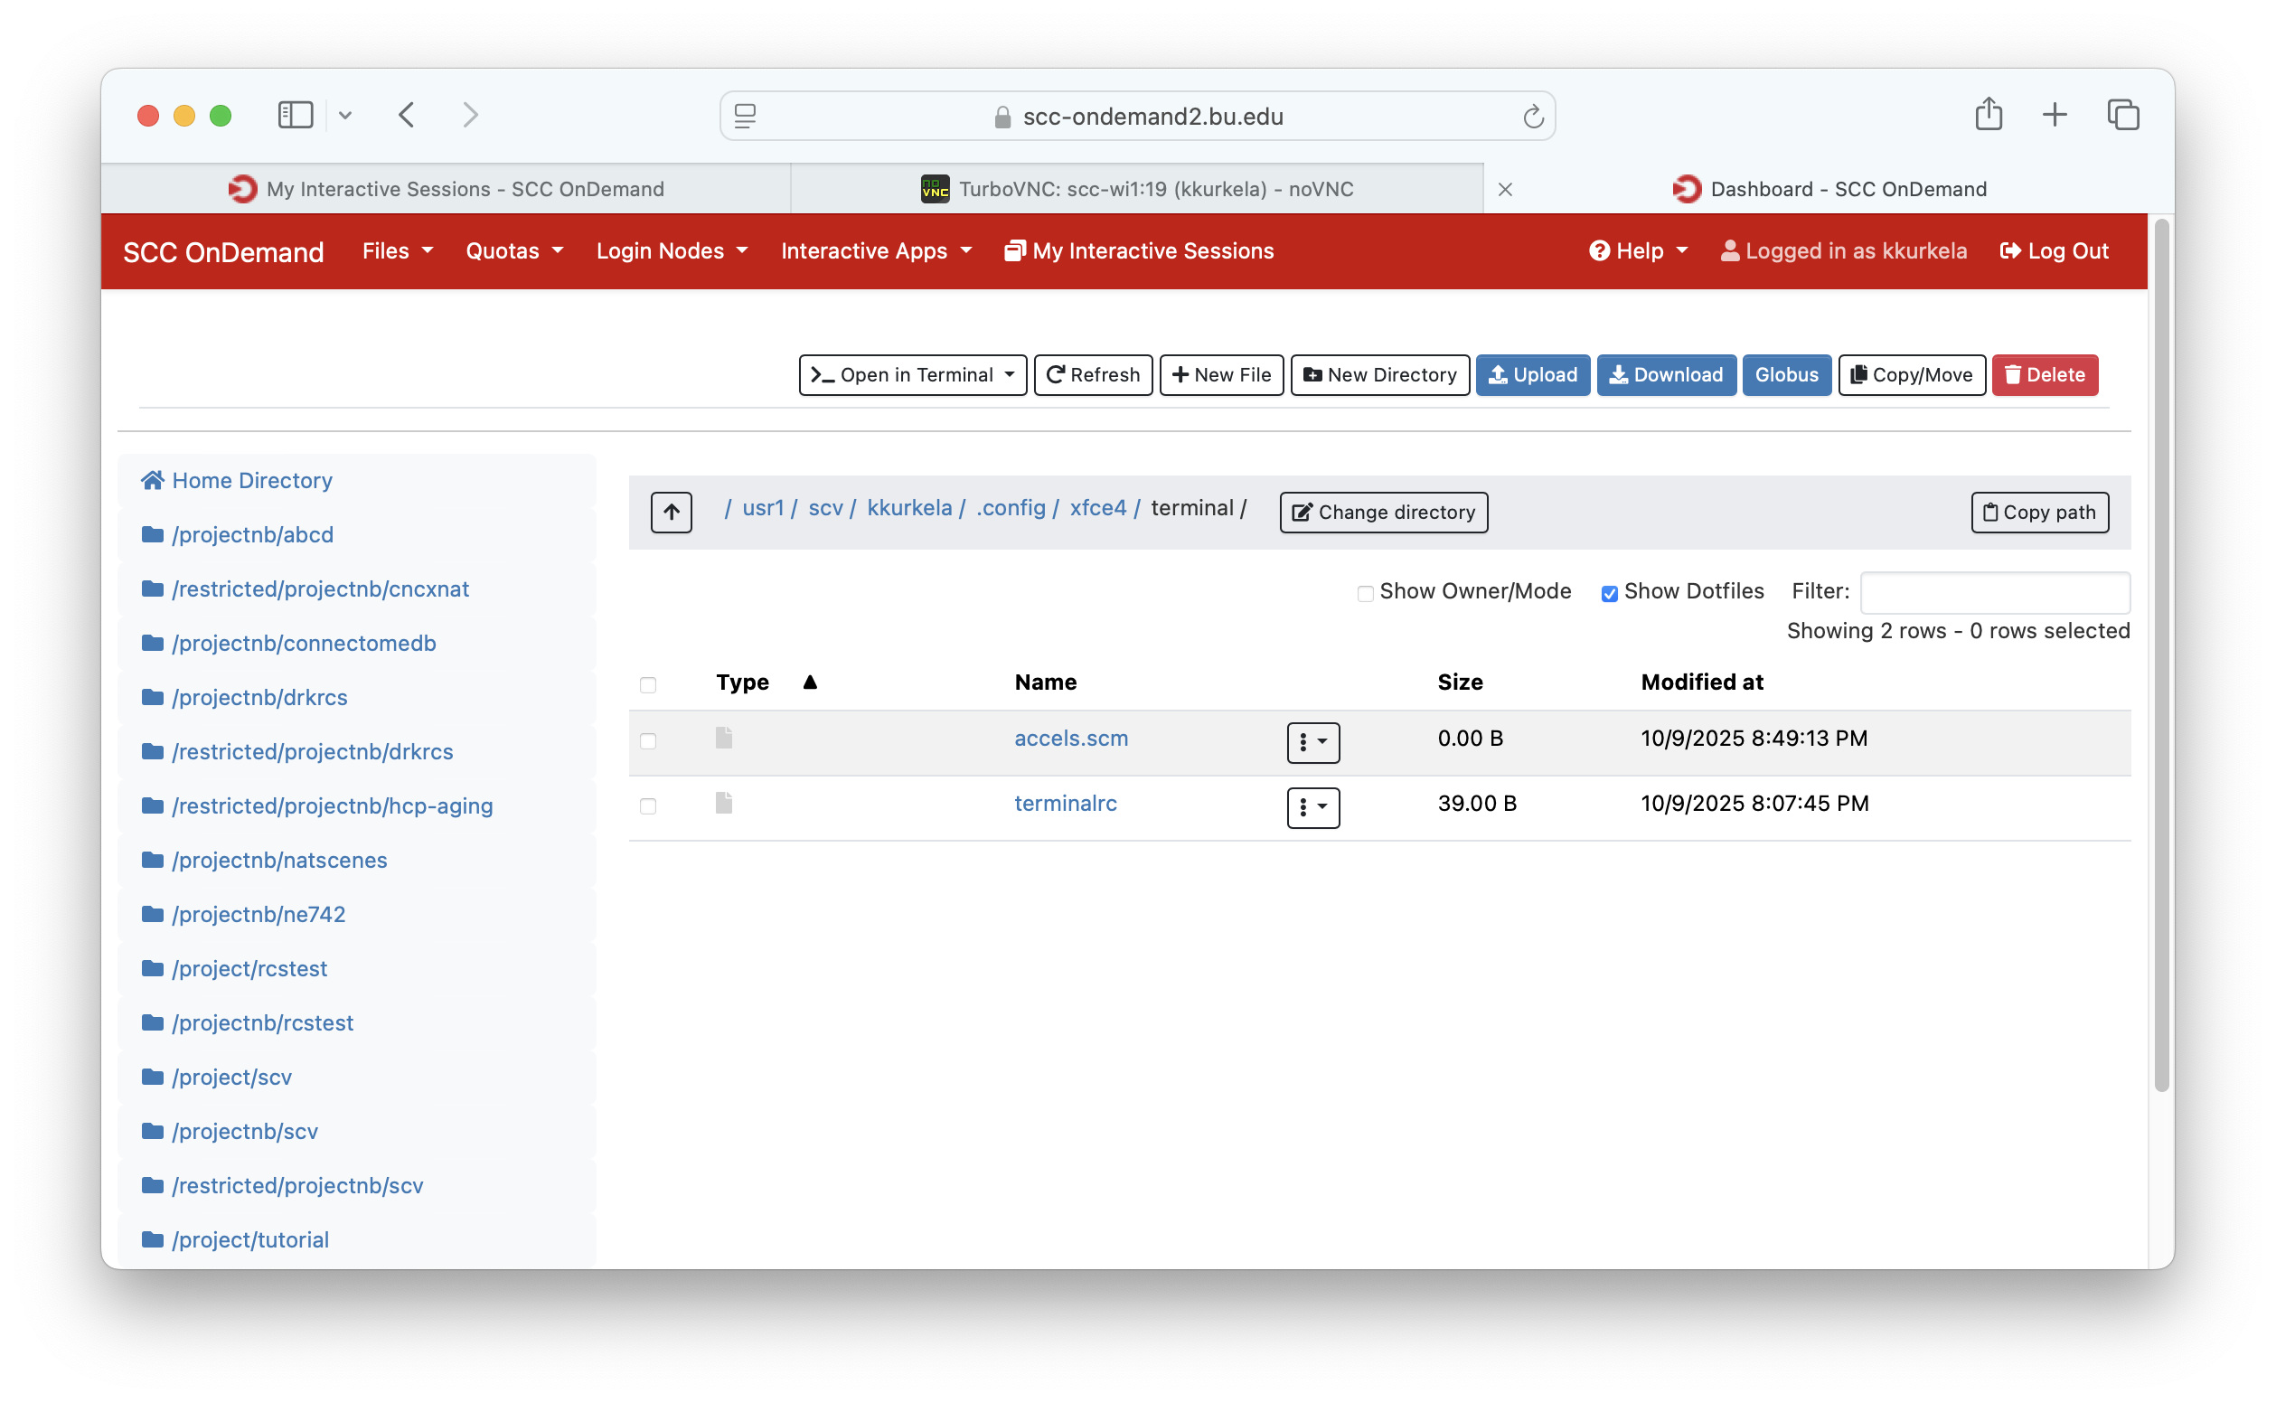
Notes:
The SCC, by default, uses linux keyboard shortcuts which are (annoyingly) different from those used by the Mac and Windows machines we are all used to using. For example:
Copy keyboard shortcut
On Windows/Mac: CTR+C, CMD+C
In Linux’s Terminal: CTR+SHIFT+C
Paste keyboard shortcut
On Windows/Mac: CTR+V, CMD+V
In Linux’s Terminal: CTR+SHIFT+V

Slide 70
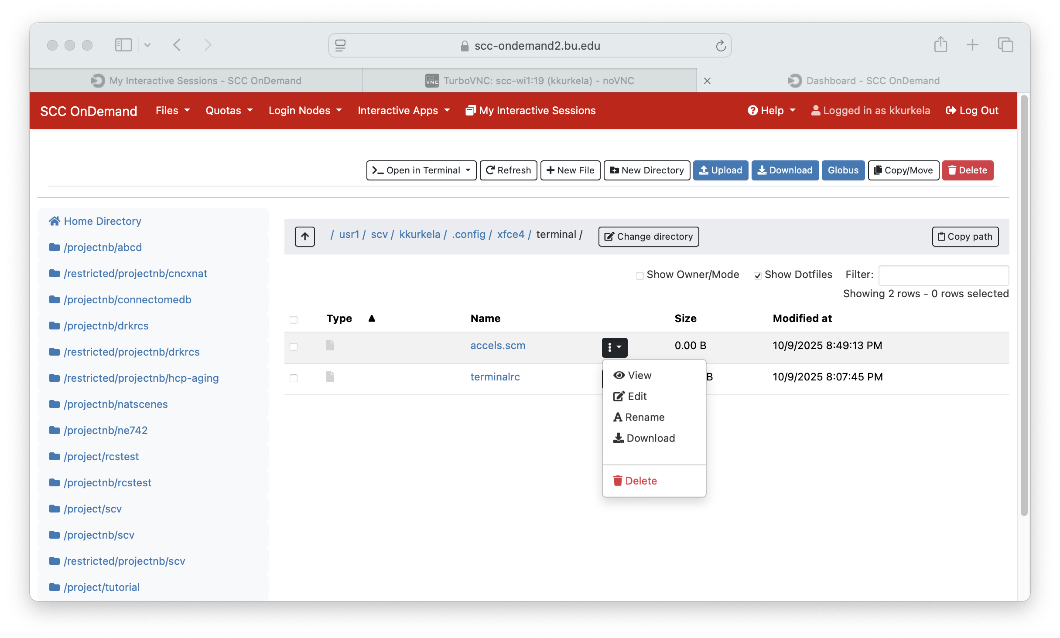
Notes:
The SCC, by default, uses linux keyboard shortcuts which are (annoyingly) different from those used by the Mac and Windows machines we are all used to using. For example:
Copy keyboard shortcut
On Windows/Mac: CTR+C, CMD+C
In Linux’s Terminal: CTR+SHIFT+C
Paste keyboard shortcut
On Windows/Mac: CTR+V, CMD+V
In Linux’s Terminal: CTR+SHIFT+V

Slide 71
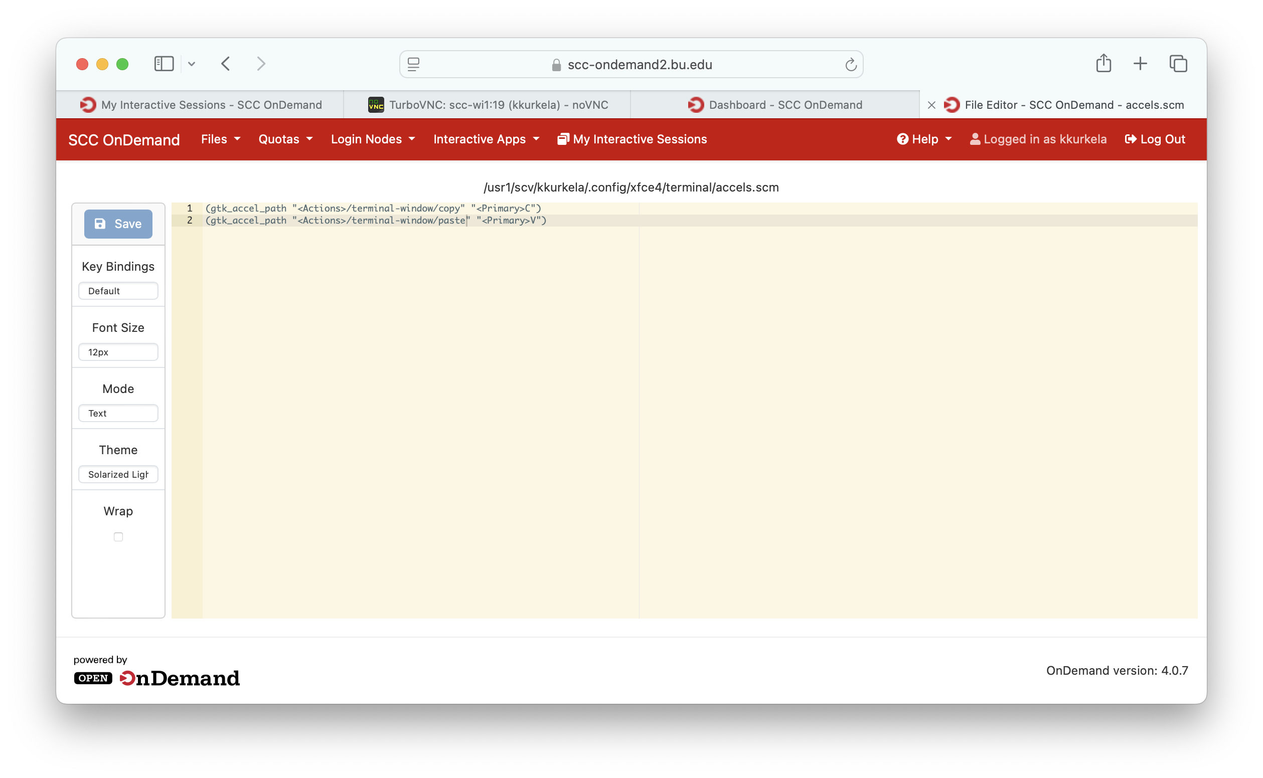
Notes:
The SCC, by default, uses linux keyboard shortcuts which are (annoyingly) different from those used by the Mac and Windows machines we are all used to using. For example:
Copy keyboard shortcut
On Windows/Mac: CTR+C, CMD+C
In Linux’s Terminal: CTR+SHIFT+C
Paste keyboard shortcut
On Windows/Mac: CTR+V, CMD+V
In Linux’s Terminal: CTR+SHIFT+V

Slide 72
Workshop Overview
Who am I?
What is the SCC?
How does the SCC work?
SCC On Demand
Connecting to a Desktop Session
The Linux Desktop Environment
The Linux Command Line
Customizing the Linux Command Line
The Linux File System
The Module System
How to submit jobs to the SCC
How to upload and download data/files to the SCC
Yaxil Demonstration

Slide 73
Linux File System
/
ne742
projectnb
students
kylekurk
materials
lbakst
fmriprep.tar
code.py
Linux file systems are organized into hierarchical trees

Slide 74
Linux File System
/
ne742
projectnb
students
kylekurk
materials
lbakst
fmriprep.tar
code.py
A directory is uniquely identified via its path. A path describes how to navigate to a directory on the tree.

Slide 75
Linux File System
/
ne742
projectnb
students
kylekurk
materials
lbakst
fmriprep.tar
code.py
Paths start at what is called the root (represented by “/”)
Paths list all the directories that you need to descend into to reach your destination from the root

Slide 76
Linux File System
/
ne742
projectnb
students
kylekurk
materials
lbakst
fmriprep.tar
code.py
For example, the path to the directory “kylieisen” is:
/projectnb/ne742/students/kylieisen

Slide 77
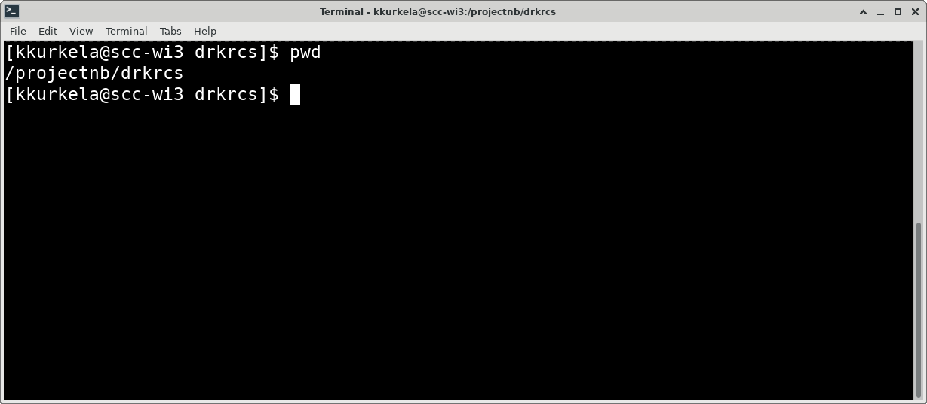
Linux navigation
Command Spotlight : “pwd” prints the full path to your current working directory. This is where you currently reside within the filesystem.

Slide 78
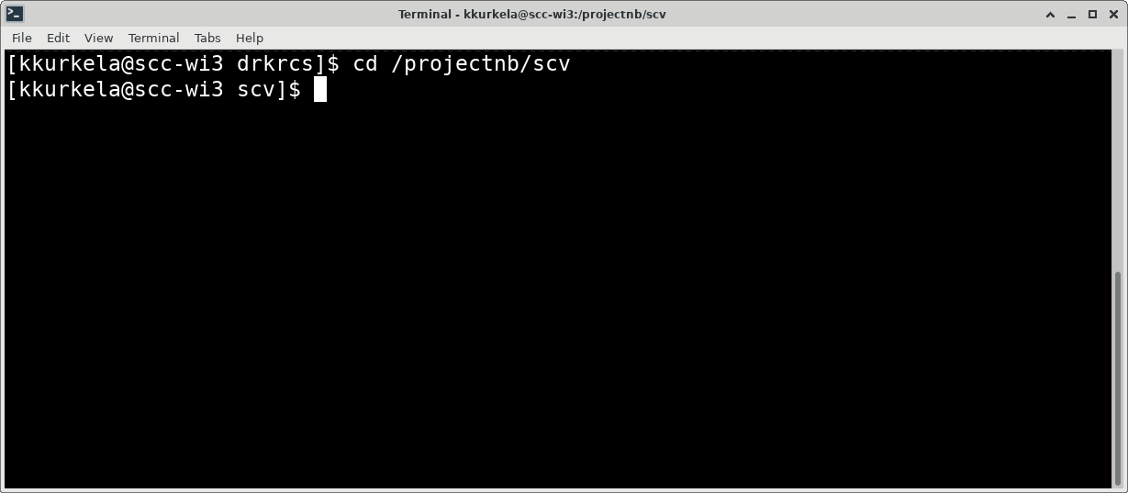
Linux navigation
Command Spotlight: The command “cd” allows you to change your working directory. It takes a path as input.

Slide 79
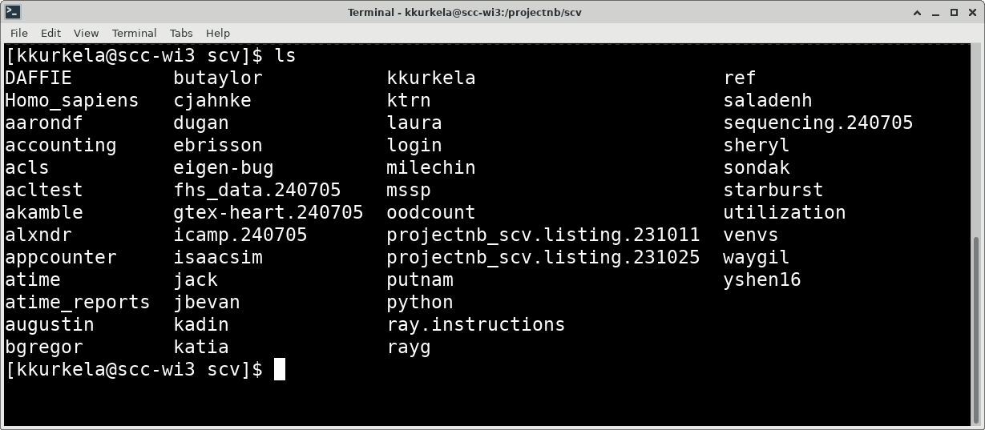
Linux navigation
Command Spotlight: the ”ls” command will print contents of a directory. If you invoke it without an input argument, it will print the contents of the working directory

Slide 80
Linux navigation
EXERCISE: Let’s try together to navigate to this directory on the SCC:
/projectnb/scv/kkurkela/tutorial

Slide 81
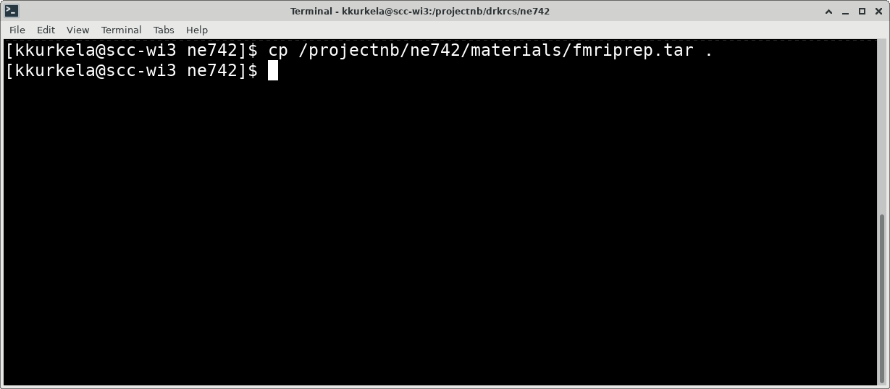
Linux Basics – copying files
Command spotlight: the ”cp” command allows you to copy files from one directory to another. It takes two inputs arguments. The path to the file you want to copy and the path to the destination directory. Hint: you can use the “.” to indicate the present working directory.

Slide 82
Linux Basics – copying files
EXERCISE: copy the file “fmriprep.tar” from the directory “/projectnb/ne724/materials” to your student directory.
Notes:
Tips and tricks:
Up arrow to go to the last command
Tab complete
Ctrl+R to search your command history for a previous command

Slide 83
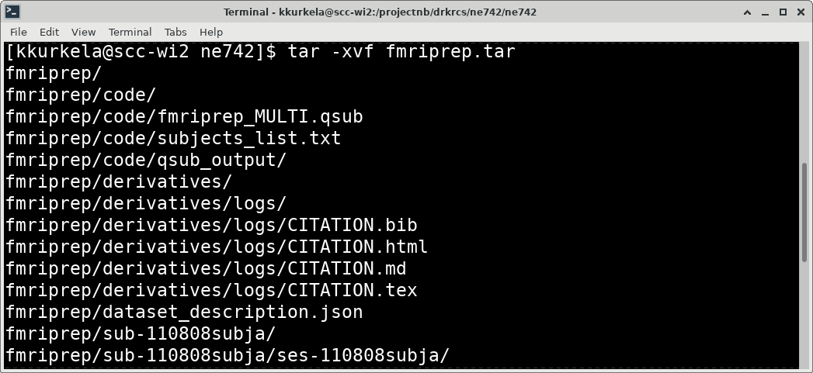
Linux Basics – tar
The file that you just copied is called a tar ball. It is a zip archive that contains a bunch of files and directories within it.

Slide 84
Linux Basics – tar
To see these files/directories, we need to “untar” this file. You can do that using the “tar” command as you see here.

Slide 85
Linux Basics – tar
EXERCISE: unpack the fmriprep tarball using the tar command. Inspect the resulting files/directory structure using the “tree” command.

Slide 86
Workshop Overview
Who am I?
What is the SCC?
How does the SCC work?
SCC On Demand
Connecting to a Desktop Session
The Linux Desktop Environment
The Linux Command Line
Customizing the Linux Command Line
The Linux File System
The Module System
How to submit jobs to the SCC
How to upload and download data/files to the SCC
Yaxil Demonstration

Slide 87
The Module System
For more information, checkout our webpage here:
  https://www.bu.edu/tech/support/research/software-and-programming/software-and-applications/modules/
To request new software, fill out this form:
  https://www.bu.edu/tech/support/research/software-and-programming/software-and-applications/request-software/

Slide 88
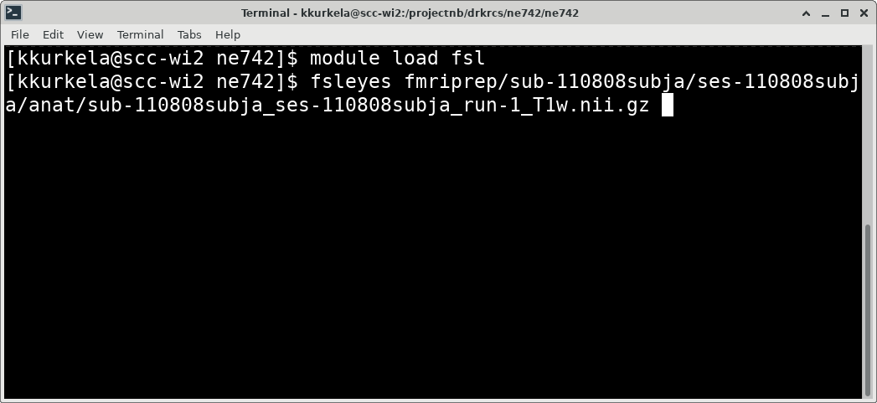
Load software using module load
Once you load fsl, you now have access to fsl commands. Use the command “fsleyes” with the path to an *.nii.gz image as the first input argument.
Notes:
run the fsleyes command

Slide 89
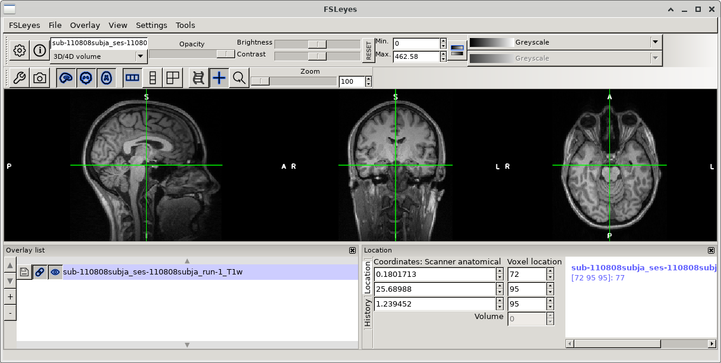
Load software using module load
This will open the fsleyes user interface with the input scan. Play around and examine this scan.

Slide 90
Workshop Overview
Who am I?
What is the SCC?
How does the SCC work?
SCC On Demand
Connecting to a Desktop Session
The Linux Desktop Environment
The Linux Command Line
Customizing the Linux Command Line
The Linux File System
The Module System
How to submit jobs on the SCC
How to upload and download data/files to the SCC
Yaxil Demonstration

Slide 91
SGE Job Scheduler
The SCC uses the Sun Grid Engine (SGE) job scheduling system.
Think of the job scheduler as a person who works at desk. This “person’s” jobs is to follow a set of rules to determine a “fair” and ”efficient” dolling out of computer resources.
  For example, this “person” might be programmed to follow a rule that limits users to using a maximum of 4 GPUs are a time
  There might be special exceptions made

Slide 92
The qsub command
The qsub command is how you send an official request to the job scheduler
Check out our website for an excellent overview:
  https://www.bu.edu/tech/support/research/system-usage/running-jobs/submitting-jobs/#job-options
Keep our cheat sheet handy when submitting jobs:
  http://scv.bu.edu/documents/SCC_CheatSheet.pdf

Slide 93
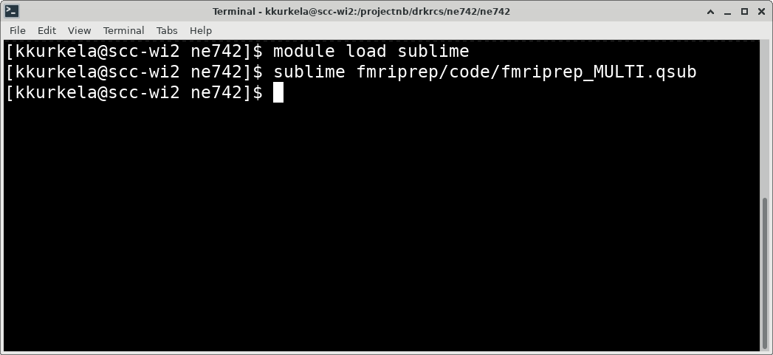
SCC Basics – job submission
We are now going to submit a job to the job scheduler. We submit jobs to the job scheduler using job scripts.
Notes:
Job scripts are typically given the file extension .qsub, but they do not have to be.
Job scripts are bash scripts are essentially a recipe/script that you want the computer to follow.

Slide 94
SCC Basics – job submission
An example job script has been written for you. Open this script up using a text editor and we will edit it to work for you.

Slide 95
SCC Basics – job submission
EXERCISE: follow the steps above to open the example job submission script in the text editor sublime.
Notes:
Edit line 10 → path for output files
Edit line 35 → use older version of fmriprep
Edit line 42 → path to your dataset
Delete lines 53-58
Edit line 59 “subjectid=“ to be the subjects id contained in the subject list

Slide 96
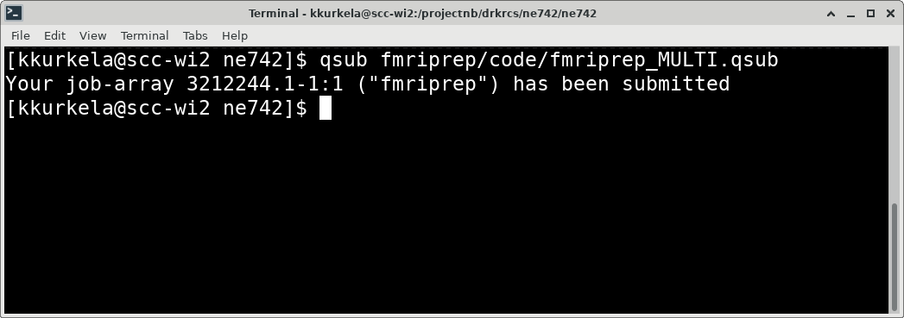
SCC Basics – job submission
Once you have properly edited your job script you can submit it to the job scheduler using the command “qsub” with the path to your job script as the input argument.

Slide 97
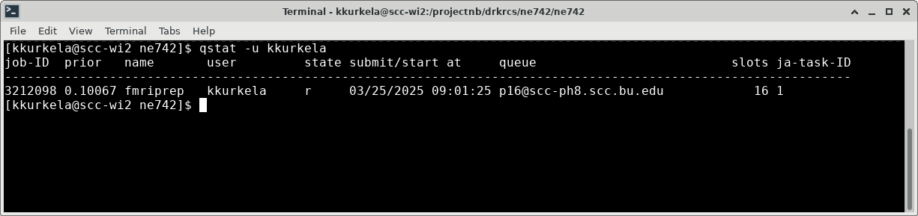
SCC Basics – job submission
You can check the status of your job using the command “qstat –u USERNAME”. Try it out.

Slide 98
SCC Basics – job submission
This job should take few hours to run. You will receive an email from nobody@scc.bu.edu telling you that your job completed (or encountered an error).

Slide 99
Workshop Overview
Who am I?
What is the SCC?
How does the SCC work?
SCC On Demand
Connecting to a Desktop Session
The Linux Desktop Environment
The Linux Command Line
Customizing the Linux Command Line
The Linux File System
The Module System
How to submit jobs on the SCC
How to upload and download data/files to the SCC
Yaxil Demonstration

Slide 100
File Transfer on the SCC

Slide 101
Workshop Overview
Who am I?
What is the SCC?
How does the SCC work?
SCC On Demand
Connecting to a Desktop Session
The Linux Desktop Environment
The Linux Command Line
Customizing the Linux Command Line
The Linux File System
The Module System
How to submit jobs on the SCC
How to upload and download data/files to the SCC
Yaxil Demonstration

Slide 102
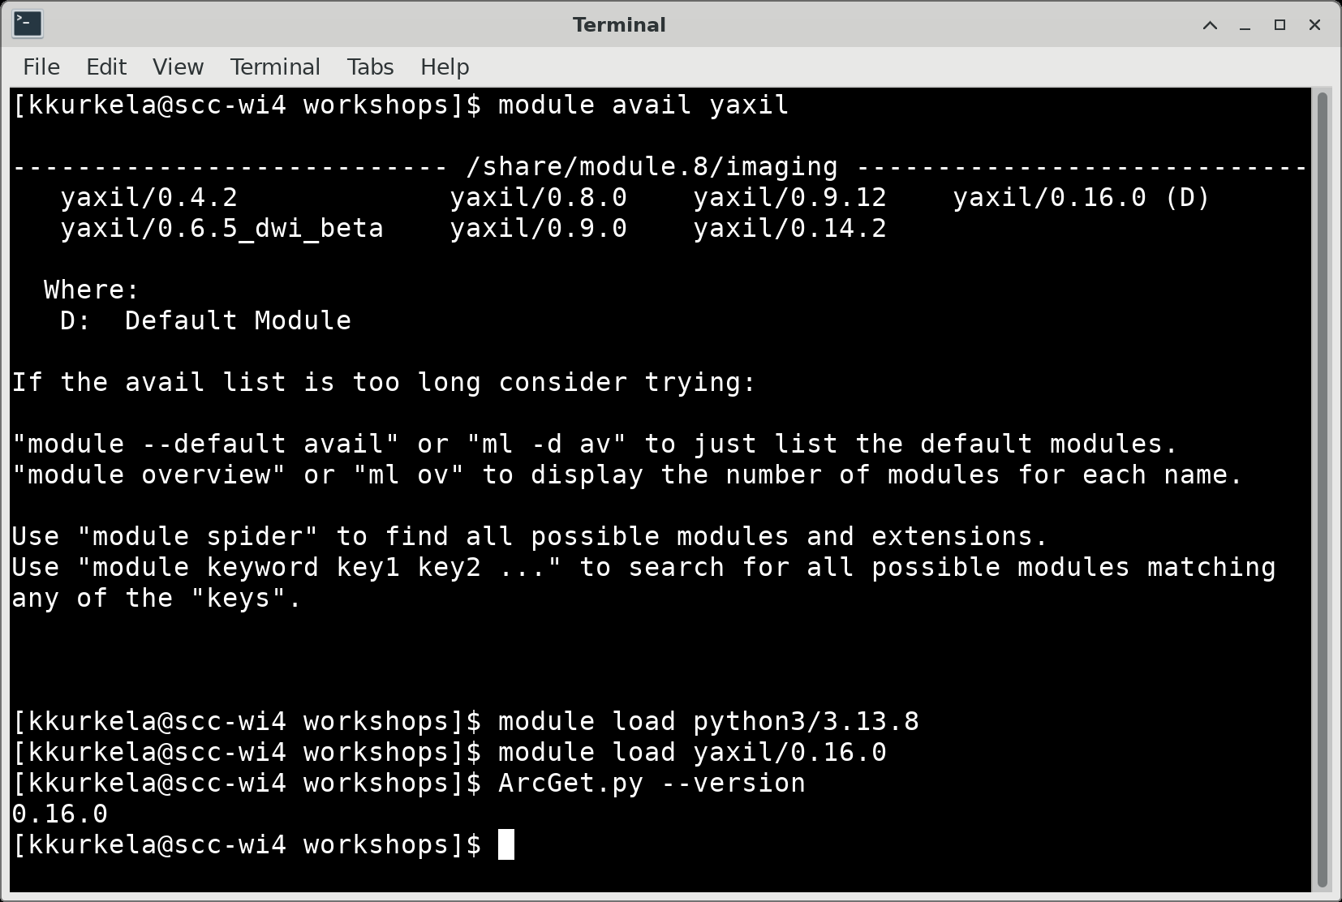
Load the yaxil module

Slide 103
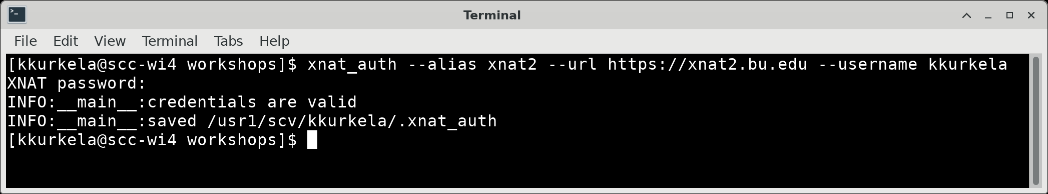
You only need to do this once. Set up an “auth” file. This allows you to automatically sign in to XNAT.
Notes:
./ How to load yaxil
./ Yaxil authentication setup
./ How to download a session
How to download a session and sort into BIDS
./Show commands to copy over the example configuration file
./Show commands to open up VSCode – example file
./Show VSCode Window – example
./Show VSCode Window – final product
./Execute the command
./Viewing the Output

Slide 104
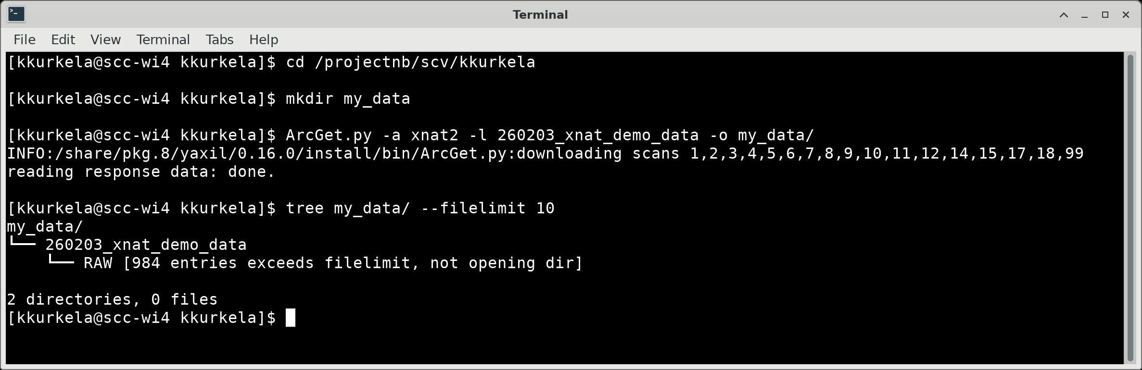
Let’s download the DICOM files of the example dataset “260203-xnat_demo_data” from xnat2.bu.edu

Slide 105
YAXIL – BIDS Configuration

Slide 106
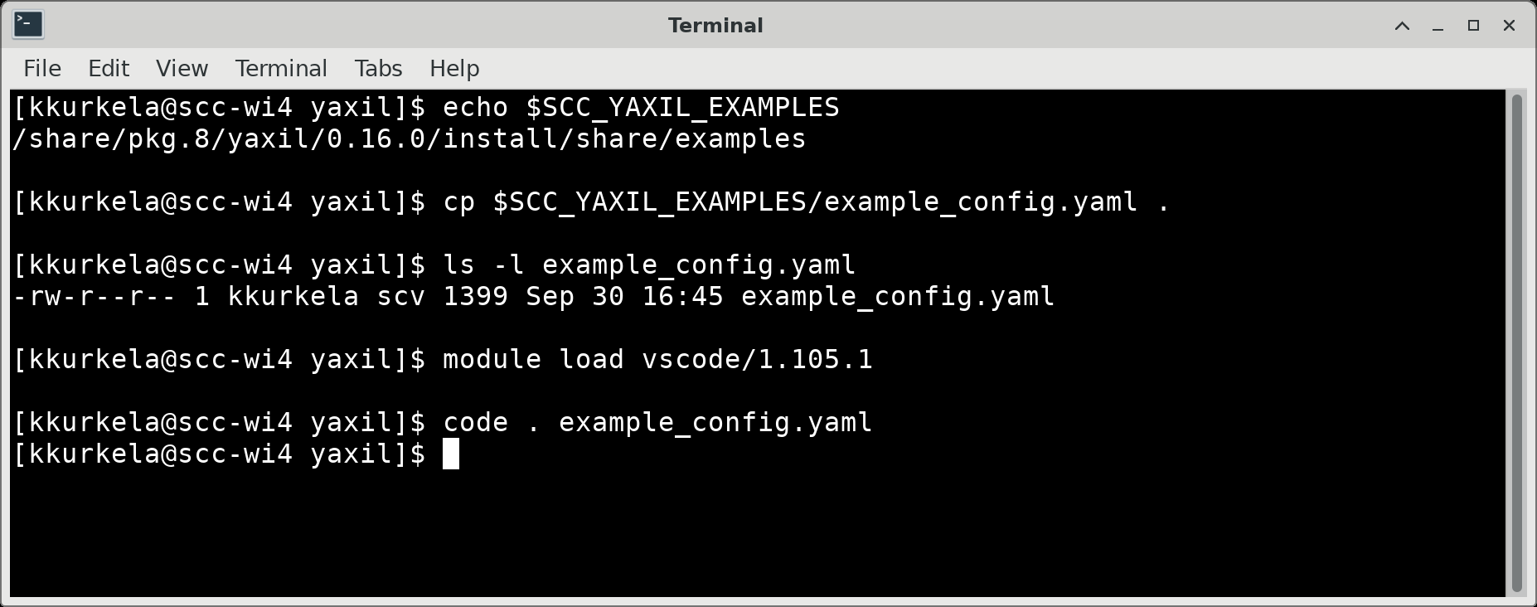
Copy the example BIDS configuration file to your working directory. Open the configuration file in the text editor ”vscode”.

Slide 107
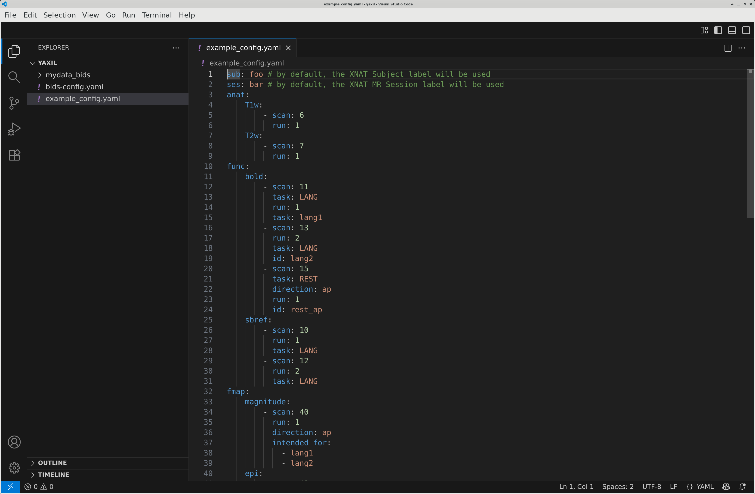
Create a new copy of the file “bids-config.yaml”.

Slide 108
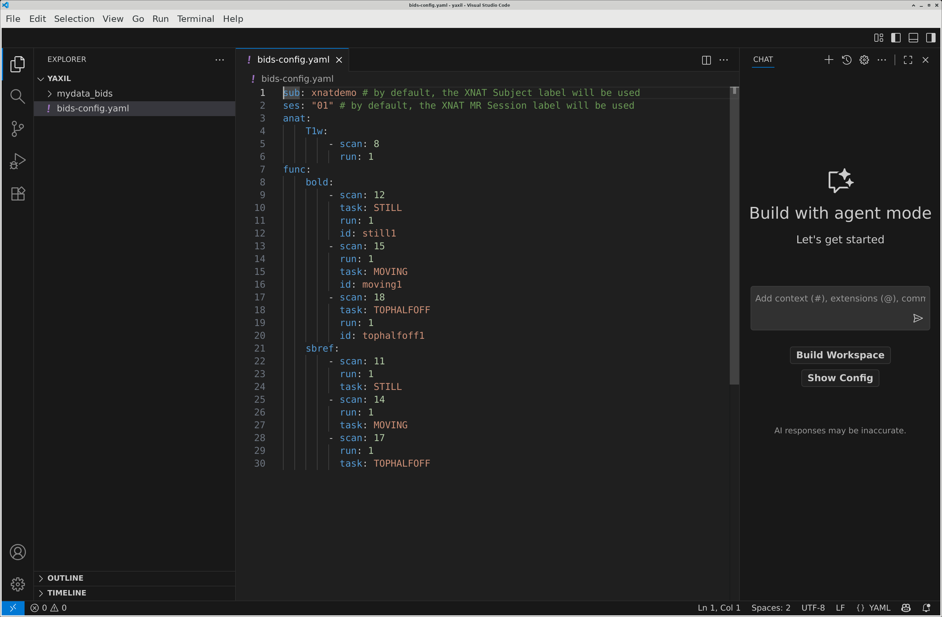
Edit the file so that it looks like this.

Slide 109
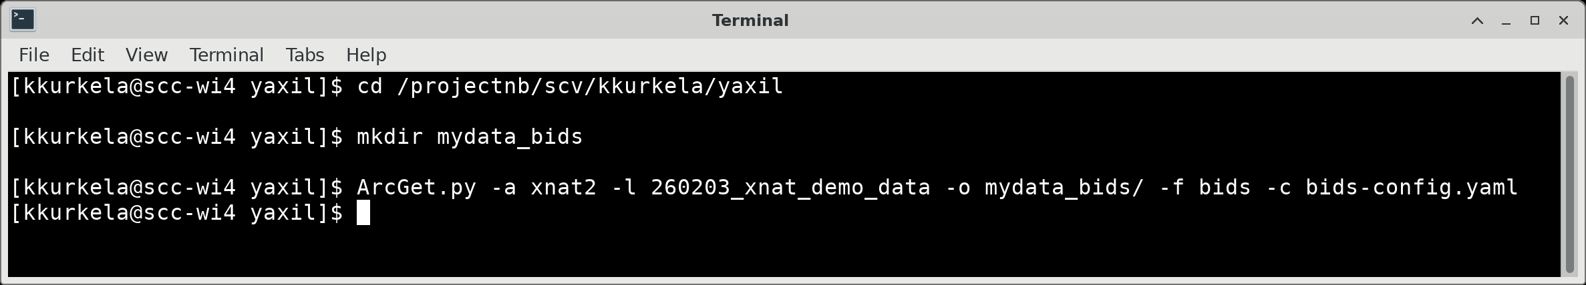
Run the ArcGet.py command to copy over your data and sort it into BIDS format.

Slide 110
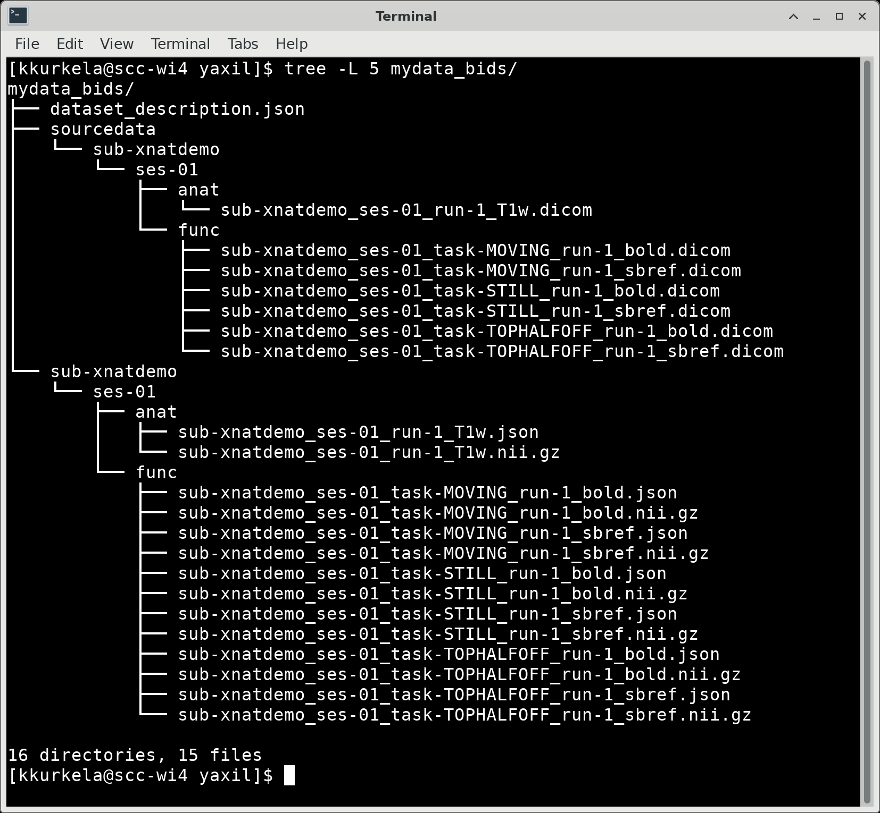

Slide 111
Questions? Comments? Concerns?

Slide 112
How do I get access to the SCC?
https://www.bu.edu/tech/support/research/account-management/getting-an-scc-account/
  TL;DR: You need to be added to a project by a BU faculty member
Notes:
Does everyone here have an SCC account?

Slide 113
How do I create a project?
Visit our web page here and fill out an application:
  https://www.bu.edu/tech/support/research/account-management/create-project/
Note: you need to be a BU faculty member to create a project on the SCC
Note: projects can have up to 1000GB of free storage space AND each PI have an additional limit of 3000 GB of free storage

Slide 114
Workshop Overview
Who am I?
What is the SCC?
How does the SCC work?
Why should you use the SCC?
SCC On Demand
Connecting to a Desktop Session
The Linux Desktop Environment
The Linux Command Line
Customizing the Linux Command Line
The Linux File System
The Module System
How to submit jobs to the SCC
How to upload and download data/files to the SCC
Yaxil Demonstration

Slide 115
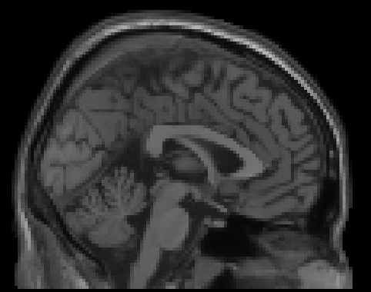

Why the SCC?
Personal Computer
Notes:
Great! three-dimensional the SCC is a whole bunch of computers organized in a specific way. So what is the big deal? Why would you want to use it as a neuroimager.
To illustrate why, lets look at an example.
Say your name is Suzy Graduate Student and you want to process and analyze some MRI data for your dissertation. The typical way you would go about doing so would be to take your personal computer, downloading some MRI data, and processing locally on that computer. Say you want to generate some three-dimensional cortical surfaces from subjects that you have scanned using freesurfer.

Slide 116
Why the SCC?
~ 6 Hours
Personal Computer
Notes:
Depending on the specs of your computer, using freesurfer to generate cortical surfaces make take as long as six hours to complete. Suzy the graduate student may be thinking – well that is pretty long, but not that big of a deal. I can just set the program to run in the evening and it will be completed in the morning. No harm done, right?

Slide 117
Why the SCC?
Personal Computer

Slide 118
Why the SCC?
Personal Computer
Notes:
Well, now imagine Suzy Graduate Student is given 5 subjects to analyze and her PI expects to present the results of her study during lab meeting tomorrow.

Slide 119
Why the SCC?
6 Hours x 5 subjects = 30 hours!
Personal Computer
Notes:
Using her personal computer setup, it would take Suzy 30 hours to process all 5 subjects. There is only 24 hours until her lab meeting! What is she to do?

Slide 120
Why the SCC?
Personal Computer

Slide 121
Why the SCC?
The SCC
Notes:
In comes the SCC to the rescue.
The SCC, as previously mentioned, is a whole bunch of computers. These computers can be used in parallel, greatly increasing the speed with which Suzy can process her data.

Slide 122
Why the SCC?
The SCC

Slide 123
Why the SCC?
6 Hours x 5 subjects = 30 6 hours!
The SCC
Notes:
So instead of it taking Suzy 30 hours to process these 5 subjects, she can process her subjects in parallel on the SCC and the whole process will instead take just 6 hours to complete. Plenty of time for her to inspect the results and present her data during lab meeting.
The power of the SCC, and the reason to use it as a neuroimager, is that it greatly increases the speed with which you can process and analyze your large, high dimensional neuroimaging datasets.

Slide 124
Why the SCC?
The power of the SCC is that it greatly increases the speed with which you can process and analyze your large, high dimensional neuroimaging datasets.
The SCC
Notes:
So instead of it taking Suzy 30 hours to process these 5 subjects, she can process her subjects in parallel on the SCC and the whole process will instead take just 6 hours to complete. Plenty of time for her to inspect the results and present her data during lab meeting.
The power of the SCC, and the reason to use it as a neuroimager, is that it greatly increases the speed with which you can process and analyze your large, high dimensional neuroimaging datasets.

