Slide 1
Introduction to SQL
Research Computing Services
Yun Shen
http://rcs.bu.edu
http://rcs.bu.edu/eval
help@scc.bu.edu

Slide 2
A little bit of about our group and me
Research Computing services, visit http://rcs.bu.edu for more info
  Consulting
  Teaching
  Graphics
  Optimization
Experience:
  Database programming
  Software development

Slide 3
Tutorial Outlines
  What is SQL
  SQL History
  Terminology By Examples
  SQL Syntax By Examples
  SQL Category
  Small yet worth noting points
  Tutorial sample db overview
  Schema of the sample db
  Data of the sample db
  Hands on Tutorial Setup

Slide 4
What is SQL ( ‘Structured Query Language’ )?
SQL stands for ‘Structured Query Language’
SQL is domain-specific language, NOT a general programming language
  SQL is specialized to handle ‘structured data’ that follows relational model – data that incorporates relations among entities and variables.
  Used to interact with relational databases to manage data: create, populate, modify, or destroy data. Also can manage data access

Slide 5
SQL is a standard language
Nevertheless, SQL is a ‘language’. It has its language specification – a set of language elements, rules and syntax
Rigid and structural – have both advantages and disadvantages
  Since the underlying data model is structural, SQL is very ‘structural’ too - requiring rigid predefined schema as compared with those of ‘noSQL’
  Syntax and grammar is also strict
SQL specific features – triggers, stored procedures

Slide 6
History of SQL
First developed in 1970s by two scientists at IBM following a theory of ‘relational algebra’ by Edgar F. Codd, who was also an IBM scientist.
First commercial implementation of SQL-based RDBMS was Oracle’s V2.
First adopted by ANSI in 1986, and ISO in 1987 as standard.
The latest version of the SQL standard is from 2016. There have been very many versions in between.
Though standardized, this does not necessarily mean SQL code can be migrated between different RDBMS seamlessly (Why?)

Slide 7
Terminology - Structure
Database
Table
Column
Row
Relation
Primary key
Foreign key

Slide 8
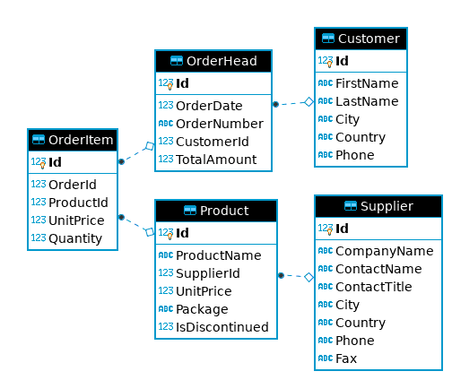
Take sample_ecomm.db as an Example - schema
Notes:
When write SQL, you must be very clear about the underlying table structure. Here is the ERD for sample_ecomm.db. It shows the overall structure and relationships of tables it has.

Slide 9
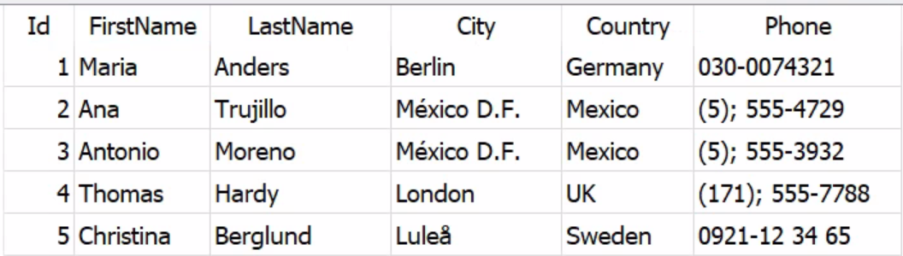
Customer
Notes:
When write SQL, you must be very clear about the underlying table structure. Here is the ERD for sample_ecomm.db. It shows the overall structure and relationships of tables it has.

Slide 10
Terminology - SQL Language Elements
Clause
Statement
Query
Function
Stored Procedure
Predicate
Expression
Keyword
Identifier

Slide 11
A SQL Example From Wikipedia
Let’s take the following SQL UPDATE statement as an example:
UPDATE country
SET population=population+1
WHERE name=‘USA’
A chart showing several of the SQL language elements that compose a single statement
(source: https://wikimedia.org/api/rest_v1/media/math/render/svg/b83ad563285f7b0ebb325226d91f25ca0bffa7cd )

Slide 12
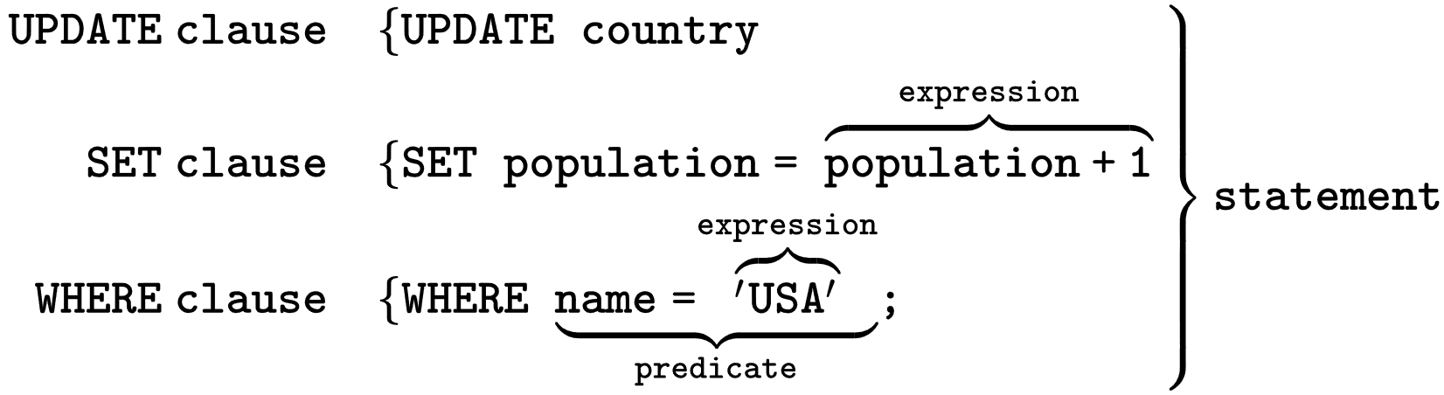
A SQL Example From Wikipedia
A chart showing several of the SQL language elements that compose a single statement
(source: https://wikimedia.org/api/rest_v1/media/math/render/svg/b83ad563285f7b0ebb325226d91f25ca0bffa7cd )

Slide 13
Our Own Query Example
SELECT FirstName, LastName -- SELECT clause
FROM Customer -- FROM clause
WHERE Id=1 – WHERE Clause
Clean way:
SELECT FirstName, LastName FROM Customer WHERE Id=1

Slide 14
Complete Query Statement Syntax – Order Matters !
Clause | Priority | Required? Covered In Tutorial?
SELECT <columns> | 5. | Mandatory ✓
FROM <table> | 1. | Mandatory ✓
WHERE <predicate on rows> | 2. | Optional ✓
GROUP BY <columns> | 3. | Optional ✓
HAVING <predicate on groups> | 4. | Optional, work with GROUP BY
ORDER BY <columns> | 6. | Optional ✓
OFFSET | 7. | Optional
FETCH FIRST | 8. | Optional

Slide 15
SQL Category
1. Data Query Language (DQL) - used to query data
2. Data Manipulation Language (DML) – used to create/modify/destroy data
3. Data Definition Language (DDL) – used to define database schema
4. Data Control Language (DCL) – used for security and access control

Slide 16
Most Important SQL Statements
SELECT - extracts data from a database (DQL)
UPDATE - updates data in a database (DML)
DELETE - deletes data from a database (DML)
INSERT - inserts new data into a database (DML)
CREATE DATABASE - creates a new database (DDL)
CREATE TABLE - creates a new table (DDL)
DROP TABLE - deletes a table (DDL)

Slide 17
Attention Please !
1. SQL keywords and table/column names are NOT case sensitive: ‘select’ and ‘SELECT’ are the same
2. values stored in a table can be case-sensitive – depending on configuration
3. Usually single quotes (‘’) or double quotes (“”) don’t matter, but could be configured otherwise
4. Semicolon ‘;’ is the standard way to separate SQL statements. It can be required in some DBMS. So always end each statement with a ‘;’ even after a single statement
5. Comments can be used to make SQL more readable. Usually ‘--’ for single line comment, and ‘/*’ and ’*/’ for multiline comments. Add ‘--’ at the beginning to indicate a comment line
6. Use alias to make query clear to understand. “AS” keyword can be omitted sometimes.

Slide 18
Standard is NOT STANDARD!!
Standard is NOT STANDARD – none of SQL standard is fully implemented by all vendors. Pay attention to the differences that each vendor’s implementation has from the SQL ‘standard’

Slide 19
In this Tutorial
We will use all upper-case for all keywords
We will use double quotes “” to indicate strings
We will end each SQL statement with a ‘;’

Slide 20
Keywords Used in this Tutorial
INNER JOIN
SELECT
*
FROM
ORDER BY
ASC
DESC
AND
OR
NOT
WHERE
LIMIT
DISTINCT
AS
GROUP BY
ON
!=
INSERT
UPDATE
DELETE
CREATE
TABLE
LIKE
%
INTO
VALUES
DROP
NULL

Slide 21
Functions Used in this Tutorial
COUNT()
MIN()
MAX()
AVG()
SUM()
REPLACE()

Slide 22
Hands On Demo
Basic | SELECT + WHERE
Aggregation | SELECT + GROUP BY
JOIN | SELECT + JOIN
WRITE Queries | INSERT/UPDATE/DELETE
Read Only

Slide 23
Tutorial Tools and Files Overview
  DB GUI : DB Browser for SQLite
  sufficient yet simple/clean interface for demo purpose
  SQLite engine is already embedded in this tool
  Sample DB: sample_ecomm.db
  - a simple example e-commerce db. We will explore it a bit more …
Notes:
SQLite is a serverless, in-memory db engine. It doesn’t have its GUI by itself. Many other companies step up to fill the blank. DBBrowser is one of them.
Almost all major database engines provide programming APIs for application developers to get access to database through programming interfaces.

Slide 24
sample_ecomm.db E-R Diagram
Notes:
When write SQL, you must be very clear about the underlying table structure. Here is the ERD for sample_ecomm.db. It shows the overall structure and relationships of tables it has.

Slide 25
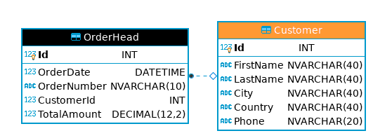
Look Into Individual Table – Customer

Slide 26
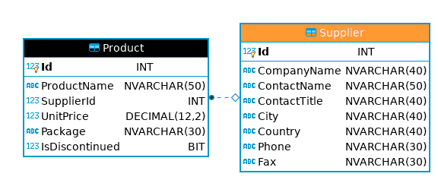
Look Into Individual Table – Supplier

Slide 27
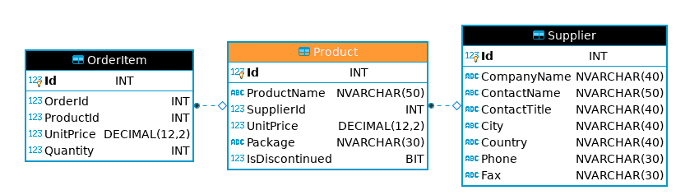
Look Into Individual Table – Product

Slide 28
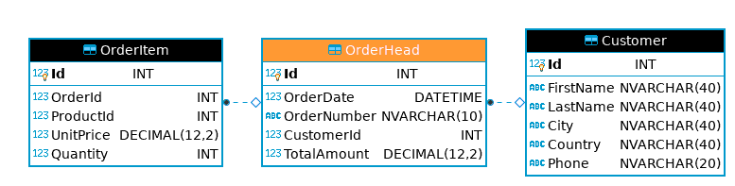
Look Into Individual Table – OrderHead

Slide 29
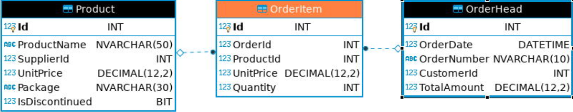
Look Into Individual Table – OrderItem

Slide 30
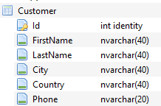
Customer - data view and schema view
Notes:
When write SQL, you must be very clear about the underlying table structure. Here is the ERD for sample_ecomm.db. It shows the overall structure and relationships of tables it has.

Slide 31
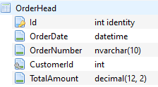
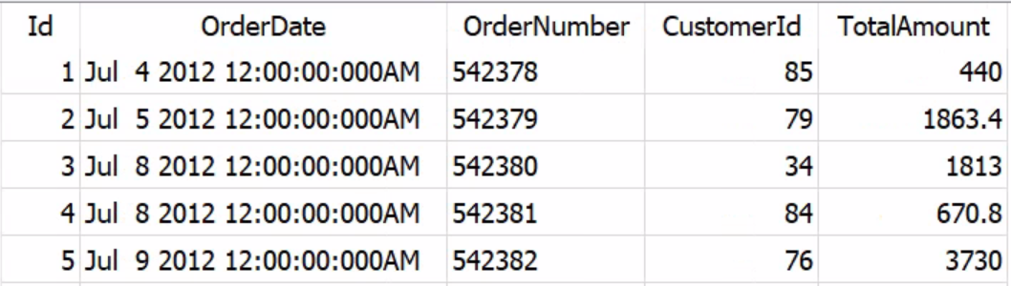
OrderHead - data view and schema view
Notes:
When write SQL, you must be very clear about the underlying table structure. Here is the ERD for sample_ecomm.db. It shows the overall structure and relationships of tables it has.

Slide 32
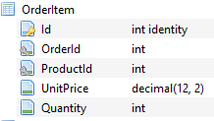
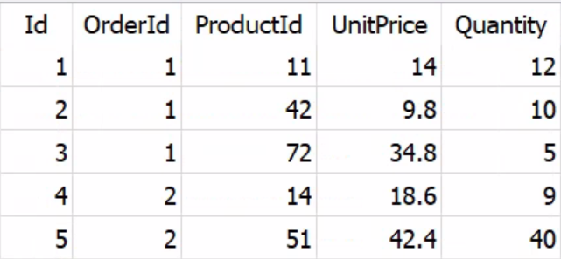
OrderItem - data view and schema view
Notes:
When write SQL, you must be very clear about the underlying table structure. Here is the ERD for sample_ecomm.db. It shows the overall structure and relationships of tables it has.

Slide 33
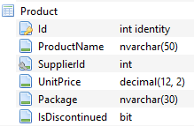
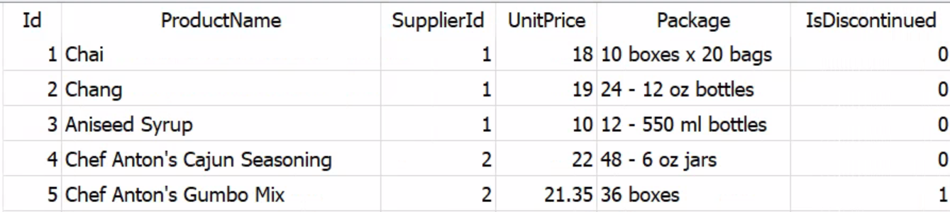
Product - data view and schema view
Notes:
When write SQL, you must be very clear about the underlying table structure. Here is the ERD for sample_ecomm.db. It shows the overall structure and relationships of tables it has.

Slide 34
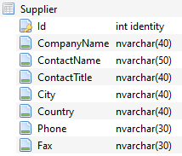
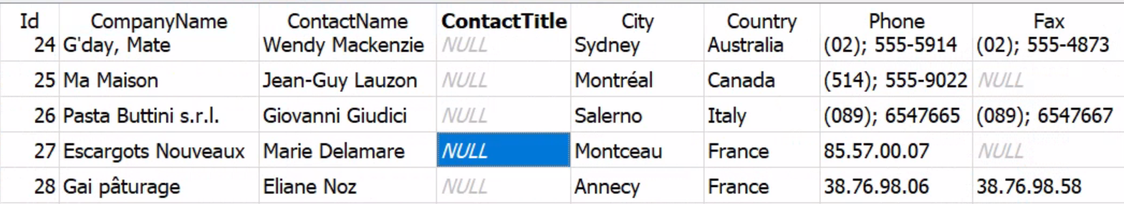
Supplier - data view and schema view
Notes:
When write SQL, you must be very clear about the underlying table structure. Here is the ERD for sample_ecomm.db. It shows the overall structure and relationships of tables it has.

Slide 35
Tutorial Setup
  Option 1: Use BU Common App - https://rdweb.wvd.microsoft.com/arm/webclient/index.html
  Other options: install local copy
  All the tutorial files can be accessed from:
  http://rcs.bu.edu/examples/db/tutorials/intro_to_SQL/
  Download Tutorial materials as one single package (After download, please unzip the above zip file before you move forward !! ):
  http://rcs.bu.edu/examples/db/tutorials/intro_to_SQL/intro_to_SQL.zip
  Tutorial Setup Instructions are at the ‘presentation/’ subdirectory:
  presentation/instr_tutorialSetup_local.docx (install on PC/Windows)
  presentation/instr_tutorialSetup_local_mac.docx (install on Apple Mac OS 10.12+)
  presentation/instr_tutorialSetup_vdi.docx (Connect to BU Common Apps via BU Login)
  DB Browser software tool : tutfiles/software/
  Tutorial Sample DB : tutfiles/db/sample_ecomm.db
  Demo SQL script: tutfiles/sql/ecomm_demo.sql

Slide 36
Some Extra Info
The following pages are some extra information you may be interested in

Slide 37
Point #1: GUI tool is not the only way!
A GUI tool like DB Browser is not the only way to access databases!
There could be many other ways! The following are the two ways:
Notes:
SQLite is a serverless, in-memory db engine. It doesn’t have its GUI by itself. Many other companies step up to fill the blank. DBBrowser is one of them.
Almost all major database engines provide programming APIs for application developers to get access to database through programming interfaces.

Slide 38
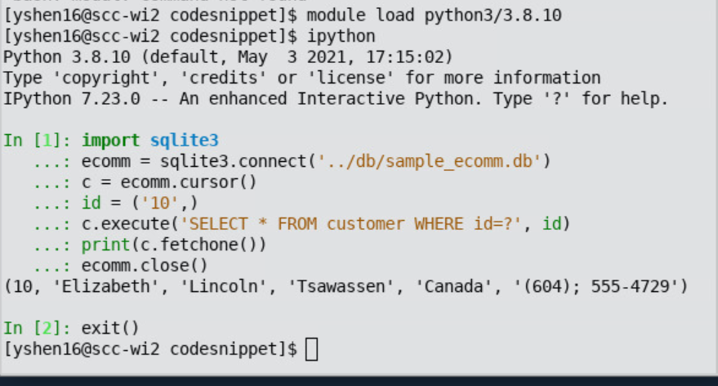
SQLite Programming Interface - Python

Slide 39

SQLite Programming Interface - Python
Just run as normal python script:

Slide 40
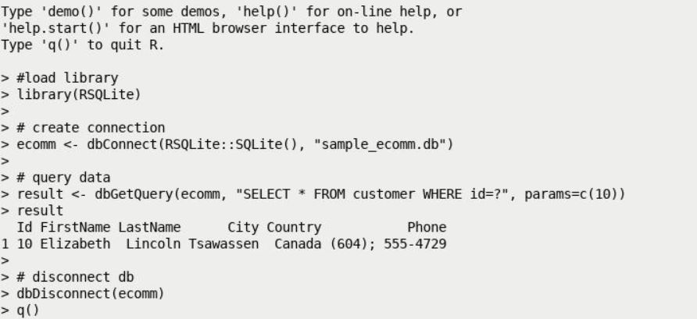
SQLite Programming Interface - R

Slide 41
Point #2: How to Choose Database Tool
1. understand the differences among Database Management Systems (DBMSs)
2. Analyze Data
  a. writing DB/reading DB
  b. frequency
  c. application domain (real time/transactional) ?
3. Budget and Cost
  a. initial cost
  b. maintainence

Slide 42
Useful Resources:
This tutorial materials:
  http://rcs.bu.edu/examples/db/tutorials/intro2SQL/
W3Schools SQL tutorial: https://www.w3schools.com/sql/
Khan Academy:
https://www.khanacademy.org/computing/computer-programming/sql

Slide 43
Thank You !!
Please don’t forget to spend some time to give me some feedback at
http://rcs.bu.edu/eval

