Slide 1
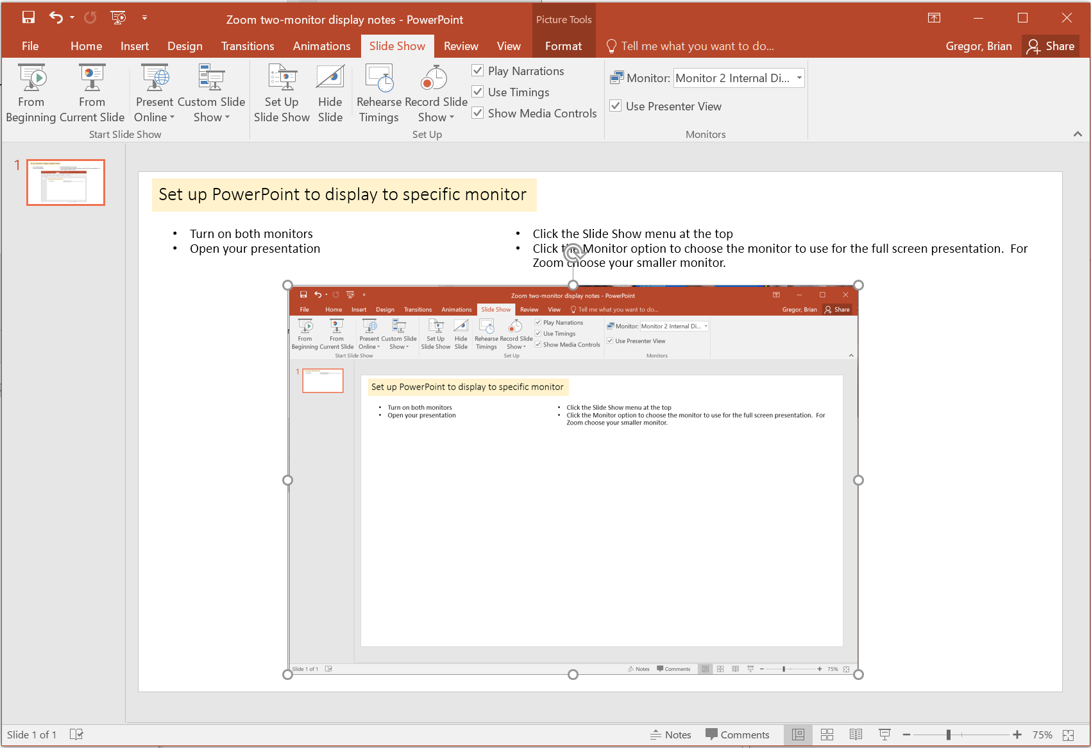
Set up PowerPoint to display to specific monitor
Turn on both monitors
Open your presentation
Click the Slide Show menu at the top
Click the Monitor option to choose the monitor to use for the full screen presentation. For Zoom choose your smaller monitor.

Slide 2
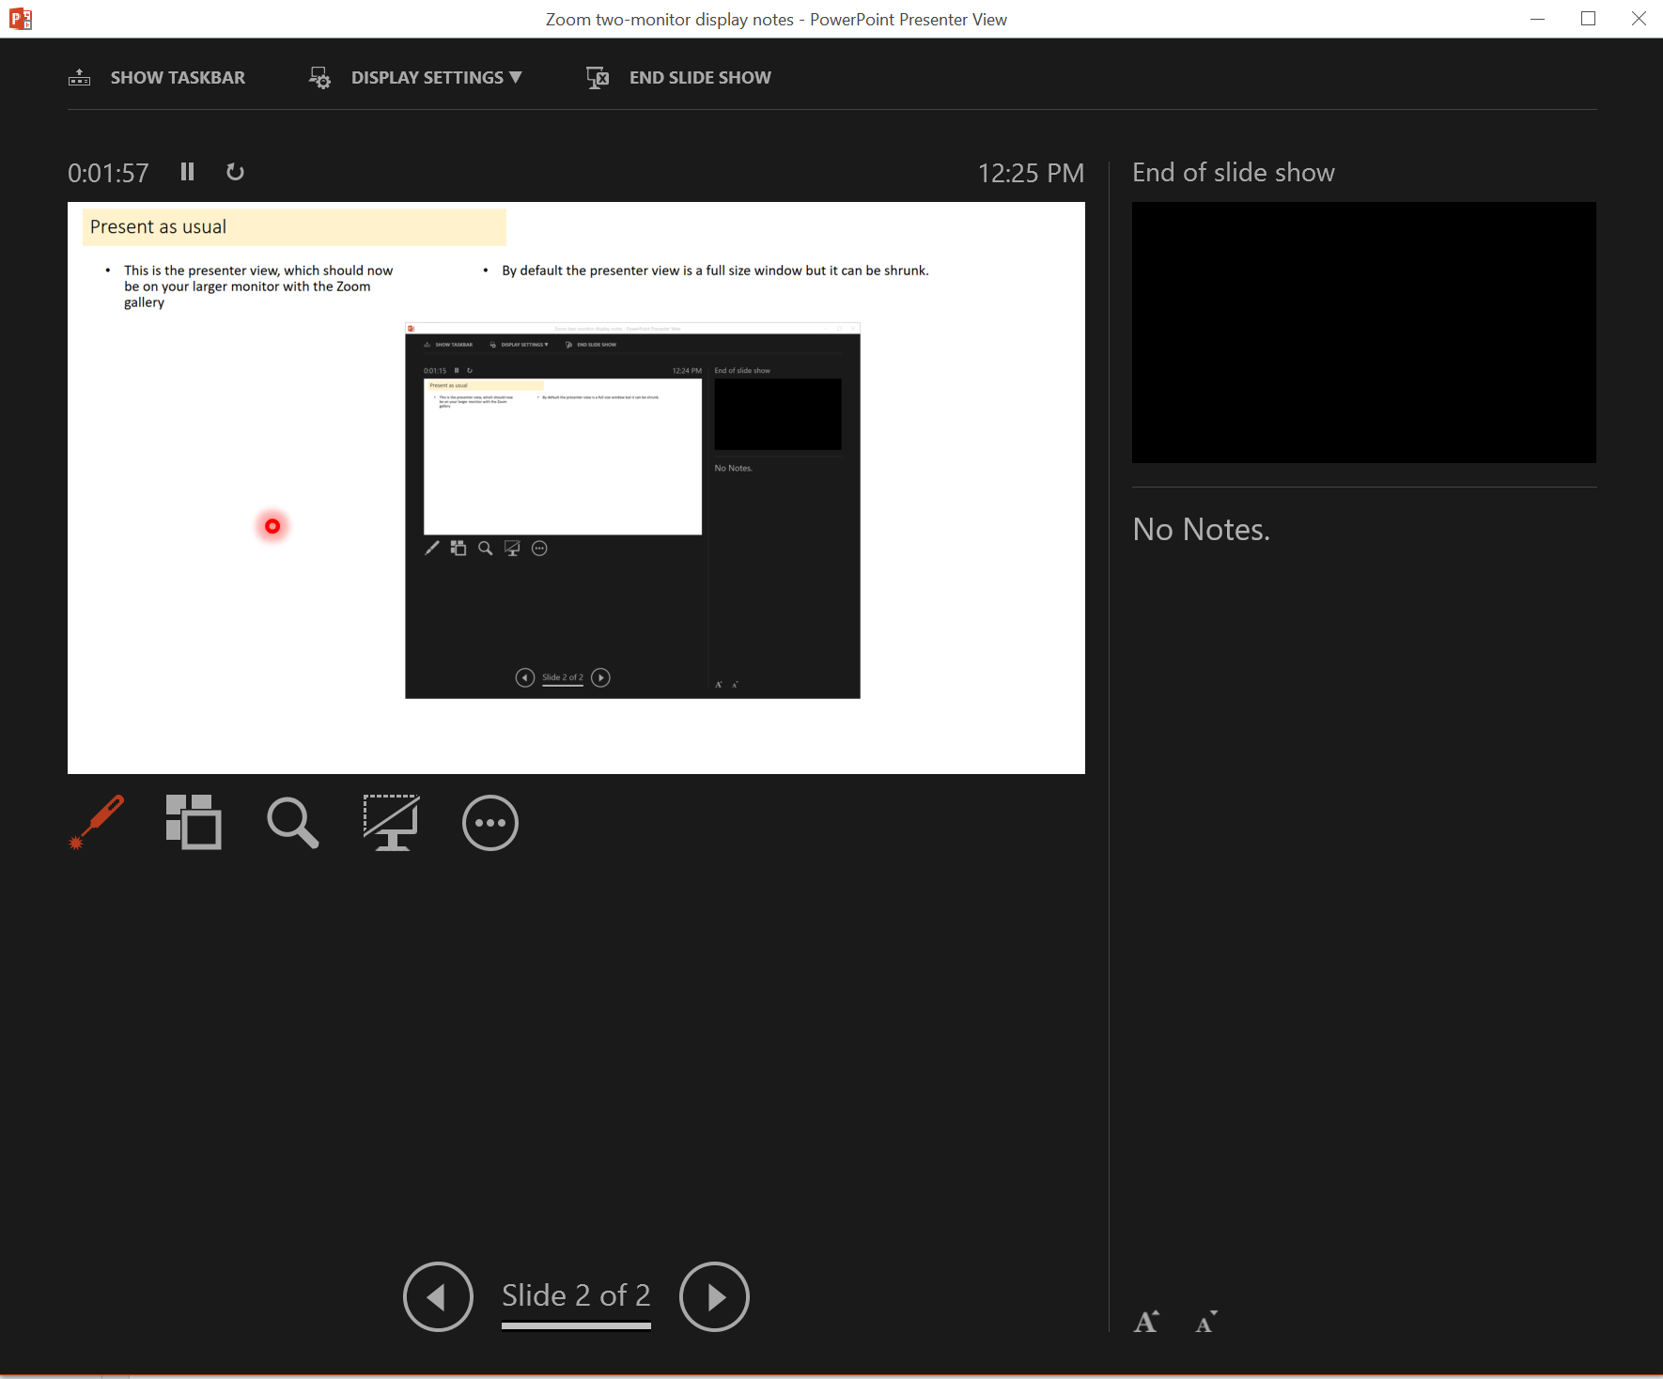
Present as usual
This is the presenter view, which should now be on your larger monitor with the Zoom gallery. Hopefully that is also where your camera is so you’re looking at the camera.
By default the presenter view is a full size window but it can be shrunk.
Share the entire screen showing the slideshow.
laser pointer
The leftmost icon under the slide display lets you select the laser pointer (selected here)
  Other options include adding annotations
This draws the highlighted red circle on the presenter view AND the full screen presentation on the 2nd monitor.
If you’re screen sharing the full screen presentation on the 2nd monitor you can look at your slides in the presenter view, use the pointer there to highlight parts of the slide, and still see the Zoom gallery.

