Slide 1
Introduction to SQL
Research Computing Services
Yun Shen
http://rcs.bu.edu
http://rcs.bu.edu/eval
help@scc.bu.edu

Slide 2
A little bit of about our group and me
Research Computing services, visit http://rcs.bu.edu for more info
Consulting
Training
Visualization
Optimization
Experience:
Database programming
Software development

Slide 3
Tutorial Outlines
What is SQL
SQL History
Terminology By Examples
SQL Syntax By Examples
SQL Category
Small yet worth noting points
Tutorial sample db overview
Schema of the sample db
Data of the sample db
Hands on Tutorial Setup
Notes:
Spend ~25 min to do the slides.

Slide 4
What is SQL ( ‘Structured Query Language’ )?
SQL stands for ‘Structured Query Language’
SQL is domain-specific language, NOT a general programming language
SQL is specialized to handle ‘structured data’ that follows relational model – data that incorporates relations among entities and variables.
Used to interact with relational databases to manage data: create, populate, modify, or destroy data. Also can manage data access

Slide 5
SQL is a standard language
Nevertheless, SQL is a ‘language’. It has its language specification – a set of language elements, rules (grammar) and syntax
Rigid and structural – have both advantages and disadvantages
Since the underlying data model is structural, SQL is very ‘structural’ too - requiring rigid predefined schema as compared with those of ‘noSQL’
Syntax and grammar is also strict
SQL specific features – triggers, stored procedures

Slide 6
History of SQL
First developed in 1970s by two scientists at IBM following a theory of ‘relational algebra’ by Edgar F. Codd, who was also an IBM scientist.
First commercial implementation of SQL-based RDBMS was Oracle’s V2.
First adopted by ANSI in 1986, and ISO in 1987 as standard.
The latest version of the SQL standard is from 2016. There have been very many versions in between.
Though standardized, this does not necessarily mean SQL code can be migrated between different RDBMS seamlessly (Why?)
Notes:
Two scientists’ names: Donald D. Chamberlin and Raymond F. Boyce

Slide 7
Terminology - Structure
Database
Table
Column
Row
Relation
Primary key
Foreign key
Notes:
These terms are very much different from what we mean in our daily communication. They have their specific meaning in the database technology domain.

Slide 8
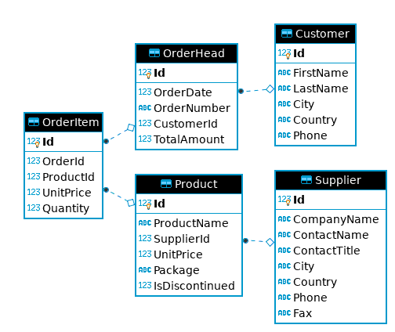
Take sample_ecomm.db as an Example - schema
Notes:
When write SQL, you must be very clear about the underlying table structure. Here is the ERD for sample_ecomm.db. It shows the overall structure and relationships of tables it has.
And sometimes, we also refer it to logical model. Think of it as a ‘blue print’ to the database to be built, very high level thing.
Shall spend some time to mention ‘primary key’, ‘foreign key’, ‘relation’ between two tables

Slide 9
Customer
Notes:
When write SQL, you must be very clear about the underlying table structure. Here is the ERD for sample_ecomm.db. It shows the overall structure and relationships of tables it has.

Slide 10
Terminology - SQL Language Elements
Clause
Statement
Query
Function
Stored Procedure
Predicate
Expression
Keyword
Identifier
Notes:
Clause – phrase
Statement – sentence
Query – question asked
Function /Stored Procedure – freq. made queries and other organic pience put together to accomplish a dedicated task

Slide 11
A SQL Example From Wikipedia Let’s take the following SQL UPDATE statement as an example: UPDATE country SET population=population+1 WHERE name=‘USA’
A chart showing several of the SQL language elements that compose a single statement
(source: https://wikimedia.org/api/rest_v1/media/math/render/svg/b83ad563285f7b0ebb325226d91f25ca0bffa7cd )

Slide 12
A SQL Example From Wikipedia
A chart showing several of the SQL language elements that compose a single statement
(source: https://wikimedia.org/api/rest_v1/media/math/render/svg/b83ad563285f7b0ebb325226d91f25ca0bffa7cd )

Slide 13
Our Own Query Example
SELECT FirstName, LastName -- SELECT clause FROM Customer -- FROM clause WHERE Id=1 – WHERE Clause
Clean way:
SELECT FirstName, LastName FROM Customer WHERE Id=1

Slide 14
Complete Query Statement Syntax – Order Matters !
Clause | Priority | Required? Covered In Tutorial?
SELECT <columns> | 5. | Mandatory ✓
FROM <table> | 1. | Mandatory ✓
WHERE <predicate on rows> | 2. | Optional ✓
GROUP BY <columns> | 3. | Optional ✓
HAVING <predicate on groups> | 4. | Optional, work with GROUP BY
ORDER BY <columns> | 6. | Optional ✓
OFFSET | 7. | Optional
FETCH FIRST | 8. | Optional
Notes:
This is a simplified general syntax for SELECT query statement
1st column is the clause allowed
2nd column shows the priority order when the query is executed
3rd column indicates if the clause is optional or mandatory
4th column check mark means it will be covered in this tutorial

Slide 15
SQL Category
1. Data Query Language (DQL) - used to query data
2. Data Manipulation Language (DML) – used to create/modify/destroy data
3. Data Definition Language (DDL) – used to define database schema
4. Data Control Language (DCL) – used for security and access control
Notes:
DQL: ‘read only’, the underlying data would not be affected.
DML: ‘write permission’, the underlying data can be either created, destroyed or modified.
DDL: ‘definition/declare’, this is where schema and other overall structure design take place
DCL: ‘access control’, for security and access permission (user authentication and data scope)

Slide 16
Most Important SQL Statements
SELECT - extracts data from a database (DQL)
UPDATE - updates data in a database (DML)
DELETE - deletes data from a database (DML)
INSERT - inserts new data into a database (DML)
CREATE DATABASE - creates a new database (DDL)
CREATE TABLE - creates a new table (DDL)
DROP TABLE - deletes a table (DDL)

Slide 17
Attention Please !
1. SQL keywords and table/column names are NOT case sensitive: ‘select’ and ‘SELECT’ are the same
2. values stored in a table can be case-sensitive – depending on configuration
3. Usually single quotes (‘’) or double quotes (“”) don’t matter, but could be configured otherwise
4. Semicolon ‘;’ is the standard way to separate SQL statements. It can be required in some DBMS. So always end each statement with a ‘;’ even after a single statement
5. Comments can be used to make SQL more readable. Usually ‘--’ for single line comment, and ‘/*’ and ’*/’ for multiline comments. Add ‘--’ at the beginning to indicate a comment line
6. Use alias to make query clear to understand. “AS” keyword can be omitted sometimes.

Slide 18
Standard is NOT STANDARD!!
Standard is NOT STANDARD – none of SQL standard is fully implemented by all vendors. Pay attention to the differences that each vendor’s implementation has from the SQL ‘standard’

Slide 19
In this Tutorial
We will use upper-case only in all keywords
We will use double quotes “” to indicate strings
We will end each SQL statement with a ‘;’

Slide 20
Keywords Used in this Tutorial
INNER JOIN
SELECT
*
FROM
ORDER BY
ASC
DESC
AND
OR
NOT
WHERE
LIMIT
DISTINCT
AS
GROUP BY
ON
!=
INSERT
UPDATE
DELETE
CREATE
TABLE
LIKE
%
INTO
VALUES
DROP
NULL
Notes:
SQLite3 has 147 keywords defined (https://www.sqlite.org/lang_keywords.html)
It’s said there are over 800 reserved SQL keywords in the SQL standard (https://www.drupal.org/docs/develop/coding-standards/list-of-sql-reserved-words), Microsoft SQL Server doc may run up to 26k page.

Slide 21
Functions Used in this Tutorial
Aggregation Function:
COUNT()
MIN()
MAX()
AVG()
SUM()
String Function:
REPLACE()

Slide 22
Hands On Demo
Basic | SELECT + WHERE
Aggregation | SELECT + GROUP BY
JOIN | SELECT + JOIN
WRITE Queries | INSERT/UPDATE/DELETE
Read Only

Slide 23
Tutorial Tools and Files Overview
DB GUI : DB Browser for SQLite
sufficient yet simple/clean interface for demo purpose
SQLite engine is already embedded in this tool
Sample DB: sample_ecomm.db
- a simple example e-commerce db. We will explore it a bit more …
Notes:
SQLite is a serverless, in-memory db engine. It doesn’t have its GUI by itself (it does have a simple command line tool, though). Many other companies step up to fill the blank. DBBrowser for SQLite is one of them.
Almost all major database engines provide programming APIs for application developers to get access to database through programming interfaces.

Slide 24
sample_ecomm.db E-R Diagram
Notes:
When write SQL, you must be very clear about the underlying table structure. Here is the ERD for sample_ecomm.db. It shows the overall structure and relationships of tables it has.

Slide 25
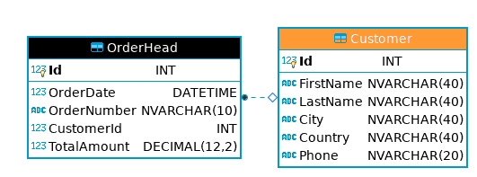
Look Into Individual Table – Customer

Slide 26
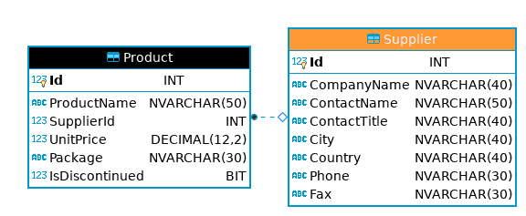
Look Into Individual Table – Supplier

Slide 27
Look Into Individual Table – Product

Slide 28
Look Into Individual Table – OrderHead

Slide 29
Look Into Individual Table – OrderItem

Slide 30
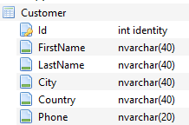
Customer - data view and schema view
Notes:
When write SQL, you must be very clear about the underlying table structure. Here is the ERD for sample_ecomm.db. It shows the overall structure and relationships of tables it has.

Slide 31
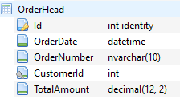
OrderHead - data view and schema view
Notes:
When write SQL, you must be very clear about the underlying table structure. Here is the ERD for sample_ecomm.db. It shows the overall structure and relationships of tables it has.

Slide 32
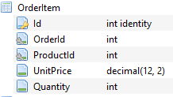
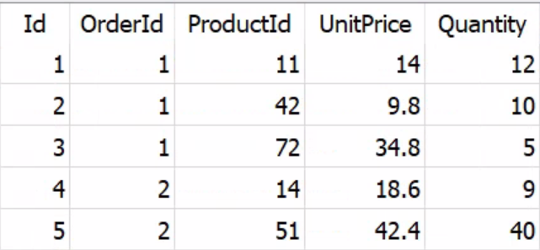
OrderItem - data view and schema view
Notes:
When write SQL, you must be very clear about the underlying table structure. Here is the ERD for sample_ecomm.db. It shows the overall structure and relationships of tables it has.

Slide 33
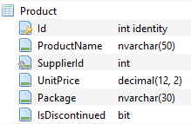
Product - data view and schema view
Notes:
When write SQL, you must be very clear about the underlying table structure. Here is the ERD for sample_ecomm.db. It shows the overall structure and relationships of tables it has.

Slide 34
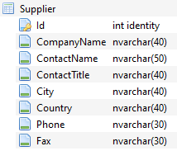
Supplier - data view and schema view
Notes:
When write SQL, you must be very clear about the underlying table structure. Here is the ERD for sample_ecomm.db. It shows the overall structure and relationships of tables it has.

Slide 35
Tutorial Setup
All the tutorial files can be accessed from:
http://rcs.bu.edu/examples/db/tutorials/intro_to_SQL/
You can download all the tutorial materials as one single package, then unzip it:
http://rcs.bu.edu/examples/db/tutorials/intro_to_SQL/intro_to_SQL.zip
This presentation: presentation/intro2SQL.pdf
DB Browser software tool: tutfiles/software/
Tutorial Sample DB: tutfiles/db/sample_ecomm.db
Demo SQL script: tutfiles/sql/ecomm_demo.sql
Python code snipet: codesnippet/sample_ecomm_python.py
R code snipet: codesnippet/sample_ecomm_Rexample.R

Slide 36
Some Extra Info
The following pages are some extra information you may be interested in

Slide 37
Point #1: GUI tool is not the only way!
A GUI tool like DB Browser is not the only way to access databases!
There could be many other ways! The following are the two ways:
Notes:
SQLite is a serverless, in-memory db engine. It doesn’t have its GUI by itself. Many other companies step up to fill the blank. DBBrowser is one of them.
Almost all major database engines provide programming APIs for application developers to get access to database through programming interfaces.

Slide 38
SQLite Programming Interface - Python

Slide 39
SQLite Programming Interface - Python
Just run as normal python script:

Slide 40
SQLite Programming Interface - R

Slide 41
Point #2: How to Choose Database Tool
1. understand the differences among Database Management Systems (DBMSs)
2. Analyze Data
a. writing DB/reading DB
b. frequency
c. application domain (real time/transactional) ?
3. Budget and Cost
a. initial cost
b. maintainence

Slide 42
Useful Resources:
This tutorial materials:
http://rcs.bu.edu/examples/db/tutorials/intro2SQL/
W3Schools SQL tutorial: https://www.w3schools.com/sql/
Online cheat sheets:
https://www.sqltutorial.org/sql-cheat-sheet/
https://intellipaat.com/mediaFiles/2019/02/SQL-Commands-Cheat-Sheet.pdf
How to use DB Browser:
https://datacarpentry.org/sql-socialsci/02-db-browser/index.html

Slide 43
Thank You !!
Please don’t forget to spend some time to give me some feedback at
http://rcs.bu.edu/eval

