Slide 1
Introduction to C++: Part 4

Slide 2
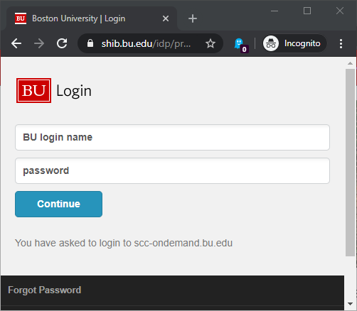
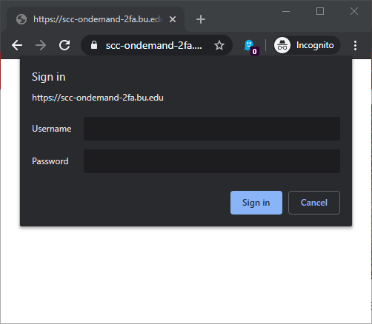
Existing SCC Account
Open a web browser
Navigate to http://scc-ondemand.bu.edu
Log in with your BU Kerberos Credentials
Temporary Tutorial Account
Open a web browser
Navigate to http://scc-ondemand-tutorial.bu.edu
Log in with Tutorial Account

Slide 3
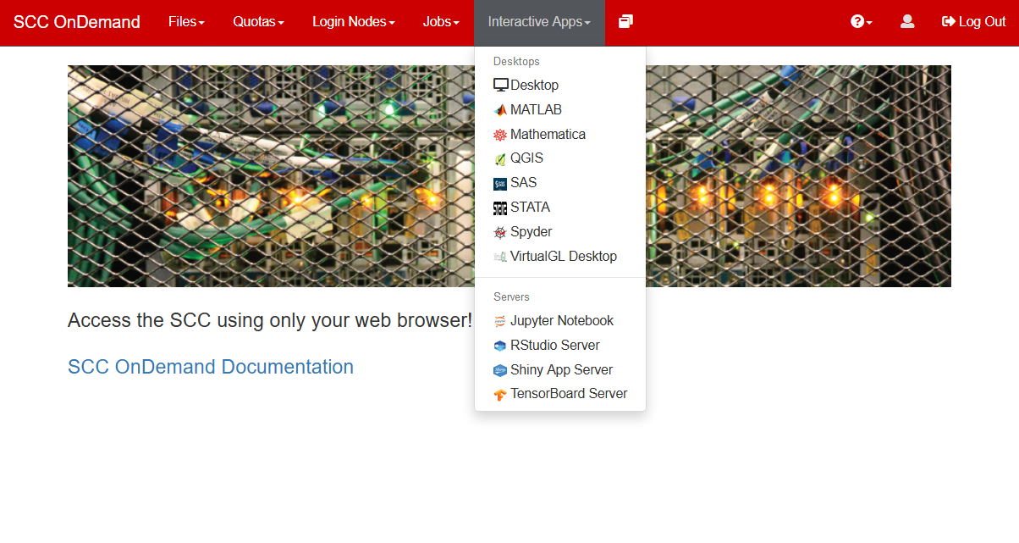
Click on Interactive Apps/Desktop

Slide 4
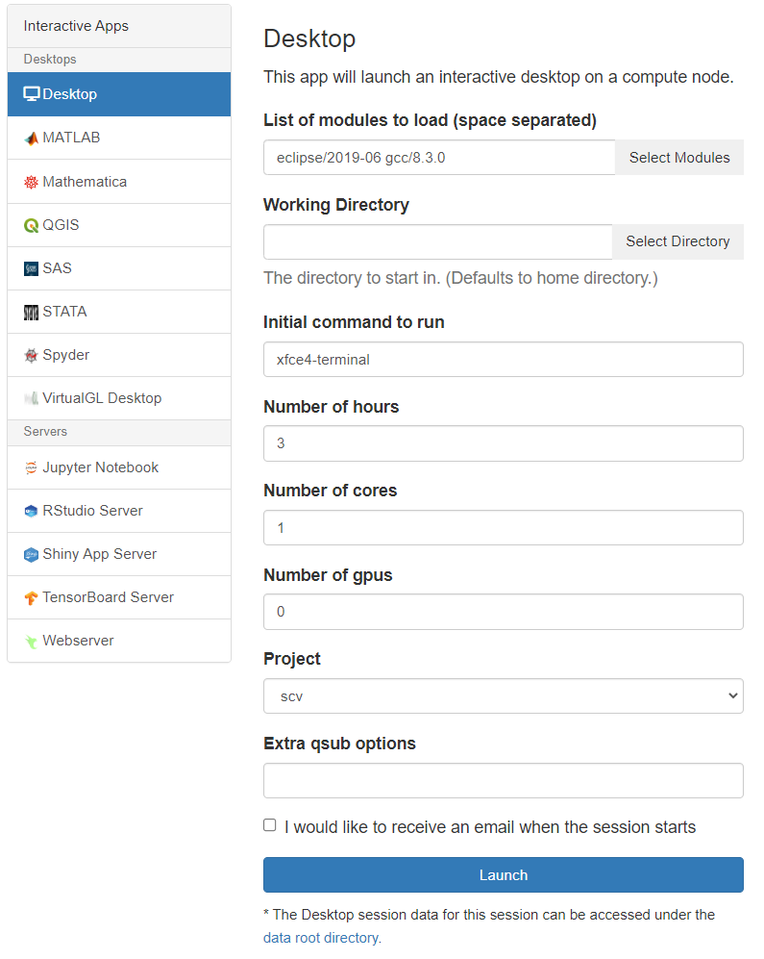
eclipse/2019-06
gcc/8.3.0
3
click

Slide 5
When your desktop is ready click Connect to Desktop

Slide 6
Enter this command to create a directory in your home folder and to copy in tutorial files:
/net/scc2/scratch/intro_to_cpp4.sh
or
Download Part4.zip:
http://rcs.bu.edu/examples/cpp/tutorial/

Slide 7
C++ Libraries
There are a LOT of libraries available for C++ code.
Sourceforge alone has > 9400
Before jumping into writing your code, consider what you need and see if there are libraries available.
Many libraries contain code developed by professionals or experts in a particular field.
Consider what you are trying to accomplish in your research:
A) accomplishments in your field or
B) C++ programming?

Slide 8
C++ Compilers on the SCC
Module name | Vendor | Compiler | Versions
gnu | GNU | g++ | 4.8.5 - 11.2.0
intel | Intel | icpc | 2016 - 2021.1
pgi | Portland Group / Nvidia | pgc++ | 16.5 - 19.4
llvm | LLVM | clang++ | 3.9 .1- 12.0.1
There are 4 families of compilers on the SCC for C++.
To see versions use the module avail command, e.g. module avail gnu
They have their strengths and weaknesses.
For info on how to choose compiler optimizations for the SCC see the RCS website:
http://www.bu.edu/tech/support/research/software-and-programming/programming/compilers/compiler-optimizations/

Slide 9
C++ Standard by Compiler
Support for C++ standards in g++
Intel icpc: On Linux, g++ header files are used by the Intel icpc compiler, so icpc will support the standards used by the available g++.
Support in Microsoft Visual C++ compiler
Support in clang++
(as used on Mac OSX

Slide 10
Multithreading
OpenMP
Open MP is a standard approach to writing multithreaded code to exploit multiple CPU cores with your program.
Fully supported in C++
Intel Thread Building Blocks
C++ specific library
Available on the SCC from Intel and is also open source. (in the intel modules)
Much more flexible and much more C++-ish than OpenMP
Offers high performance memory allocators for multithreaded code
Includes concurrent data types (vectors, etc.) that can automatically be shared amongst threads with no added effort for the programmer to control access to them.
Data Parallel C++
Dialect of C++ with extensive multi-threading built in.

Slide 11
Math and Linear Algebra
Eigen
http://eigen.tuxfamily.org/index.php?title=Main_Page
“Eigen is a C++ template library for linear algebra: matrices, vectors, numerical solvers, and related algorithms.”
Armadillo
http://arma.sourceforge.net/
“Armadillo is a high quality linear algebra library (matrix maths) for the C++ language, aiming towards a good balance between speed and ease of use. Provides high-level syntax (API) deliberately similar to Matlab.”
OpenCV
A computer vision and image processing library, with excellent high-performance support for linear algebra, many algorithms, and GPU acceleration.
Ceres
non-linear optimization
LAPACK++
C++ wrapper for the BLAS and LAPACK libraries
dlib
Machine learning and data analysis

Slide 12
Other useful libraries
Parsers
CLI11 - https://github.com/CLIUtils/CLI11
Command line arguments. Header-only library, C++11 standard required
json - https://github.com/nlohmann/json
JSON format reading/writing. Header-only library.
Physical units (enforced at compile time!):
mp-units - https://github.com/mpusz/units
In consideration to be included in the C++23/26 standard.
Needs C++20 to compile and use
units - https://github.com/nholthaus/units
Header-only library, requires C++14
The doomed Mars Observer spacecraft.
Random Numbers
C++11 standard RNGs
PCG library
Faster number generation, works with C++11 RNG containers

Slide 13
Using subclasses
A function that takes a superclass argument can also be called with a subclass as the argument.
The reverse is not true – a function expecting a subclass argument cannot accept its superclass.
Copy the code to the right and add it to your main.cpp file.
void PrintArea(Rectangle &rT) {
cout << rT.Area() << endl ;
}
int main() {
Rectangle rT(1.0,2.0) ;
Square sQ(3.0) ;
PrintArea(rT) ;
PrintArea(sQ) ;
}
The PrintArea function can accept the Square object sQ because Square is a subclass of Rectangle.

Slide 14
Overriding Methods
class Super {
public:
void PrintNum() {
cout << 1 << endl ;
}
} ;
class Sub : public Super {
public:
// Override
void PrintNum() {
cout << 2 << endl ;
}
} ;
Super sP ;
sP.PrintNum() ; // Prints 1
Sub sB ;
sB.PrintNum() ; // Prints 2
Sometimes a subclass needs to have the same interface to a method as a superclass but with different functionality.
This is achieved by overriding a method.
Overriding a method is simple: just re-implement the method with the same name and arguments in the subclass.

Slide 15
Overriding Methods
Seems simple, right?
class Super {
public:
void PrintNum() {
cout << 1 << endl ;
}
} ;
class Sub : public Super {
public:
// Override
void PrintNum() {
cout << 2 << endl ;
}
} ;
Super sP ;
sP.PrintNum() ; // Prints 1
Sub sB ;
sB.PrintNum() ; // Prints 2

Slide 16
How about in a function call…
class Super {
public:
void PrintNum() {
cout << 1 << endl ;
}
} ;
class Sub : public Super {
public:
// Override
void PrintNum() {
cout << 2 << endl ;
}
} ;
Using a single function to operate on different types is polymorphism.
Given the class definitions, what is happening in this function call?
void FuncRef(Super &sP) {
sP.PrintNum() ;
}
Super sP ;
Func(sP) ; // Prints 1
Sub sB ;
Func(sB) ; // Hey!! Prints 1!!
“C++ is an insult to the human brain”
– Niklaus Wirth (designer of Pascal)

Slide 17
Type casting
void FuncRef(Super &sP) {
sP.PrintNum() ;
}
The Func function passes the argument as a reference (Super &sP).
What’s happening here is dynamic type casting, the process of converting from one type to another at runtime.
Same mechanism as the dynamic_cast<type>() function
The incoming object is treated as though it were a superclass object in the function.
When methods are overridden and called there are two points where the proper version of the method can be identified: either at compile time or at runtime.

Slide 18
Virtual methods
class SuperVirtual
{
public:
virtual void PrintNum()
{
cout << 1 << endl ;
}
} ;
class SubVirtual : public SuperVirtual
{
public:
// Override
virtual void PrintNum()
{
cout << 2 << endl ;
}
} ;
void Func(SuperVirtual &sP)
{
sP.PrintNum() ;
}
SuperVirtual sP ;
Func(sP) ; // Prints 1
SubVirtual sB ;
Func(sB) ; // Prints 2!!
When a method is labeled as virtual and overridden the compiler will generate code that will check the type of an object at runtime when the method is called.
The type check will then result in the expected version of the method being called.
When overriding a virtual method in a subclass, it’s a good idea to label the method as virtual in the subclass as well.
…just in case this gets subclassed again!

Slide 19
Early (static) vs. Late (dynamic) binding
Leaving out the virtual keyword on a method that is overridden results in the compiler deciding at compile time which version (subclass or superclass) of the method to call.
This is called early or static binding.
At compile time, a function that takes a superclass argument will only call the non-virtual superclass method under early binding.
Making a method virtual adds code behind the scenes (that you, the programmer, never interact with directly)
Lookups in a hidden table, called the vtable, are done to figure out what version of the virtual method should be run.
This is called late or dynamic binding.
There is a small performance penalty for late binding due to the vtable lookup.
This only applies when an object is referred to by a reference or pointer.

Slide 20
Behind the scenes – vptr and vtable
Func(SuperVirtual &sP)
C++ classes have a hidden pointer (vptr) generated that points to a table of virtual methods associated with a class (vtable).
When a virtual class method (base class or its subclasses) is called by reference ( or pointer) when the program is running the following happens:
The object’s class vptr is followed to its class vtable
The virtual method is looked up in the vtable and is then called.
One vptr and one vtable per class so minimal memory overhead
If a method override is non-virtual it won’t be in the vtable and it is selected at compile time.
sP is a reference to a…
SuperVirtual
SubVirtual
SuperVirtual’s vptr
SubVirtual’s vptr
Vtable
& SuperVirtual::PrintNum()
Vtable
& SubVirtual::PrintNum()

Slide 21
Let’s run this through the debugger
Open the project Virtual_Method_Calls.
Everything here is implemented in one big main.cpp
Place a breakpoint at the first line in main() and in the two implementations of Func()

Slide 22
When to make methods virtual
If a method will be (or might be) overridden in a subclass, make it virtual
There is a minuscule performance penalty. Will that even matter to you?
i.e. Have you profiled and tested your code to show that virtual method calls are a performance issue?
When is this true?
Almost always! Who knows how your code will be used in the future?
Constructors are never virtual in C++.
Destructors in a base class should always be virtual.
Also – if any method in a class is virtual, make the destructor virtual
These are important when dealing with objects via reference and it avoids some subtleties when manually allocating memory.

Slide 23
Why all this complexity?
void FuncEarly(SuperVirtual &sP)
{
sP.PrintNum() ;
}
void FuncLate(SuperVirtual sP)
{
sP.PrintNum() ;
}
Called by reference – late binding to PrintNum()
Called by value – early binding to PrintNum even though it’s virtual!
Late binding allows for code libraries to be updated for new functionality. As methods are identified at runtime the executable does not need to be updated.
This is done all the time! Your C++ code may be, for example, a plugin to an existing simulation code.
Greater flexibility when dealing with multiple subclasses of a superclass.
Most of the time this is the behavior you are looking for when building class hierarchies.

Slide 24
Shape
virtual float print_info(){}
Remember the Deadly Diamond of Death? Let’s explain.
Look at the class hierarchy on the right.
Square and Circle inherit from Shape
Squircle inherits from both Square and Circle
Syntax:
class Squircle : public Square, Circle
The Shape class implements an empty print_info() method. The Square and Circle classes override it. Squircle does not.
Under late binding, which version of print_info() is accessed from Squircle? Square. info() or Circle. info()?
Square
virtual float print_info() {…}
Circle
virtual float print_info() {…}
Squircle
Squircle is not a made-up word.

Slide 25
Interfaces
Log
Shape
Interfaces are a way to have your classes share method names without them sharing actual code.
…and hopefully methods with the same name are implemented to do the same thing, that’s up to you!
Gives much of the benefit of multiple inheritance without the complexity and pitfalls
Square
Circle
Example: for debugging you want each class to have a Log() method that writes some info to a file.
Implement with an interface.

Slide 26
Interfaces
#ifndef SQUARE_H
#define SQUARE_H
#include "rectangle.h"
class Log {
virtual void LogInfo()=0 ;
};
class Square : public Rectangle, Log
{
public:
Square(float length);
virtual ~Square();
// virtual void LogInfo() {}
protected:
private:
};
#endif // SQUARE_H
An interface class in C++ is called a pure virtual class.
It contains virtual methods only with a special syntax. Instead of {} the function is set to 0.
Any subclass must implement pure virtual methods!
Modified Square.h shown.
What happens when this is compiled?
Once the LogInfo() is uncommented it will compile.
(…error…)
include/square.h:10:7: note: because the following virtual functions are pure within 'Square':
class Square : public Rectangle, Log
^
include/square.h:7:18: note: virtual void Log::LogInfo()
virtual void LogInfo()=0 ;

Slide 27
Putting it all together
Shape
Now let’s revisit our Shapes project.
Open the “Shapes with Circle” project.
This has a Shape base class with a Rectangle and a Square
Add a Circle class to the class hierarchy in a sensible fashion.
???
Rectangle
Circle
Square
Hint: Think first, code second.

Slide 28
New pure virtual Shape class
Slight bit of trickery:
An empty constructor is defined in shape.h
No need to have an extra shape.cpp file if these functions do nothing!
Q: How much code can be in the header file?
A: Most of it with some exceptions.
.h files are not compiled into .o files so a header with a lot of code gets re-compiled every time it’s referenced in a source file.
In other words, avoid putting source code in .h files.
#ifndef SHAPE_H
#define SHAPE_H
class Shape
{
public:
Shape() {}
virtual ~Shape() {}
virtual float Area()=0 ;
protected:
private:
};
#endif // SHAPE_H

Slide 29
Give it a try
Add inheritance from Shape to the Rectangle class
Add a Circle class, inheriting from wherever you like.
Implement Area() for the Circle
If you just want to see a solution, open the project “Shapes with Circle solved”

Slide 30
A Potential Solution
Shape
A Circle has one dimension (radius), like a Square.
Would only need to override the Area() method
But…
Would be storing the radius in the members m_width and m_length. This is not a very obvious to someone else who reads your code.
Maybe:
Change m_width and m_length names to m_dim_1 and m_dim_2?
Just makes everything more muddled!
Rectangle
Square
Circle

Slide 31
A Better Solution
Shape
Inherit separately from the Shape base class
Seems logical, to most people a circle is not a specialized form of rectangle…
Add a member m_radius to store the radius.
Implement the Area() method
Makes more sense!
Easy to extend to add an Oval class, etc.
Rectangle
Circle
Square

Slide 32
New Circle class
#ifndef CIRCLE_H
#define CIRCLE_H
#include "shape.h"
class Circle : public Shape
{
public:
Circle();
Circle(float radius) ;
virtual ~Circle();
virtual float Area() ;
const float PI = 3.14;
float m_radius ;
protected:
private:
};
#endif // CIRCLE_H
Also inherits from Shape
Adds a constant value for π
Constant values can be defined right in the header file.
If you accidentally try to change the value of PI the compiler will throw an error.

Slide 33
#include "circle.h"
Circle::Circle()
{
//ctor
}
Circle::~Circle()
{
//dtor
}
// Use a member initialization list.
Circle::Circle(float radius) : m_radius{radius} {}
float Circle::Area()
{
// Quiz: what happens if this line is
// uncommented and then compiled:
//PI=3.14159 ;
return m_radius * m_radius * PI ;
}
circle.cpp
Questions?

Slide 34
Quiz time!
void PrintArea(Shape &shape) {
cout << "Area: " << shape.Area() << endl ;
}
int main()
{
Square sQ(4) ;
Circle circ(3.5) ;
Rectangle rT(21,2) ;
// Print everything
PrintArea(sQ) ;
PrintArea(rT) ;
PrintArea(circ) ;
return 0;
}
What happens behind the scenes when the function PrintArea is called?
How about if PrintArea’s argument was instead:
void PrintArea(Shape shape)

Slide 35
Quick mention…
Aside from overriding functions it is also possible to override operators in C++.
As seen in the C++ string. The + operator concatenates strings:
It’s possible to override +,-,=,<,>, brackets, parentheses, etc.
Syntax:
Recommendation:
Use with great caution. This is an easy way to write very confusing code.
A well-named function will almost always be easier to understand than an operator.
An exceptions is the assignment operator: operator=
MyClass operator*(const MyClass& mC) {...}
string str = "ABC" ;
str = str + "DEF" ;
// str is now "ABCDEF"

Slide 36
Summary
C++ classes can be created in hierarchies via inheritance, a core concept in OOP.
Classes that inherit from others can make use of the superclass’ public and protected members and methods
You write less code!
Virtual methods should be used whenever methods will be overridden in subclasses.
Avoid multiple inheritance, use interfaces instead.
Subclasses can override a superclass method for their own purposes and can still explicitly call the superclass method.
Abstraction means hiding details when they don’t need to be accessed by external code.
Reduces the chances for bugs.
While there is a lot of complexity here – in terms of concepts, syntax, and application – keep in mind that OOP is a highly successful way of building programs!

Slide 37
Some OOP Guidelines
Here are some guidelines for putting together a program using OOP to keep in mind while getting up and running with C++.
Keep your classes simple and single purpose.
Logically organize your classes to re-use code via inheritance.
Use interfaces in place of multiple inheritance
Keep your methods short
Many descriptive methods that do little things is easier to debug and understand.
Follow the KISS principle:
“Keep it simple stupid”
“Keep it simple, silly”
“Keep it short and sweet”
“Make Simple Tasks Simple!” – Bjarne Stroustroup
“Make everything as simple as possible, but not simpler” – Albert Einstein

Slide 38
Putting your classes together
Effective use of OOP demands that the programmer think/plan/design first and code second.
There is a large body of information on this topic:
As this is an academic institution your code may:
Live on in your lab long after you have graduated
Be worked on by multiple researchers
Adapted to new problems you haven’t considered
Be shared with collaborators
For more structured environments (ex. a team of professional programmers) there exist concepts like SOLID:
https://en.wikipedia.org/wiki/SOLID_(object-oriented_design)
…and there are many others.

Slide 39
Keep your classes simple
Avoid “monster” classes that implement everything including the kitchen sink.
Our Rectangle class just holds dimensions and calculates its area.
It cannot print out its area, send email, draw to the screen, etc.
Single responsibility principle:
Every class has responsibility for one piece of functionality in the program.
https://en.wikipedia.org/wiki/Single_responsibility_principle
Example:
An Image class holds image data and can read and write it from disk.
A second class, ImageFilter, has methods that manipulate Image objects and return new ones.
Resource Allocation Is Initialization (RAII):
A late 80’s concept, widely used in OOP.
https://en.wikipedia.org/wiki/Resource_acquisition_is_initialization
ALL Resources in a class are created in the constructor and released in the destructor.
Example: opening files, allocating memory, etc.
If an object is created it is ready to use.

Slide 40
Further learning
When looking for C++ tutorials and guides, look for ones that use at least the C++11 standard.
This is “modern C++”
Some tutorials:
https://cplusplus.com/doc/tutorial/
https://www.w3schools.com/CPP/default.asp
Books:
Effective Modern C++
The C++ Programming Language

