Slide 1
Introduction to C++: Part 3

Slide 2
Tutorial Outline: Part 3
Defining Classes
Class inheritance
Public, private, and protected access
Virtual functions

Slide 3
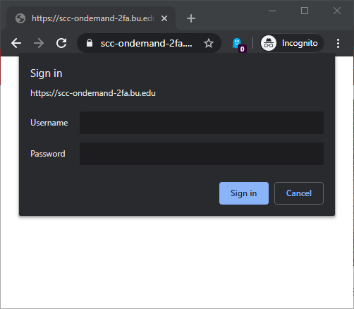
Existing SCC Account
Open a web browser
Navigate to http://scc-ondemand.bu.edu
Log in with your BU Kerberos Credentials
Temporary Tutorial Account
Open a web browser
Navigate to http://scc-ondemand-2fa.bu.edu
Log in with Tutorial Account

Slide 4
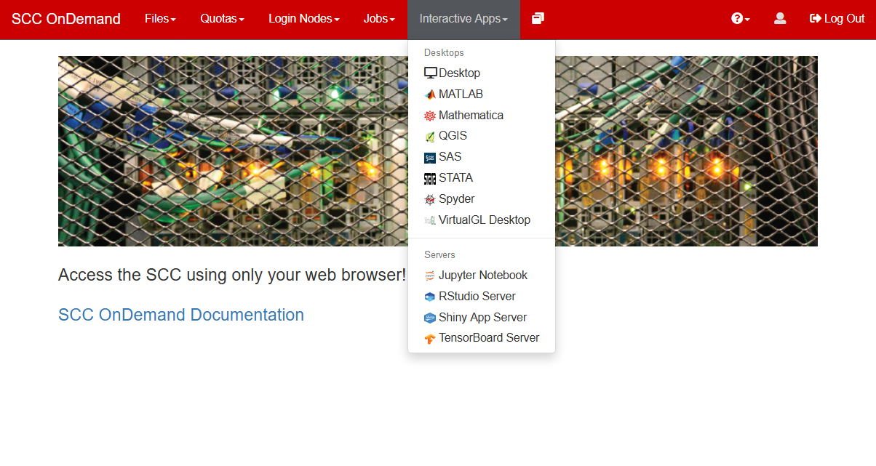
Click on Interactive Apps/Desktop

Slide 5
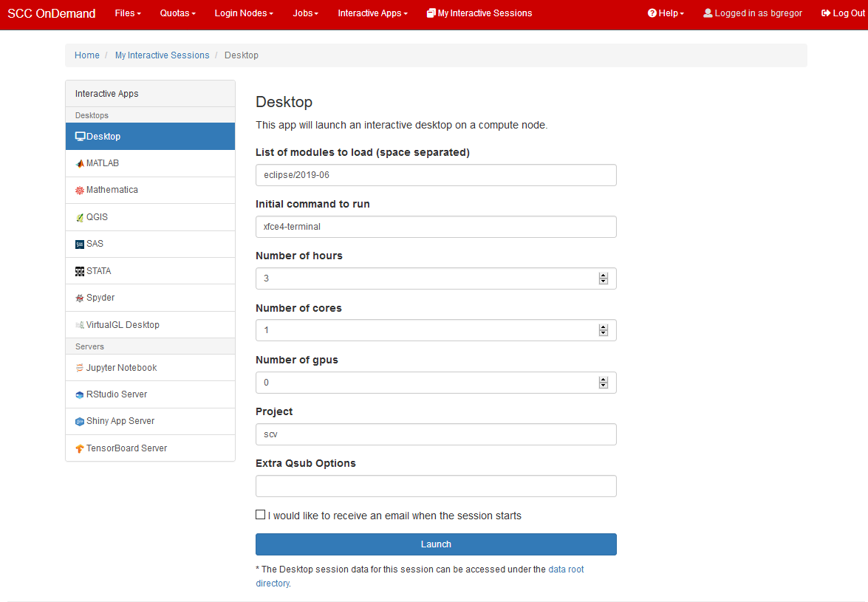
eclipse/2019-06
3
click

Slide 6
When your desktop is ready click Connect to Desktop

Slide 7
Enter this command to create a directory in your home folder and to copy in tutorial files:
Also get the tutorial slides here:
/net/scc2/scratch/intro_to_cpp_3.sh
http://rcs.bu.edu/examples/cpp/tutorial/

Slide 8
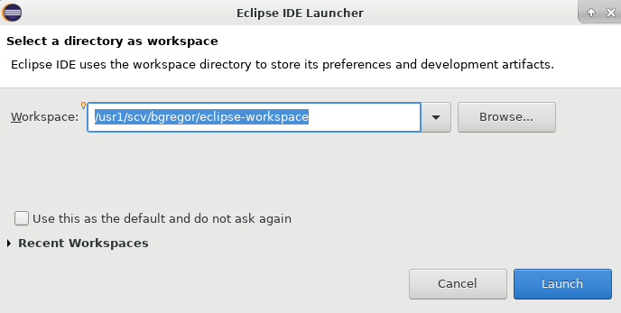
Run the Eclipse software
Enter this command to start up the Eclipse development environment.
When this window appears just click the Launch button:
eclipse &

Slide 9
A first C++ class
Open project Basic_Rectangle.
We’ll add our own custom class to this project.
A C++ class consists of 2 files: a header file (.h) and a source file (.cpp)
The header file contains the definitions for the types and names of members, methods, and how the class relates to other classes (if it does).
The source file contains the code that implements the functionality of the class
Sometimes there is a header file for a class but no source file.

Slide 10
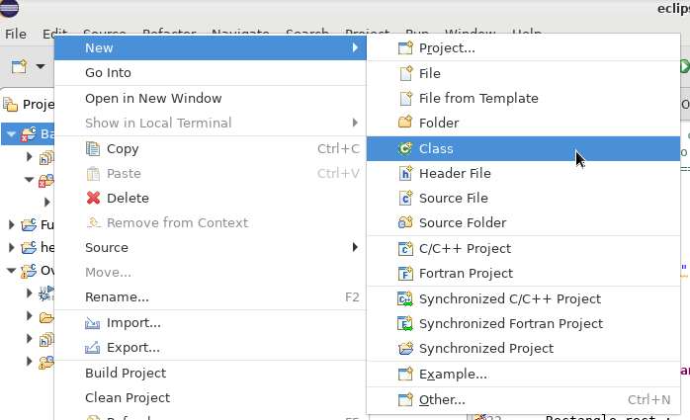
Using Eclipse
An IDE is very useful for setting up code that follows patterns and configuring the build system to compile them.
This saves time and effort for the programmer.
Right-click on the Basic_Rectangle project and choose New→Class

Slide 11
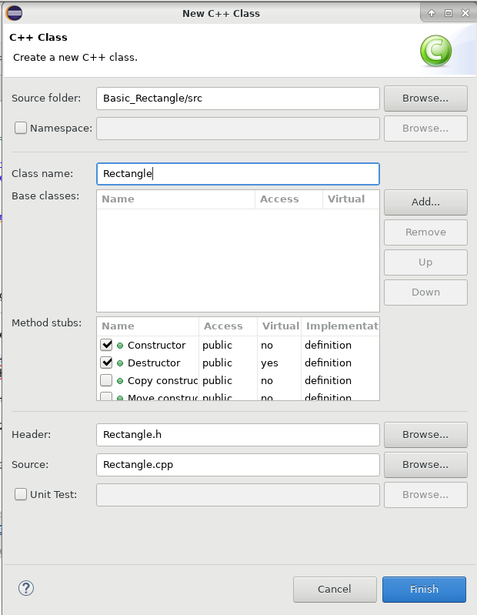
Give it the name Rectangle and click the Finish button.
Open the new files Rectangle.h and Rectangle.cpp

Slide 12
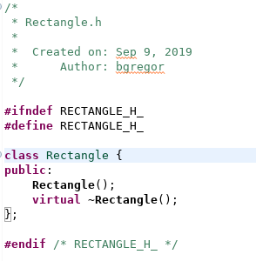
Rectangle.h
Class name
keyword
Curly brace
Access control
Curly brace and a semi-colon.

Slide 13
Default declared methods
Rectangle();
A constructor. Called when an object of this class is created.
~Rectangle();
A destructor. Called when an object of this class is removed from memory, i.e. destroyed.
Ignore the virtual keyword for now.

Slide 14
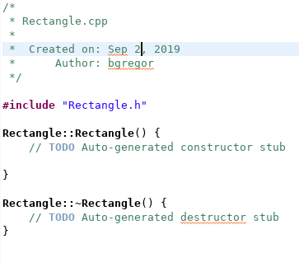
Rectangle.cpp
Header file included
Class_name:: pattern indicates the method declared in the header is being implemented in code here.
Methods are otherwise regular functions with arguments () and matched curly braces {}.

Slide 15
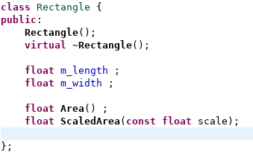
Let’s add some functionality
A Rectangle class should store a length and a width.
To make it useful, let’s have it supply an Area() method to compute its own area.
Edit the header file to look like the code to the right.

Slide 16
Encapsulation
Bundling the data and area calculation for a rectangle into a single class is an example of the concept of encapsulation.

Slide 17
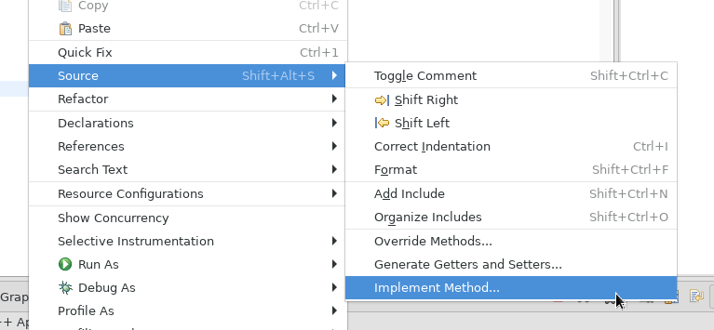
The code for the two methods is needed
Right-click in the Rectangle.h window and choose Source→Implement Methods

Slide 18
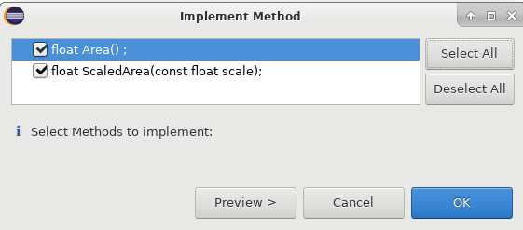
Click Select All then click OK.

Slide 19
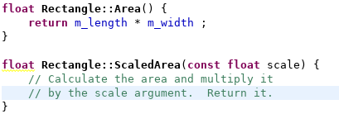
Fill in the methods
Step 1: add some comments.
Step 2: add some code.
Member variables can be accessed as though they were passed to the method.
Methods can also call each other.
Fill in the Area() method and then write your own ScaledArea(). Don’t forget to compile!

Slide 20
Using the new class
Open Basic_Rectangle.cpp
Add an include statement for the new Rectangle.h
Create a Rectangle object and call its methods.
We’ll do this together…

Slide 21
Special methods
There are several methods that deal with creating and destroying objects.
These include:
Constructors – called when an object is created. Can have many defined per class.
Destructor – one per class, called when an object is destroyed
Copy – called when an object is created by copying an existing object
Move – a feature of C++11 that is used in certain circumstances to avoid copies.

Slide 22
Construction and Destruction
The constructor is called when an object is created.
This is used to initialize an object:
Load values into member variables
Open files
Connect to hardware, databases, networks, etc.
The destructor is called when an object goes out of scope.
Example:
Object c1 is created when the program reaches the first line of the function, and destroyed when the program leaves the function.
void function() {
ClassOne c1 ;
}

Slide 23
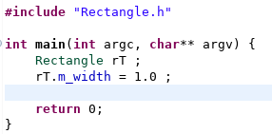
When an object is instantiated…
The rT object is created in memory.
When it is created its constructor is called to do any necessary initialization.
The constructor can take any number of arguments like any other function but it cannot return any values.
What if there are multiple constructors?
The compiler follows standard function overload rules.
Note the constructor has no return type!

Slide 24
A second constructor
rectangle.h
rectangle.cpp
class Rectangle
{
public:
Rectangle();
Rectangle(const float width,
const float length) ;
/* etc */
};
#include "rectangle.h“
/* C++11 style */
Rectangle::Rectangle(const float width,
const float length):
m_width(width),
m_length(length)
{
/* extra code could go here */
}
Adding a second constructor is similar to overloading a function.
Here the modern C++11 style is used to set the member values – this is called a member initialization list

Slide 25
Member Initialization Lists
Syntax:
Colon goes here
MyClass(int A, OtherClass &B, float C):
m_A(A),
m_B(B),
m_C(C) {
/* other code can go here */
}
Members assigned and separated with commas. The order doesn’t matter.
Additional code can be added in the code block.

Slide 26
And now use both constructors
#include <iostream>
using namespace std;
#include "Rectangle.h“
int main(int argc, char** argv)
{
Rectangle rT ;
rT.m_width = 1.0 ;
rT.m_length = 2.0 ;
cout << rT.Area() << endl ;
Rectangle rT_2(2.0,2.0) ;
cout << rT_2.Area() << endl ;
return 0;
}
Both constructors are now used. The new constructor initializes the values when the object is created.
Constructors are used to:
Initialize members
Open files
Connect to databases
Etc.

Slide 27
Default values
class Rectangle {
public:
Rectangle();
Rectangle(const float width,
const float length) ;
Rectangle(const Rectangle& orig);
virtual ~Rectangle();
float m_length = 0.0 ;
float m_width = 0.0 ;
float Area() ;
float ScaledArea(const float scale);
private:
};
C++11 added the ability to define default values in headers in an intuitive way.
Pre-C++11 default values would have been coded into source files.
If members with default values get their value set in the constructor than the default value is ignored.
i.e. no “double setting” of the value.

Slide 28
Default constructors and destructors
The two methods created by Eclipse automatically are explicit versions of the default C++ constructors and destructors.
Every class has them – if you don’t define them then empty ones that do nothing will be created for you by the compiler.
If you really don’t want the default constructor you can delete it with the delete keyword.
Also in the header file you can use the default keyword if you like to be clear that you are using the default.
class Foo {
public:
Foo() = delete ;
// Another constructor
// must be defined!
Foo(int x) ;
};
class Bar {
public:
Bar() = default ;
};

Slide 29
Custom constructors and destructors
You must define your own constructor when you want to initialize an object with arguments.
A custom destructor is always needed when internal members in the class need special handling.
Examples: manually allocated memory, open files, hardware drivers, database or network connections, custom data structures, etc.

Slide 30
Destructors
This class just has 2 floats as members which are automatically removed from memory by the compiler.
Destructors are called when an object is destroyed.
Destructors have no return type.
There is only one destructor allowed per class.
Objects are destroyed when they go out of scope.
Destructors are never called explicitly by the programmer. Calls to destructors are inserted automatically by the compiler.
The destructor will automatically call the destructor for every member in the object where the members are themselves objects.
Rectangle::~Rectangle()
{
}
~House() destructor
House object

Slide 31
A Custom Destructor
class Example {
public:
Example() = delete ;
Example(int count) ;
virtual ~Example() ;
// A pointer to some memory
// that will be allocated manually.
float *m_values = nullptr ;
// A vector of strings.
vector<string> m_lines ;
};
Example::Example(int count) {
// Allocate memory to store "count"
// floats.
values = new float[count];
// And size the string vector to
// hold the same number of strings.
m_lines.reserve(count) ;
}
Example::~Example() {
// The destructor MUST free this
// memory. Only do so if values is not
// null. - deleting a null pointer will
// crash your program.
if (values) {
delete[] values ;
}
// m_lines gets its destructor called and
// it cleans up after itself.
}

Slide 32
Manual Allocations
// Dynamically allocate a double value.
double *dbl = new double ;
// Dynamically allocate a vector.
vector<int> *dyn_vec = new vector<int>() ;
// And an array of strings
string *str_arr = new string[6] ;
*dbl = 2.0;
// Pointer access to a method use ->
dyn_vec->push_back(11) ;
str_arr[0] = "blarf" ;
// Always delete your allocations!
delete dbl ;
delete dyn_vec ;
delete[] str_arr ;
C code: Use malloc() and free()
C++: use new and delete
delete[] must be used for array allocations.

Slide 33
Copy, Assignment, and Move Constructors
The compiler will automatically create constructors to deal with copying, assignment, and moving. NetBeans filled in an empty default copy constructor for us.
How do you know if you need to write one?
When the code won’t compile and the error message says you need one!
OR unexpected things happen when running.
You may require custom code when...
dealing with open files inside an object
The class manually allocated memory
Hardware resources (a serial port) opened inside an object
Etc.
Rectangle rT_1(1.0,2.0) ;
// Now use the copy constructor
Rectangle rT_2(rT_1) ;
// Do an assignment, with the
// default assignment operator
rT_2 = rT_1 ;

Slide 34
Templates and classes
Classes can also be created via templates in C++
Templates can be used for type definitions with:
Entire class definitions
Members of the class
Methods of the class
Templates can be used with class inheritance as well.
This topic is way beyond the scope of this tutorial!

Slide 35
Tutorial Outline: Part 3
Defining Classes
Class inheritance
Public, private, and protected access
Virtual functions

Slide 36
Inheritance
Inheritance is the ability to form a hierarchy of classes where they share common members and methods.
Helps with: code re-use, consistent programming, program organization
This is a powerful concept!
Molecule
Inorganic
Organic
Mineral
Protein

Slide 37
Inheritance
Superclass
Base Class
The class being derived from is referred to as the base, parent, or super class.
The class being derived is the derived, child, or sub class.
For consistency, we’ll use superclass and subclass in this tutorial. A base class is the one at the top of the hierarchy.
Molecule
Inorganic
Organic
Mineral
Protein
Subclass

Slide 38
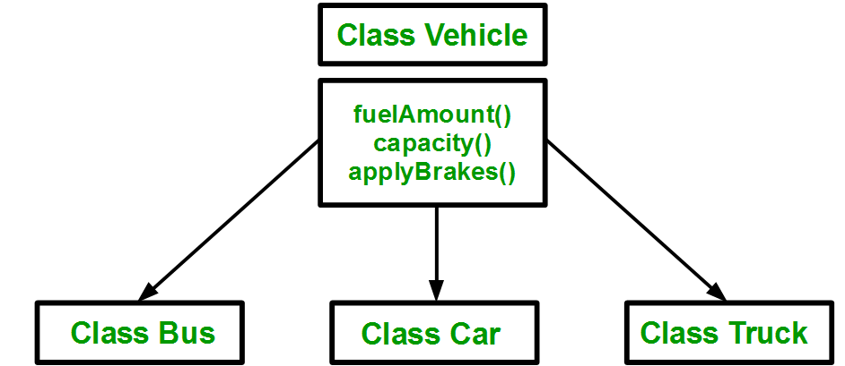
Why inherit?
OO programming helps you to model the problem you’re solving in your program.
Inheritance allows for class hierarchies to be built to organize your program – and share code.
https://www.geeksforgeeks.org/inheritance-in-c/

Slide 39
Inheritance in Action
Streams in C++ are series of characters – the C+ I/O system is based on this concept.
cout is an object of the class ostream. It is a write-only series of characters that prints to the terminal.
There are two subclasses of ostream:
ofstream – write characters to a file
ostringstream – write characters to a string
Writing to the terminal is straightforward:
cout << some_variable ;
How might an object of class ofstream or ostringstream be used if we want to write characters to a file or to a string?

Slide 40
Inheritance in Action
For ofstream and ofstringstream the << operator is inherited from ostream and behaves the same way for each from the programmer’s point of view.
The ofstream class adds a constructor to open a file and a close() method.
ofstringstream adds a method to retrieve the underlying string, str()
If you wanted a class to write to something else, like a USB port…
Maybe look into inheriting from ostream!
Or its underlying class, basic_ostream which handles types other than characters…

Slide 41
Inheritance in Action
#include <iostream> // cout
#include <fstream> // ofstream
#include <sstream> // ostringstream
using namespace std ;
void some_func(string msg) {
cout << msg ; // to the terminal
// The constructor opens a file for writing
ofstream my_file("filename.txt") ;
// Write to the file.
my_file << msg ;
// close the file.
my_file.close() ;
ostringstream oss ;
// Write to the stringstream
oss << msg ;
// Get the string from stringstream
cout << oss.str() ;
}

Slide 42
Tutorial Outline: Part 3
Defining Classes
Class inheritance
Public, private, and protected access
Virtual functions

Slide 43
Public, protected, private
“There are only two things wrong with C++: The initial concept and the implementation.”
– Bertrand Meyer (inventor of the Eiffel OOP language)
class Rectangle
{
public:
Rectangle();
Rectangle(float width, float length) ;
virtual ~Rectangle();
float m_width ;
float m_length ;
float Area() ;
protected:
private:
};
We can have public, private, and protected modifiers in the class definition.
These are used to control access to parts of the class with inheritance and when using the class.

Slide 44
C++ Access Control and Inheritance
Access | public | protected | private
Same class | Yes | Yes | Yes
Subclass | Yes | Yes | No
Outside classes | Yes | No | No
i.e. using the class in your program
Inheritance
class Super {
public:
int i;
protected:
int j ;
private:
int k ;
};
class Sub : public Super {
// in methods, could access
// i and j from Parent only.
};
Outside code
Sub myobj ;
Myobj.i = 10 ; // public - ok
Myobj.j = 3 ; // protected - Compiler error
Myobj.k = 1 ; // private - Compiler error

Slide 45
Inheritance
class A
class B : public A
public
public A
public
protected
protected A
protected
private
private
With inheritance subclasses have access to private and protected members and methods all the way back to the base class.
Each subclass can still define its own public, protected, and private members and methods along the way.
class C : public B
public A
public
public B
protected A
protected
protected B
private

Slide 46
Single vs Multiple Inheritance
A
C++ supports creating relationships where a subclass inherits data members and methods from a single superclass: single inheritance
C++ also support inheriting from multiple classes simultaneously: Multiple inheritance
This tutorial will only cover single inheritance.
Generally speaking…
Multiple inheritance requires a large amount of design effort
It’s an easy way to end up with overly complex, fragile code
Java and C# (both came after C++) exclude multiple inheritance on purpose to avoid problems with it.
B
C
D
With multiple inheritance a hierarchy like this is possible to create…this is nicknamed the Deadly Diamond of Death.

Slide 47
C++ Inheritance Syntax
Inheritance syntax pattern:
class SubclassName : public SuperclassName
Here the public keyword is used.
Methods implemented in class Sub can access any public or protected members and methods in Super but cannot access anything that is private.
Other inheritance types are protected and private.
class Super {
public:
int i;
protected:
int j ;
private:
int k ;
};
class Sub : public Super {
// ...
};

Slide 48
Square
Let’s make a subclass of Rectangle called Square.
Open the Eclipse project Shapes
This has the Rectangle class from Part 2 implemented.
Add a class named Square.
Make it inherit from Rectangle.

Slide 49
Square.h
Square.cpp
#ifndef SQUARE_H
#define SQUARE_H
#include "Rectangle.h"
class Square : public Rectangle
{
public:
Square();
virtual ~Square();
protected:
private:
};
#endif // SQUARE_H
#include “Square.h"
Square::Square()
{}
Square::~Square()
{}
Note that subclasses are free to add any number of new methods or members, they are not limited to those in the superclass.
Class Square inherits from class Rectangle

Slide 50
A new Square constructor is needed.
A square is, of course, just a rectangle with equal length and width.
The area can be calculated the same way as a rectangle.
Our Square class therefore needs just one value to initialize it and it can re-use the Rectangle.Area() method for its area.
Go ahead and try it:
Add an argument to the default constructor in Square.h
Update the constructor in Square.cpp to do…?
Remember Square can access the public members and methods in its superclass

Slide 51
Solution 1
#ifndef SQUARE_H
#define SQUARE_H
#include “Rectangle.h"
class Square : public Rectangle
{
public:
Square(float width);
virtual ~Square();
protected:
private:
};
#endif // SQUARE_H
#include “Square.h"
Square::Square(float length):
m_width (length), m_length(length)
{
}
Square can access the public members in its superclass.
Its constructor can then just assign the length of the side to the Rectangle m_width and m_length.
This is unsatisfying – while there is nothing wrong with this it’s not the OOP way to do things.
Why re-code the perfectly good constructor in Rectangle?

Slide 52
The delegating constructor
class class_c {
public:
int max;
int min;
int middle;
class_c(int my_max) {
max = my_max > 0 ? my_max : 10;
}
class_c(int my_max, int my_min) : class_c(my_max) {
min = my_min > 0 && my_min < max ? my_min : 1;
}
class_c(int my_max, int my_min, int my_middle) :
class_c (my_max, my_min){
middle = my_middle < max &&
my_middle > min ? my_middle : 5;
}
};
C++11 added a new constructor type called the delegating constructor.
Using member initialization lists you can call one constructor from another.
Even better: with member initialization lists C++ can call superclass constructors!
Square::Square(float length) :
Rectangle(length,length)
{
// other code could go here.
}
Reference:
https://msdn.microsoft.com/en-us/library/dn387583.aspx

Slide 53
Solution 2
#ifndef SQUARE_H
#define SQUARE_H
#include "Rectangle.h"
class Square : public Rectangle
{
public:
Square(float width);
virtual ~Square();
protected:
private:
};
#endif // SQUARE_H
#include "Square.h"
Square::Square(float length) :
Rectangle(length, length) {}
Square can directly call its superclass constructor and let the Rectangle constructor make the assignment to m_width and m_length.
This saves typing, time, and reduces the chance of adding bugs to your code.
The more complex your code, the more compelling this statement is.
Code re-use is one of the prime reasons to use OOP.

Slide 54
Trying it out in main()
What happens behind the scenes when this is compiled….
#include <iostream>
using namespace std;
#include “Square.h"
int main()
{
Square sQ(4) ;
// Uses the Rectangle Area() method!
cout << sQ.Area() << endl ;
return 0;
}
sQ.Area()
Square class does not implement Area() so compiler looks to superclass
Finds Area() in Rectangle class.
Inserts call to Rectangle.Area() method in compiled code.

Slide 55
More on Destructors
When a subclass object is removed from memory, its destructor is called as it is for any object.
Its superclass destructor is than also called .
Each subclass should only clean up its own problems and let superclasses clean up theirs.
Square object is removed from memory
~Square() is called
~Rectangle() is called

