Slide 1
Introduction to C++
Brian Gregor
Research Computing Services
Information Services & Technology

Slide 2
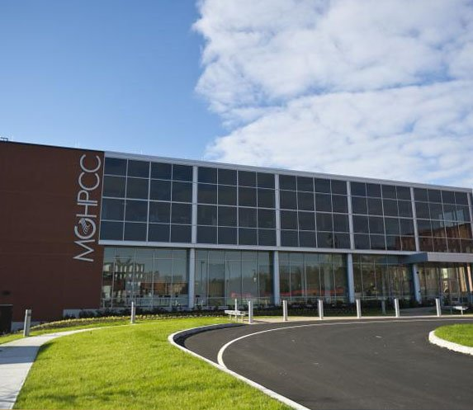
Research Computing Services (RCS)
A group within Information Services & Technology at Boston University
Provides computing, storage, and visualization resources and services to support research
Whole RCS team contact:
Use the IT Help Desk
Or help@scc.bu.edu
Three Primary Services:
Research Computation
Research Visualization
Research Consulting and Training
Maintains and administers the Shared Computing Cluster
Located in Holyoke, MA
~19000 CPUs running Linux

Slide 3
About Me
Member of the Applications group inside RCS
Office on the Boston University Charles River Campus
Right upstairs, the RCS offices are in 111 Cummington.
We also have staff on the BU Medical Campus
Contact: bgregor@bu.edu
Whole RCS team contact: help@scv.bu.edu

Slide 4
About You
Who has experience programming?
Working with C++ already?
Any other programming languages?
Why do you want to learn C++?

Slide 5
Tutorial Goals
Introduce C++ as an object-oriented language
Learn the concepts of object-oriented programming
Use a debugger and an integrated development environment

Slide 6
End-of-course Evaluation Form
Please visit this page and fill in the evaluation form for this course.
Your feedback is highly valuable to the RCS team for the improvement and development of tutorials.
http://scv.bu.edu/survey/tutorial_evaluation.html

