Slide 1

Intermediate SCC Usage
Research Computing Services
Katia Bulekova

Slide 2
Learning Objectives
Understanding Cluster Structure
  Buy-in vs. Shared nodes
  Hardware architecture
  Resources request
Learning how to retrieve and understand information about past jobs
How to run parallel Jobs on the SCC
Running multiple jobs on the cluster
  Array jobs
  Executing multiple scripts within a single job
Executing dependent jobs

Slide 3
Shared Computing Cluster
Shared - transparent multi-user and multi-tasking environment
Computing - heterogeneous environment:
  interactive jobs
  single processor and parallel jobs
  graphics job
Cluster - a set of connected via a fast local area network computers; job scheduler coordinates work loads on each node

Slide 4

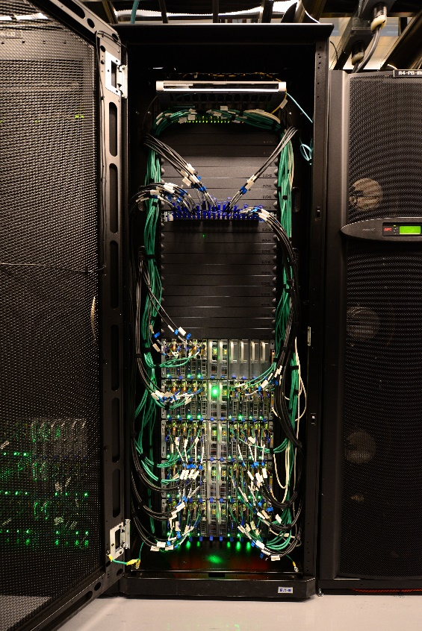
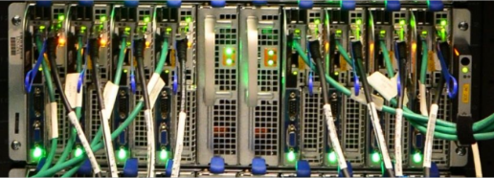
Shared Computing Cluster
Ethernet
Infiniband
Compute Nodes
Rear View

Slide 5
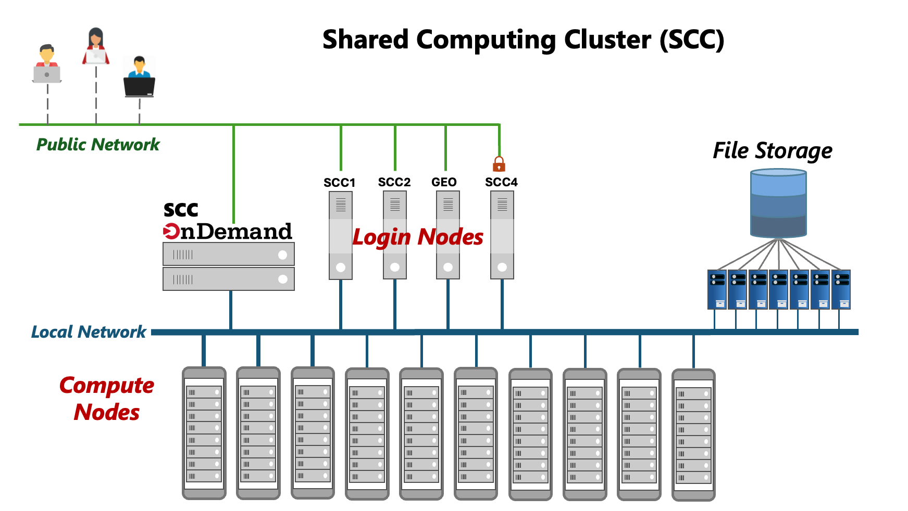
~ 14.4 PT
1,066 nodes
29,818 CPU cores
543 GPUs

Slide 6
SCC buy-in resources
All buy-in nodes have a hard limit of 12 hours for non-member jobs.
Setting time limit for a job larger than 12 hours automatically excludes all buy-in nodes from the available resources

Slide 7
SCC resources
Processors: Intel and AMD
CPU Architecture: sandybridge, ivybridge, haswell, broadwell, knl, epyc,
    skylake, cascadelake, icelake, sapphirerapids, emeraldrapids, graniterapids
    milan, rome, genoa, turin
Ethernet connection: 1 or 10 Gbps
Infiniband: EDR, FDR, QDR, HDR ( or none )
GPUs (NVIDIA): K40m, P100, V100, A100, A40, A6000, L40, L40S, H200, RTX6000, RTX8000, TitanV, TitanXp
Number of cores: 8,16, 20, 28, 32, 36, 48, 64, 96
Memory (RAM): 128 GB – 1TB
Scratch Disk: 244GB – 886GB
Technical Summary:
http://www.bu.edu/tech/support/research/computing-resources/tech-summary/

Slide 8
SCC: batch jobs
  Script organization:
Script interpreter
#!/bin/bash -l
#Time limit
#$ -l h_rt=12:00:00
#Project name
#$ -P krcs
#Send email-report at the end of the job
#$ -m e
#Job name
#$ -N myjob
#Load modules:
module load python/3.13.8
#Run the program
python myscript.py
Scheduler Directives
Commands to execute

Slide 9
SCC: batch jobs
Execute login shell
(for proper interpretation of the module commands)
  Script organization:
Script interpreter
#!/bin/bash -l
#Time limit
#$ -l h_rt=12:00:00
#Project name
#$ -P krcs
#Send email-report at the end of the job
#$ -m e
#Job name
#$ -N myjob
#Load modules:
module load python/3.13.8
#Run the program
python myscript.py
Scheduler Directives
Commands to execute

Slide 10
SCC: batch jobs
  Script organization:
Resource request
Script interpreter
#!/bin/bash -l
#Time limit
#$ -l h_rt=12:00:00
#Project name
#$ -P krcs
#Send email-report at the end of the job
#$ -m e
#Job name
#$ -N myjob
#Load modules:
module load python/3.12.4
#Run the program
python myscript.py
Scheduler Directives
Commands to execute

Slide 11
SCC Resources
All purpose nodes:
can run single-processor jobs and parallel jobs (up to 720 hours)
Whole node queues (8, 16, 28, 32 and 36 cores):
only jobs that request the above number of cores will run on them (up to 240 hours)
GPU nodes:
only jobs requesting GPU(s) will run on these nodes (up to 48 hours)
MPI queues:
only for jobs requesting multiple nodes (up to 120 hours)
VirtualGL nodes:
for interactive graphics jobs (up to 48 hours)

Slide 12
Request resources: single node parallelization
  An example of resource request for multiple cores (to run parallel codes):
  #$ -pe omp 4
Recommended values to select multiple CPU cores:
4, 8, 16, 28, 32, 36 # shared nodes
4, 8, 16, 20, 28, 32 # buy-in nodes

Slide 13
Request resources: multi-node parallelization
  An example of resource request for an MPI job:
  #$ -pe mpi_28_tasks_per_node 56
3 MPI queues:
two queues with 28-core nodes (896 total cores limit)
64-core nodes ( 1024 total cores limit)

Slide 14
Request resources: GPU jobs
  An example of resource request for a GPU job:
  #$ -l gpus=1
All shared GPU nodes have 2 or 4 GPUs per node
Buy-in queues have 1, 2, 4, 5, 6, 8, 9, 10 GPUs per node
GPUs architecture (shared nodes):
K40m, P100, V100, A100, A40, L40S, H200
qgpus -v # displays information about current GPUs on the SCC

Slide 15
Request resources: GPU jobs
  Example of resource request for a GPU job, with additional restrictions:
  # GPU capability ( current selection: 3.5, 6.0, 7.0, 7.5, 8.0, 8.6, 8.9, 9.0)
  #$ -l gpus=1
  #$ -l gpu_c=6.0 # request GPU with at least 6.0 compute capability
#$ -l gpu_memory=40G # at least 40G of VRAM
# GPU type ( see qgpus output for current selection)
  #$ -l gpus=1
  #$ -l gpu_type=P100 # request specific GPU type

Slide 16
Hardware Architecture
Processors: Intel and AMD
There are 3 compilers available on the SCC: GNU (gcc/llvm), PGI and Intel
A program compiled with options that optimize performance for a newer CPU architecture may be unable to run on older compute nodes (or a different type of a processor).
#$ -l avx
#$ -l avx2
https://www.bu.edu/tech/support/research/software-and-programming/programming/compilers/

Slide 17
Resource request: Memory
Script interpreter
#!/bin/bash -l
#Time limit
#$ -l h_rt=12:00:00
#Memory request
#$ -pe omp 28
#$ -l mem_per_core=8GB
Scheduler Directives
https://www.bu.edu/tech/support/research/system-usage/running-jobs/resources-jobs/#memory
https://www.bu.edu/tech/support/research/system-usage/running-jobs/batch-script-examples/#MEMORY

Slide 18
SCC: Job Memory usage
  Checking the status of a batch job
scc1 % qstat -u <userID>
  List only running jobs
scc1 % qstat –u <userID> -s r
  Get job information:
scc1 % qstat -j <jobID>

Slide 19
SCC: Job Memory usage
job ID
scc1 % qstat -j 596557
job_number: 596557
exec_file: job_scripts/596557
submission_time: Mon Sep 11 10:11:04 2017
owner: ktrn
. . .
sge_o_workdir: /projectnb/krcs/projects/
sge_o_host: scc4
account: sge
cwd: /projectnb/krcs/projects/chamongrp
. . .
hard resource_list: no_gpu=TRUE,h_rt=172800
soft resource_list: buyin=TRUE
env_list: PATH=/usr/java/default/jre/bin:/usr/java/default/bin
script_file: job.qsub
parallel environment: omp16 range: 16
project: krcs
usage 1: cpu=00:13:38, mem=813.90147 GBs, io=0.01024, vmem=1.013G, maxvmem=1.013G
scheduling info: (Collecting of scheduler job information is turned off)

Slide 20
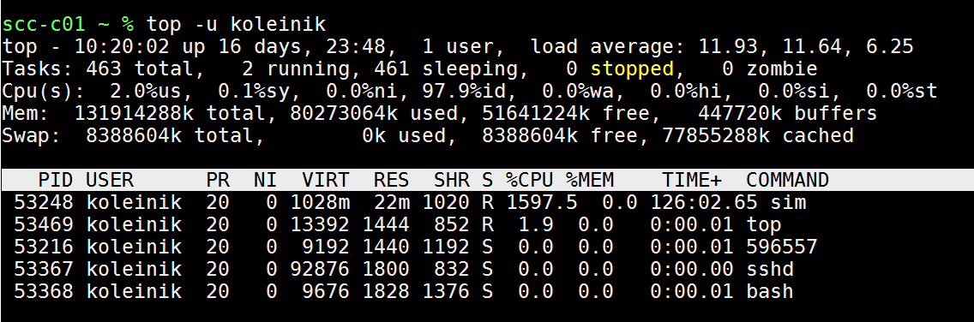
SCC: Memory and cpu core usage
  1. Login to the compute node
scc1 % ssh scc-ca1
  2. Run top command
scc1 % top -u <userID>
Top command will give you a listing of the processes running as well as memory an CPU usage
  3. Exit from the compute node
scc1 % exit

Slide 21
SCC: completed jobs report (qacct)
  qacct - query the accounting system
scc1 % qacct -j 596557
  query the job by ID
scc1 % qacct -j -d 3 -o ktrn
  query the job by the time of execution
number of days
job owner

Slide 22
SCC: completed jobs report (qacct)
qname p100
hostname scc-c11.scc.bu.edu
group scv
owner ktrn
project krcs
jobname myjob
jobnumber 551947
qsub_time Wed Sep 6 20:08:56 2017
start_time Wed Sep 6 20:09:37 2017
end_time Wed Sep 6 23:32:29 2017
granted_pe NONE
slots 1
failed 0
exit_status 0
cpu 11232.780
mem 611514.460
io 14.138
iow 0.000
maxvmem 71.494G
arid undefined

Slide 23
SCC: Array jobs
  An array job executes independent copy of the same job script. The number of tasks to be executed is set using -t option to the qsub command, .i.e:
  The script below will submit an array job consisting of 10 tasks, numbered from 1 to 10. The batch system sets up SGE_TASK_ID environment variable which can be used inside the script to pass the task ID to the program:
#!/bin/bash –l
#$ -P myproject
#$ -l h_rt=12:00:00
#$ -N myjob
#$ -t 1-10
module python3/3.10.12
python my_script.py $SGE_TASK_ID

Slide 24
SCC: Environment variables
SGE automatically sets several variables, and you can also leverage standard Linux environment variables to control your job's execution.
SGE-Specific Variables
$JOB_ID: The unique ID assigned to your job by SGE. Essential for monitoring and interacting with a specific job.
$JOB_NAME: The name of your job, as specified with the -N option in qsub.
$NSLOTS: The number of slots (CPUs) allocated to your job across all hosts.
$SGE_TASK_ID: Task ID
General Linux Variables
$PATH: Defines the directories where the shell looks for executable commands.
$HOME: The user's home directory.
$TMPDIR: A temporary directory that can be used by jobs to write temporary files. Using this can improve performance by reducing network I/O and prevent issues with shared storage.

Slide 25
SCC: Accessing Environment variables in code
Python:
import os
num_cores_requested = int( os.getenv('NSLOTS') )
R:
num.cores <- as.numeric(Sys.getenv('NSLOTS'))
MATLAB:
num_cores= str2num( getenv('NSLOTS') )

Slide 26
SCC: Running short scripts (Python example)
#!/bin/bash -l
module load python3/3.13.8
# Run same program for different parameters many times:
for i in `seq 0 4`;
do
python short.py $i outfile_${i}.txt
done

Slide 27
SCC: Running short scripts (R example)
#!/bin/bash -l
module load R/4.5.2
# Run same program for different parameters many times:
for i in `seq 0 4`;
do
Rscript short_r.R $i outfile_${i}.txt
done

Slide 28
SCC: Job dependency
  Some jobs may be required to run in a specific order. For this application, the job dependency can be controlled using "-hold_jid" option:
scc1 % qsub -N job1 script1
scc1 % qsub -N job2 -hold_jid job1 script2
scc1 % qsub -N job3 -hold_jid job2 script3
  A job might need to wait until the remaining jobs in the group have completed (aka post-processing).
  In this example, lastjob won’t start until job1, job2, and job3 have completed.
scc1% qsub -N job1 script1
scc1% qsub -N job2 script2
scc1% qsub -N job3 script3
scc % qsub -N lastJob -hold_jid "job*" script4
https://www.bu.edu/tech/support/research/system-usage/running-jobs/advanced-batch/#depend

Slide 29
SCC: Links
  Research Computing website: http://www.bu.edu/tech/support/research/
  RCS software: http://sccsvc.bu.edu/software/
  RCS examples: http://rcs.bu.edu/examples/
  RCS Tutorial Evaluation: http://scv.bu.edu/survey/tutorial_evaluation.html
  Please contact us at help@scc.bu.edu if you have any problem or question

