Slide 1
Introduction to the
Shared Compute Cluster
Katia Oleinik (koleinik@bu.edu)
Research Computing Services

Slide 2
Topics for Today
Overview of the Shared Compute Cluster
Connecting to the SCC
Using Linux
Using Software and Modules
Using Batch System Overview
Getting Help

Slide 3
The Shared Compute Cluster (SCC)
Linux compute cluster with 16,900+ processors and 250+ GPU.
Over 4.2 Petabytes of disk space.
Owned by Boston University and researchers.
Located at the Massachusetts Green High Performance Computing Center (MGHPCC) in Holyoke, MA
Went into production in June, 2013 for Research Computing.

Slide 4

MGHPCC
Collaborations between 5 universities, MA state, and industry.
State-of-the-art data center in Holyoke, MA.
MGHPCC provides physical infrastructure (i.e. space, power, cooling), not computing systems.
Individual universities or consortiums provide their own computing and support.

Slide 5
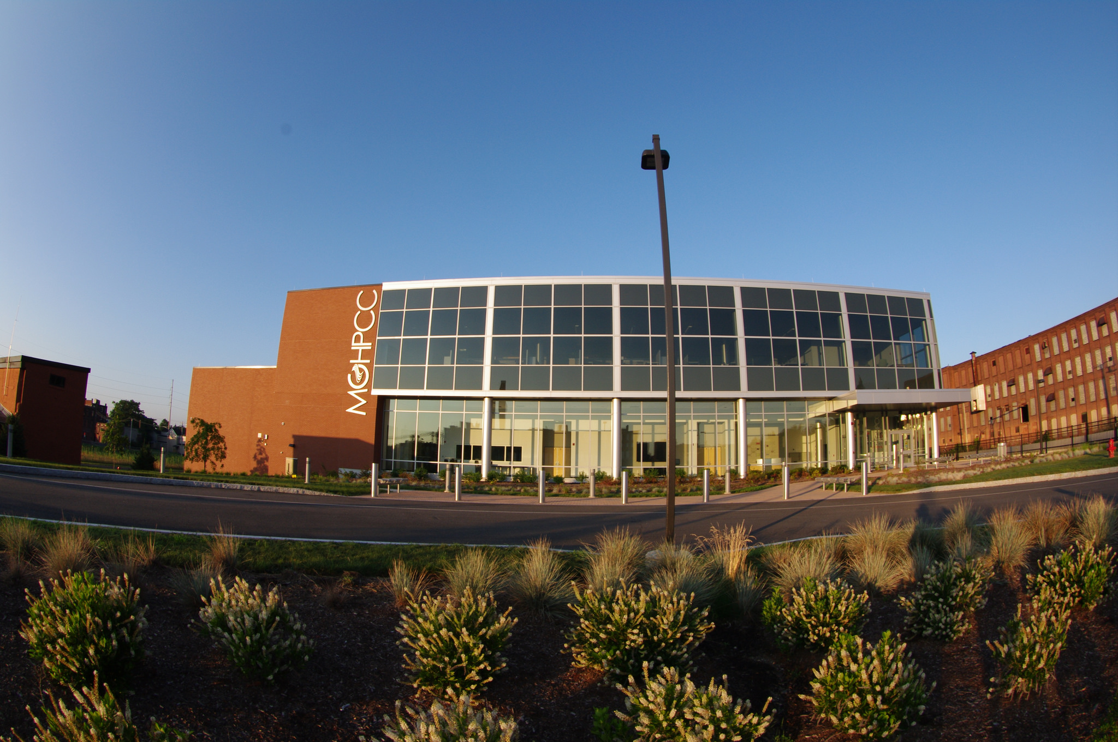

Slide 6
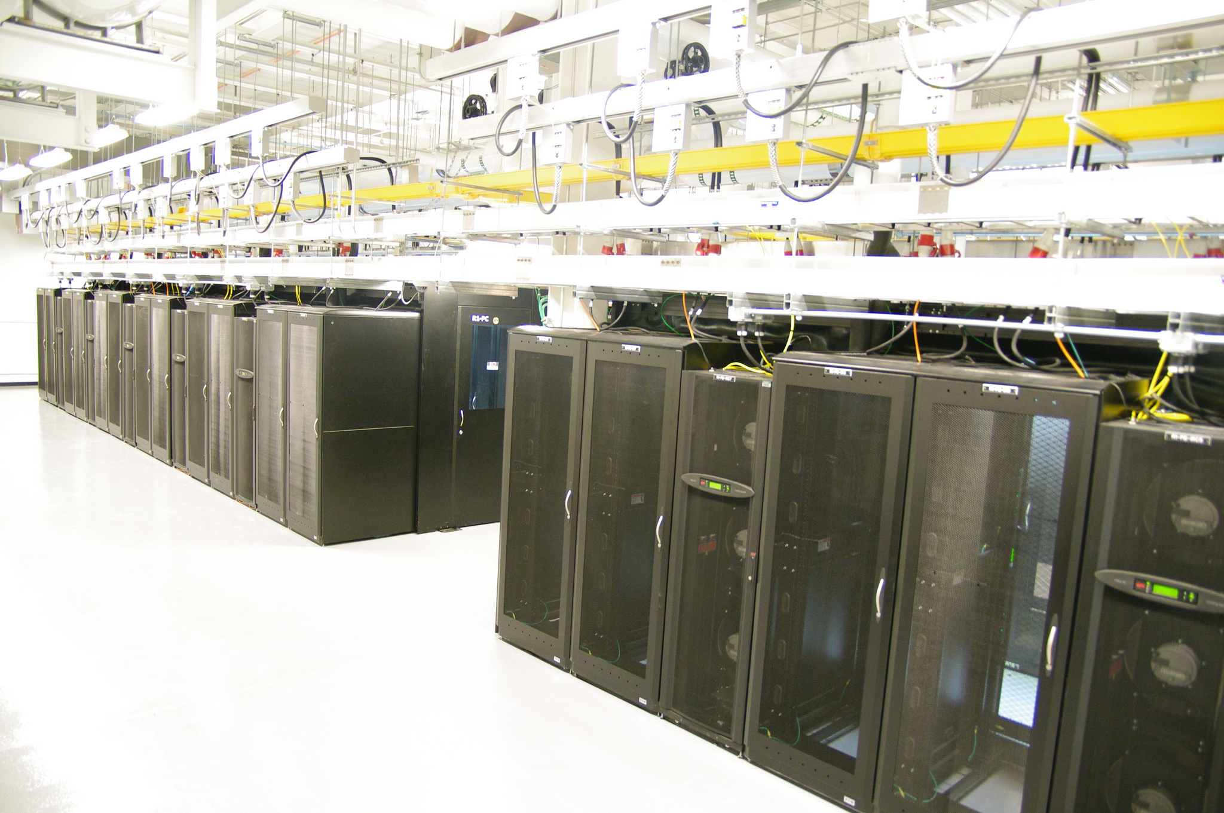

Slide 7
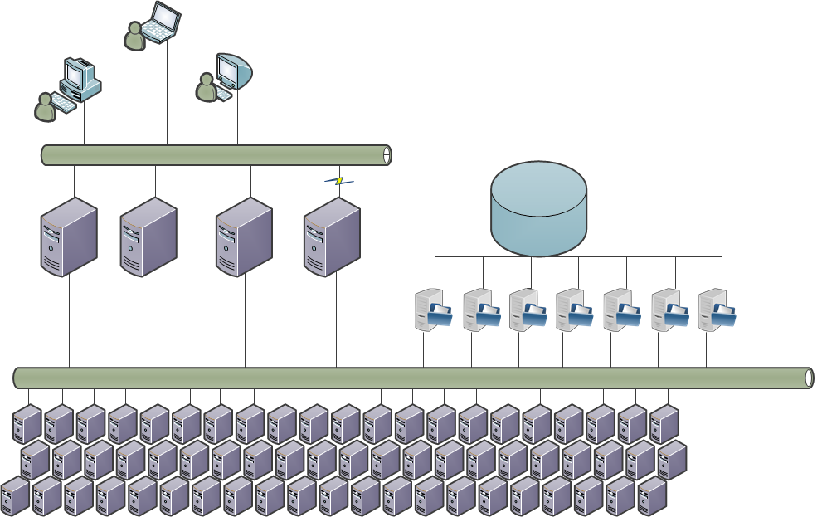
SCC Architecture
Public Network
VPN only
>2PB
File
Storage
Login
Nodes
SCC1
SCC2
SCC3
SCC4
Private Network
Compute
Nodes
420 nodes with
7072 CPUs and
250 GPUs with

Slide 8
Connection Protocols and Software
SCC supports Secure SHell (SSH) for interactive work and Secure File Transfer Protocol (SFTP) for transfer.
[Other protocols too, but let’s start with these.]
Windows: MobaXterm, PuTTY, X-Win32, …
Mac: Terminal (Optional: XQuartz)
Linux: Terminal (Optional: X11)
SCC Help: http://www.bu.edu/tech/support/research/system-usage/getting-started/connect-ssh

Slide 9
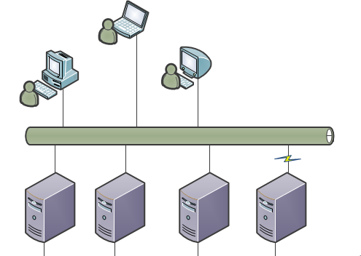
Choose a Login Node
Login Node | Hostname | Description
SCC1 | scc1.bu.edu | General purpose login node, accessible from internet
SCC2 | scc2.bu.edu | General purpose login node, accessible from internet
SCC3 | geo.bu.edu | Earth and Environment department node.
SCC4 | scc4.bu.edu | BUMC login node. Access to /restricted/project data. Requires BU network or VPN.
Public Network
Public Network
VPN only
SCC1
SCC2
VPN only
SCC2
SCC3
SCC3
SCC4
SCC4

Slide 10
SSH - Login to the SCC
Use SSH and your username to log into any login node.
Similar for Linux, Mac, and Windows (MobaXterm)
[local_prompt]$ ssh -Y username@scc1.bu.edu
username@scc1.bu.edu’s Password:
username: tuta#
password: VizTut#
*Both username and Password are case sensitive
SCC Help: http://www.bu.edu/tech/support/research/system-usage/getting-started/connect-ssh

Slide 11

SSH - Login to the SCC (X-Forwarding)
The same process with an option to enable X-Forwarding
Linux and Windows (MobaXterm)
Apple OS X
[local_prompt]$ ssh -X username@scc1.bu.edu
username@scc1.bu.edu’s Password:
[username@scc1 ~]$ xclock &
[local_prompt]$ ssh -Y username@scc1.bu.edu
username@scc1.bu.edu’s Password:
[username@scc1 ~]$ xclock &
Make sure X-Forwarding is enabled with ssh (-X or -Y)
Make sure XWin\xQuartz\X11 is installed on your local system.
Don’t see a clock?
SCC Help: http://www.bu.edu/tech/support/research/system-usage/getting-started/connect-ssh

Slide 12
Using the System (Part 1)
Basic Linux commands and system use

Slide 13
Using the System: Commands
The following link contains a brief summary of basic linux commands:
http://scv.bu.edu/documents/SCC_GettingStarted.pdf
More can be found on internet
Notes:
[You can skip through this section for time]

Slide 14
Basic navigation: Where are we?
pwd - Print Working Directory
[tuta0@scc1 ~]$ pwd
/usr4/tutorial/tuta0

Slide 15
Basic navigation: What's in there?
ls - List (files, directories, links etc.)
[tuta0@scc1 ~]$ ls
[tuta0@scc1 ~]$
ls [options] [directory path]
ls -l # long listing
ls -a # show all files including those starting with a dot
ls -l /project # listing of the files and directories in the directory /project

Slide 16
Basic navigation: Paths
/
lib
bin
usr
usr1
usr4
tutorial
tuta0
tuta1
tuta2
project
projectnb
tutorial
tutorial
mssphw1
mssphw1
tutaN

Slide 17
Basic navigation: more on paths
/
lib
bin
usr
usr1
usr4
tutorial
tuta0
tuta1
tuta2
project
projectnb
tutorial
tutorial
mssphw1
mssphw1
tutaN
Special:
~ (tilde) # shortcut for the home directory
. # current directory
.. # parent directory

Slide 18
Basic navigation: Move between directories
cd - Change directory
[tuta0@scc1 ~]$ cd /projectnb/tutorial
[tuta0@scc1 ~]$ pwd
/projectnb/tutorial
cd [directory path]
cd /projectnb/mssphw1 # move to the project directory
cd mydir # move to a subdirectory mydir
cd .. # move to a parent directory
cd # move to a home directory

Slide 19
Basic navigation: Excersize
1. Execute the "pwd" command and notice the path to your home directory
2. Get to the root directory
3. Check what files and subdirectories are there
4. Using relative paths navigate back to your home directory
5. Using absolute path navigate to /projectnb/tutorial directory.
6. Check that you are there with pwd command
7. Check what files are there

Slide 20
File Access and Permissions
Types of Access Rights
  Read access “r”
  Write access “w”
  Execute rights “x”
Types of Access Levels
  User (owner) “u”
  Group “g”
  Others “o”
[cjahnke@scc4 ~]$ ls -l /project/labunskyy/
drwxr-x--- 2 vlabuns labunskyy 512 Jul 9 12:00 amyts
drwxr-x--- 2 cbeau labunskyy 512 Jul 9 12:00 beverlyn
Group Name
Owner username
“Other” permission, last three bits
“Group” Permission, middle three bits
“Owner” permission, first three bits
Type of file (d=directory)
* The “S” you see as a group attribute is called a setgid bit. It gives special attributes to the child files/folders. In this case, you can ignore it.

Slide 21
Permission Mode Meanings
Symbolic Notation | Octal Notation | English (user, group and others have…)
--- | 0 | no permissions
--x | 1 | execute
-w- | 2 | write
-wx | 3 | write & execute
r-- | 4 | read
r-x | 5 | read & execute
rw- | 6 | read & write
rwx | 7 | read, write, & execute
http://en.wikipedia.org/wiki/File_system_permissions

Slide 22
Access Rights Examples
Permissions | Description
-rw-r--r-- | Readable and writable for file owner, only readable for others. (Standard)
-rw-r----- | Readable and writable for file owner, only readable for users belonging to the file group.
drwx------ | Directory only accessible by its owner.
-------r-x | File executable by others but neither by your friends nor by yourself. Nice protections for a trap.

Slide 23
Basic navigation: File Manipulation
mkdir - Make directory
[tuta0@scc1 tutorial]$ mkdir koleinik
[tuta0@scc1 tutorial]$ ls -l
[tuta0@scc1 tutorial]$ cd koleinik
[tuta0@scc1 tutorial]$ pwd

Slide 24
Basic navigation: File (cont.)
mkdir - Make directory
[tuta0@scc1 tutorial]$ mkdir koleinik
[tuta0@scc1 tutorial]$ ls -l
[tuta0@scc1 tutorial]$ cd koleinik
[tuta0@scc1 tutorial]$ pwd

Slide 25
Files manipulation:
touch file1 - create an empty file with a name file1
cp file1 file2 - copy file1 to file2
mv file2 notes.txt - rename file2
rm file1 - delete file1

Slide 26
Using the System (Part 2)
Some basic tools, utilities, and methods

Slide 27
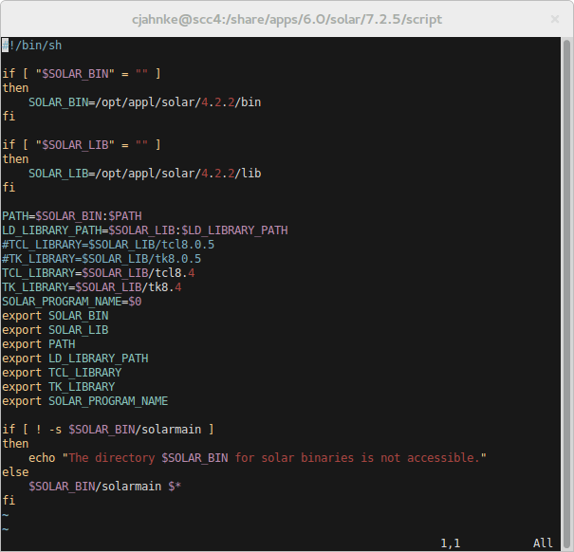
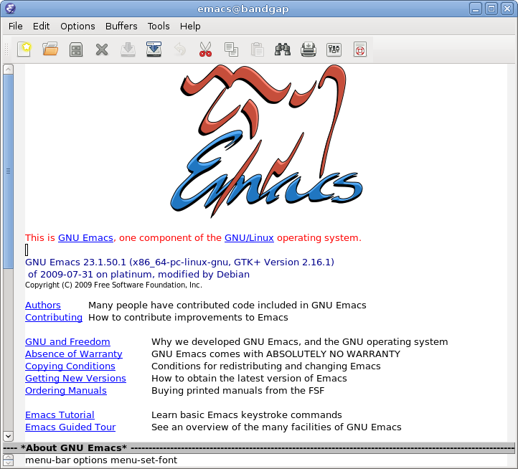
Text Editors
Command Interface
Graphical Interface
nano - “Nano's ANOther” editor
emacs - Programming Editor
vim / vi - Visual IMproved
Others
gedit - Gnome EDITor
emacs - Programming Editor
gvim - GUI VIM
Others

Slide 28
Basic text editing
gedit - Basic notepad-like editor
[tuta0@scc1 tutorial]$ gedit notes.txt &

Slide 29
Software and Modules

Slide 30
Software (without modules)
Many tools and utilities are available from the basic system environment.
Some big-name software applications are too:
  MATLAB
  R
  SAS
  STATA
Others require Modules
SCC Help: http://www.bu.edu/tech/support/research/software-and-programming/software-and-applications/modules/

Slide 31
Modules
Modules allow users to access non-standard tools or alternative versions of standard packages.
This is also an alternative way to configure your environment as required for certain packages.
Most software packages on SCC are configured this way.
SCC Help: http://www.bu.edu/tech/support/research/software-and-programming/software-and-applications/modules/

Slide 32
Module Usage
Command | Description
module list | List currently loaded modules.
module avail | List available modules.
module help [modulefile] | Displays description of specified module.
module show [modulefile] | Displays environment modifications for specified module.
module load [modulefile] | Loads specified module into environment.
module unload [modulefile] | Unloads specified module from environment.
module purge | Unloads all loaded modules.
SCC Help: http://www.bu.edu/tech/support/research/software-and-programming/software-and-applications/modules/

Slide 33
New Applications and Requests
New packages are developed every day.
Users can compile/install packages for personal use in home directories and project spaces.
Users can request global installation of software:
  Complete form on our website (Link below)
  Send an email to help@scc.bu.edu
SCC Help: http://www.bu.edu/tech/support/research/software-and-programming/software-and-applications/request-software

Slide 34
The Batch System
Submitting and Monitoring Batch Jobs
http://www.bu.edu/tech/support/research/system-usage/running-jobs

Slide 35
Batch System Overview
Login nodes are busy!
  Limited resource
  Limited runtime (15 min)
Compute Nodes provide reserved resources
  Many more nodes
  Many types of resources
“Fair Share” scheduling
Public Network
SCC1
SCC2
SCC3
SCC4
Login Nodes
Private Network
Compute Nodes
SCC Help: http://www.bu.edu/tech/support/research/system-usage/running-jobs

Slide 36
Types of Jobs
Interactive
  Just like the login node
  Can type, view output, open files, run commands
  “Interactive”
Non-Interactive “Batch”
  Instructions coordinated with a script or binary
  Easy to run 1000’s at a time.
  “Blind”
SCC Help: http://www.bu.edu/tech/support/research/system-usage/running-jobs

Slide 37
Submitting an Interactive Batch Job
Interactive jobs are submitted with one of the following commands: ‘qrsh’ or ‘qsh’ or ‘qlogin’
The general form is:
In Practice
[scc]$ qrsh [options] [ command [ command_arguments ] ]
[username@scc1 ~]$ qrsh ********************************************************************************
This machine is governed by the University policy on ethics.
http://www.bu.edu/tech/about/policies/computing-ethics/
This machine is owned and administered by
Boston University.
See the Research Computing web site for more information about our facilities.
http://www.bu.edu/tech/about/research/
Please send questions and report problems to "help@scc.bu.edu".
********************************************************************************
[cjahnke@scc-pi4 ~]$
SCC Help: http://www.bu.edu/tech/support/research/system-usage/running-jobs/interactive-jobs/

Slide 38
Submitting a Non-Interactive Batch Job
Non-interactive jobs are submitted with ‘qsub’ command.
The general form is:
In Practice: Running a Script
scc % qsub [options] command [arguments]
scc % qsub script.qsub
Your job #jobID ("jobname") has been submitted
SCC Help: http://www.bu.edu/tech/support/research/system-usage/running-jobs/submitting-jobs/

Slide 39
Submitting a Batch Job Script
Often a job is submitted using a batch script:
Example of running a binary program using qsub:
#!/bin/bash -l
#$ -P cbs
#$ -N jobname
#$ -j y
#$ -m e
# Run linux/application commands for job
module load R/3.2.3
Rscript bf591_script.R
#Language to interpret qsub script
# Job to run the project under
# Name the Job
# Join stout and sterr to a single file
# Send an email when the job ends
# Run linux/application commands for job
# Load the R module
# Run an R script
scc % qsub {options-if-not-specified-in-file} script.sh
Your job #jobID ("scipt.sh") has been submitted
SCC Help: http://www.bu.edu/tech/support/research/system-usage/running-jobs/submitting-jobs/

Slide 40
Monitoring Running Jobs
Use qstat to monitor the queue status
  Shows all users jobs. Usually a very long ist
  The “-u [username]” option will show a single user
scc % qstat -u cjahnke
job-ID prior name user state submit/start at queue slots ja-task-ID
-------------------------------------------------------------------------------------------------------
5186514 0.11176 tgauss cjahnke r 01/08/2015 16:06:58 p16@scc-ph7.scc.bu.edu 16
5226267 0.11176 tgauss cjahnke r 01/09/2015 12:41:42 b@scc-ba1.scc.bu.edu 16
5230108 0.11176 tgauss cjahnke r 01/10/2015 13:12:08 b@scc-bc1.scc.bu.edu 16
SCC Help: http://www.bu.edu/tech/support/research/system-usage/running-jobs/tracking-jobs/

Slide 41
Monitoring Completed Jobs
Use qacct query the queue accounting system
  Many options to tailor query: user, jobid, date run, etc.
Specific Job
All jobs for user
scc % qacct -j 5126219
qname ccs-pub
hostname scc-na2.scc.bu.edu
group linga_admin
owner cjahnke
project adsp
department defaultdepartment
jobname QRLOGIN
jobnumber 5126219... Many Details for job (“-j”)
scc % qacct -o cjahnke
qname ccs-pub
hostname scc-na2.scc.bu.edu
...
All Jobs by owner (“-o”) and then a summary
...
OWNER WALLCLOCK UTIME STIME CPU MEMORY
=================================================
cjahnke 43201 0.016 0.013 0.029 0.000
SCC Help: http://www.bu.edu/tech/support/research/system-usage/running-jobs/tracking-jobs/

Slide 42
Getting Help

Slide 43
How to Get Help
Upcoming Tutorials:
http://www.bu.edu/tech/about/training/classroom/rcs-tutorials/
Support Website:
http://www.bu.edu/tech/support/research/
Email (Submit a Ticket):
help@scc.bu.edu
Email Direct (Katia Oleinik):
koleinik@bu.edu

Slide 44
Questions?

