Slide 1
Machine learning with Python
Scott Ladenheim, PhD
saladenh@bu.edu
help@rcs.bu.edu

Slide 2
Machine learning
Supervised learning
Classification problem
Logistic regression
Using scikit-learn

Slide 3
Machine learning
Decision trees
K-means clustering
Reinforcement learning
Neural networks
Unsupervised
learning
Logistic regression
Support vector machine
Supervised Learning
Notes:
A learning problem considers a set of n samples of data and then tries to predict properties of unknown data. If each sample is more than a single number and, for instance, a multi-dimensional entry (aka multivariate data), it is said to have several attributes or features.

Slide 4
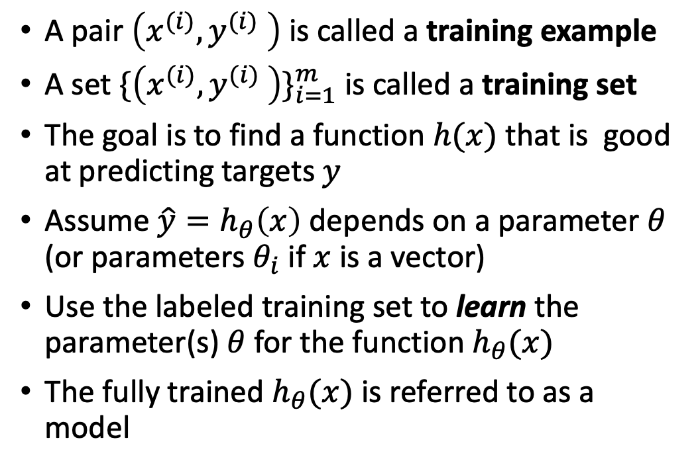
Supervised learning
Dataset has input features $x^{(i)}$ and labeled output targets $y^{(i)}$
Dataset has input features 𝑥^((𝑖)) and labeled output targets 𝑦^((𝑖))
Train a model using the input features and output targets
Predict output target values based on new input feature data
A pair $\left(x^{(i)},y^{(i)} \right)$ is called a training example
A set ${\{\left(x^{(i)},y^{(i)} \right)\}}_{i=1}^{m}$ is called a training set
The goal is to find a function $h(x)$ that is good at predicting targets $y$
Assume $\hat{y}=h_{θ}\left(x\right)$ depends on a parameter $θ$ (or parameters $θ_{i}$ if $x$ is a vector)
Use the labeled training set to learn the parameter(s) $θ$ for the function $h_{θ}(x)$
The fully trained $h_{θ}(x)$ is referred to as a model

Slide 5
Examples of Supervised Learning
Predict if an email is spam or not spam
Predict if a customer purchases a product based on how many ads they have been shown
Predict if a picture shows a cat, dog, or other
Predict if an image of a tumor is malignant or not
Predict if a student is admitted or not admitted to a college based on grades
Predict the price of a house based on its square footage
Predict how many points a Celtics player scores based on their minutes played and shots attempted
Predict price of a stock based on previous stock prices and market conditions
Classification
Regression

Slide 6
Classification
Supervised learning to segment data into 2 or more classes
Spam or non-spam email
Purchase or not purchase product
Cat, dog, or other
Binary
Multiclass
Clothing identification
Handwritten digit classification
Cat or dog picture

Slide 7
General framework for learning algorithms
Loss (error) function $ℒ(\hat{y^{(i)}},y^{(i)})$ where $\hat{y^{(i)}}=h_{θ_{0}}\left(x^{(i)}\right)$ for some initial $θ_{0}$
Loss (error) function ℒ((𝑦^((𝑖)) ) ̂,y^((𝑖))) where (𝑦^((𝑖)) ) ̂=ℎ_(𝜃_0 ) (𝑥^((𝑖)) ) for some initial 𝜃_0
$$J\left(θ\right)=\frac{1}{m}\sum_{i=1}^{m}{ℒ(\hat{y^{(i)}},y^{(i)})}$$
𝐽(𝜃)=1/𝑚 ∑_(𝑖=1)^𝑚▒〖ℒ((𝑦^((𝑖)) ) ̂,y^((𝑖)))〗
Minimization
Loss function
Cost function
$$\min_{θ}{J\left(θ\right)}$$
min_𝜃⁡𝐽(𝜃)

Slide 8
Learning algorithms for classification
Decision trees
Support vector machines
K-nearest neighbors
Naïve Bayes
Logistic regression
Neural networks
Scikit-learn
Tensorflow/Pytorch

Slide 9
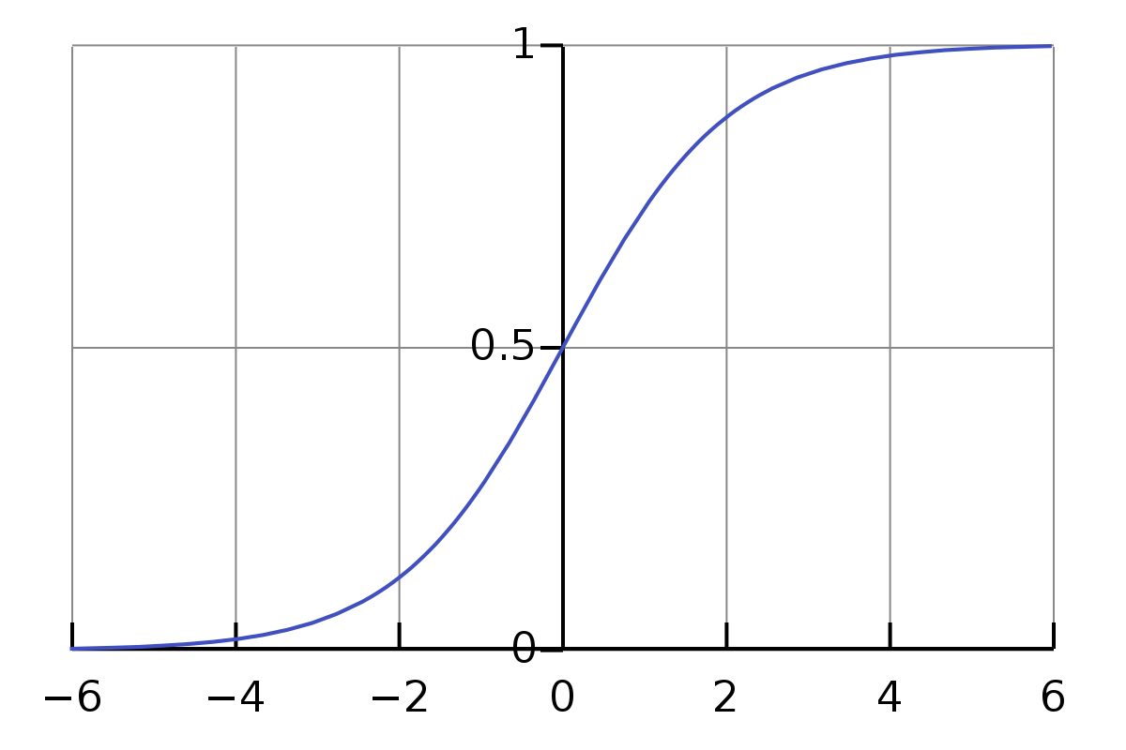
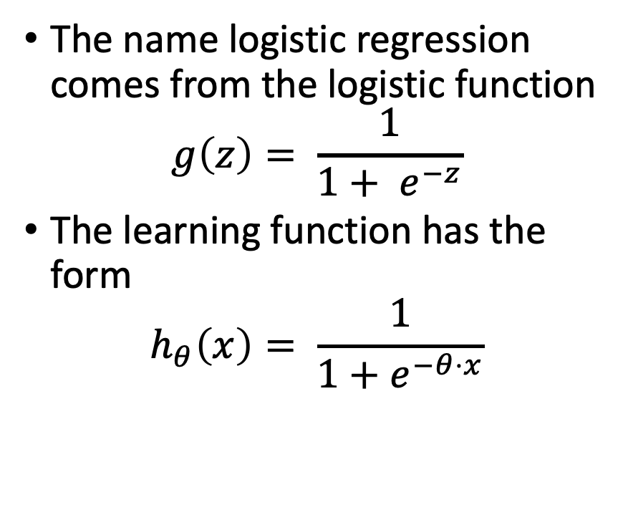
Logistic regression
The name logistic regression comes from the logistic function
$$g\left(z\right)= \frac{1}{1+ e^{−z}}$$
The learning function has the form
$$h_{θ}\left(x\right)= \frac{1}{1+e^{−θ⋅x}}$$

Slide 10

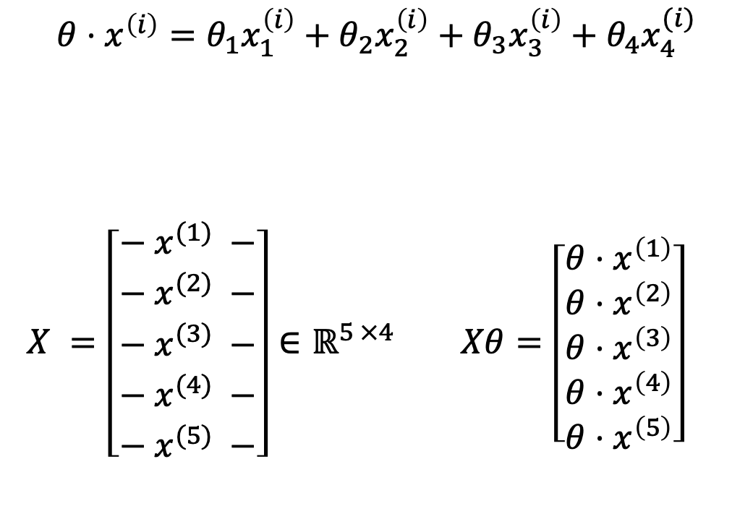



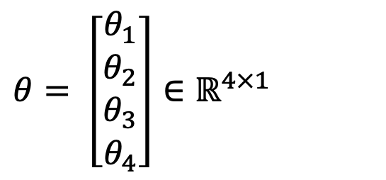

Logistic regression on a training set - Features
$θ= \left[\begin{aligned}θ_{1} \\ θ_{2} \\ θ_{3} \\ θ_{4}\end{aligned}\right]∈ℝ^{4×1}$
$$θ⋅x^{\left(i\right)}=θ_{1}x_{1}^{\left(i\right)}+θ_{2}x_{2}^{\left(i\right)}+θ_{3}x_{3}^{\left(i\right)}+θ_{4}x_{4}^{(i)}$$
$X^{ }=\left[\begin{aligned}− {x^{(1)}}_{ }^{ }− \\ − {x^{(2)}}_{ }^{ }− \\ − {x^{(3)}}_{ }^{ }− \\ − {x^{(4)}}_{ }^{ }− \\ − {x^{(5)}}_{ }^{ }−\end{aligned}\right]∈ℝ^{5 ×4}$ $Xθ=\left[\begin{aligned}θ⋅x^{\left(1\right)} \\ θ⋅x^{\left(2\right)} \\ θ⋅x^{\left(3\right)} \\ θ⋅x^{\left(4\right)} \\ θ⋅x^{\left(5\right)}\end{aligned}\right]$
$$\begin{matrix}x_{1}^{\left(1\right)} & x_{2}^{\left(1\right)} & x_{3}^{\left(1\right)} & x_{4}^{\left(1\right)}\end{matrix}$$
$$\begin{matrix}x_{1}^{\left(2\right)} & x_{2}^{\left(2\right)} & x_{3}^{\left(2\right)} & x_{4}^{\left(2\right)}\end{matrix}$$
$$\begin{matrix}x_{1}^{\left(3\right)} & x_{2}^{\left(3\right)} & x_{3}^{\left(3\right)} & x_{4}^{\left(3\right)}\end{matrix}$$
$$\begin{matrix}x_{1}^{\left(4\right)} & x_{2}^{\left(4\right)} & x_{3}^{\left(4\right)} & x_{4}^{\left(4\right)}\end{matrix}$$
$$\begin{matrix}x_{1}^{\left(5\right)} & x_{2}^{\left(5\right)} & x_{3}^{\left(5\right)} & x_{4}^{\left(5\right)}\end{matrix}$$
Notes:
Change the notation to be rows by columns

Slide 11

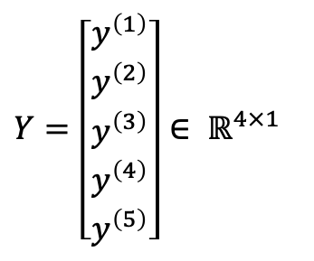










Logistic regression on a training set - Targets
$$1$$
$$y^{(1)}$$
$$\hat{y^{(i)}}=g\left(θ⋅x^{\left(i\right)}\right)=\frac{1}{1+e^{−θ⋅x^{\left(i\right)}}}$$
$$\hat{Y}=g\left(X^{T}θ\right)=\left[\begin{matrix}\hat{y^{\left(1\right)}} \\ \hat{y^{(2)}} \\ \begin{aligned}\hat{y^{(3)}} \\ \hat{y^{(4)}} \\ \hat{y^{(3)}}\end{aligned}\end{matrix}\right]$$
$$0$$
$Y=\left[\begin{matrix}y^{\left(1\right)} \\ y^{\left(2\right)} \\ \begin{aligned}y^{\left(3\right)} \\ y^{\left(4\right)} \\ y^{\left(5\right)}\end{aligned}\end{matrix}\right]∈ ℝ^{4×1}$
$$y^{(2)}$$
$$1$$
$$y^{(3)}$$
$$0$$
$$y^{(4)}$$
$$0$$
$$y^{(5)}$$

Slide 12
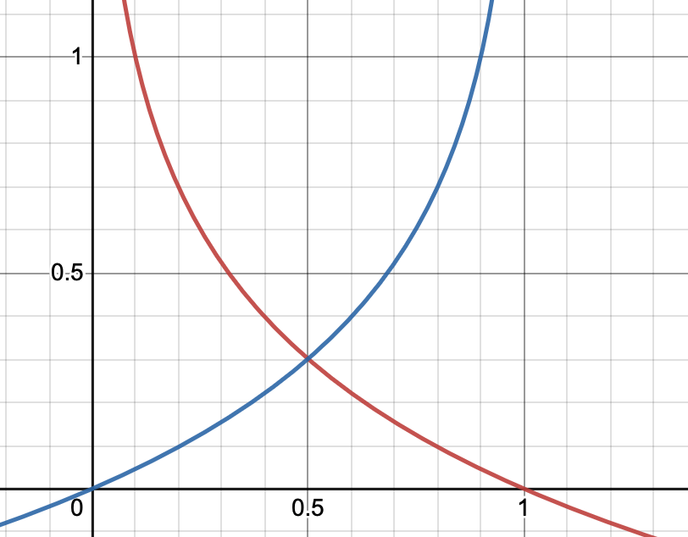
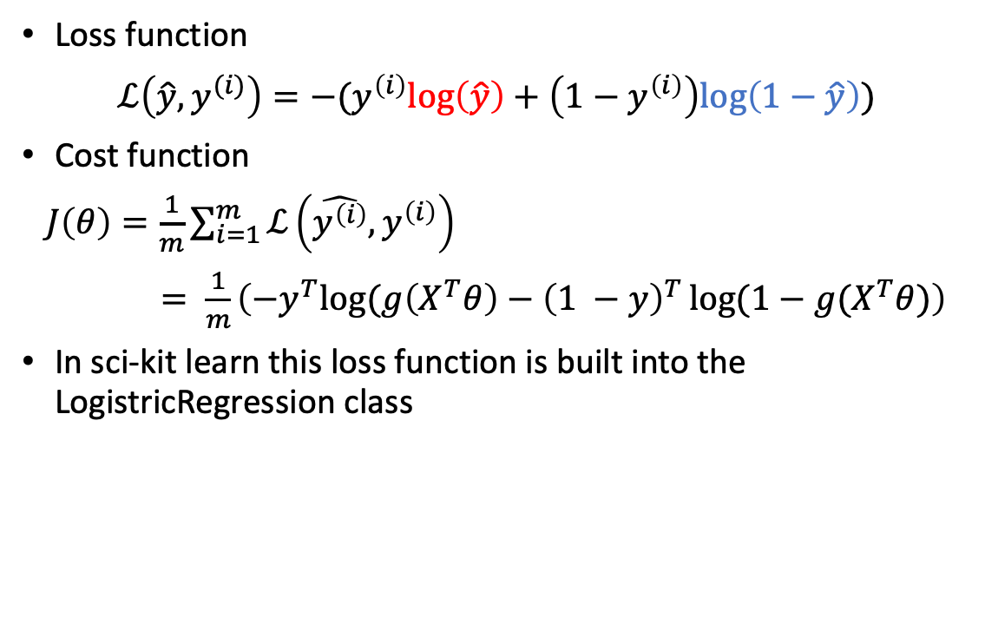
Loss and Cost Function
Loss function
$ℒ\left(\hat{y},y^{(i)}\right)=−(y^{\left(i\right)}log\left(\hat{y}\right)+\left(1−y^{\left(i\right)}\right)log\left(1−\hat{y}\right))$
Cost function
$J\left(θ\right)=\frac{1}{m}\sum_{i=1}^{m}{ℒ\left(\hat{y^{\left(i\right)}},y^{\left(i\right)}\right)}$
$= \frac{1}{m}\left(−y^{T}log⁡(g\left(X^{T}θ\right)−{\left(1 −y\right)}^{T}\log{(1−g(X^{T}θ)}\right)$
In sci-kit learn this loss function is built into the LogistricRegression class
Notes:
Intuition about loss function

Slide 13

Optimization - How do we minimize a function?
A function has a max/min where the gradient is zero
There are many methods for optimization problems
  Newton-Raphson
  Quasi-Newton
  Gradient descent/ stochastic gradient descent
  Conjugate gradient
  LFBGS
  Liblinear
  SAG
  SAGA
Gradient (1st order) methods are frequently used in machine learning
Gradient of cost function
  $∇J(θ)= \frac{1}{m}X^{T}(h_{θ}\left(x^{\left(i\right)}\right)−y^{\left(i\right)})$
Update rule for gradient descent
$$θ_{ }≔θ−α∇J\left(θ\right)$$
$$≔θ−α\frac{1}{m}X^{T}(h_{θ}\left(x^{\left(i\right)}\right)−y^{\left(i\right)})$$
Notes:
Limited memory FBGS Broyden-Fletcher-Goldfarb-Shanno – Quasi-Netwon
Liblinear – coordinate descent – updating
SAG – stochastic average gradient descent
SAGA – similar to SAG with potential for better performance (no definition for acronym even in the paper!)

Slide 14
Metrics
Evaluating a model’s performance
  Accuracy on test set
  Confusion matrix
    Precision
    Recall
  F1 score
  Precision Recall Curve
  ROC (receiver operating characteristic) curve
  AUC (area under the curve)
These are available to you in scikit-learn via a submodule called metrics
Here is a link to a list of scikit-learn metrics
We will see some of these called when we work through an example in Jupyter notebook
Notes:
ROC – receiver operating characteristic curve
Indicates the degree of separability/distinction or intermingling/crossover between predictions of 2 classes
The higher the score the better the separability of the two classes
AUC is the area under the curve
Binary classifier making random guesses would be correct 50% of the time, want your classifier to do better than this (otherwise it’s doing worse than guessing)!
TPR = TP / TP + FN – percentage of actual positives that have been correctly identified as positive
the denominator is everything classified as positive
when its positive how often does the model predict it as positive
FPR = FP / FP + TN – percentage of actual negatives that have been incorrectly predicted as positives
denominator is everything classified as negative
when its actually negative how often does the model predict otherwise
Vary the probability threshold for predicting the class (usually is 0.5)
And plot what the TPR and FPR is. As threshold increases you should approach – get less values in the positive class

Slide 15
Logistic regression in Python
We will explore using Scikit-Learn to solve a classification problem with logistic regression.
Scikit-Learn is one of the most popular and easy to use a machine learning libraries in python.
It supports both supervised and unsupervised learning algorithms.
It is built on Numpy, SciPy, and matplotlib.
It is very easy to build and test many different kinds of models, for example, RandomForestClassifier, Logistic Regression, Linear regression, Support Vector Machines (SVM) and many more!

Slide 16
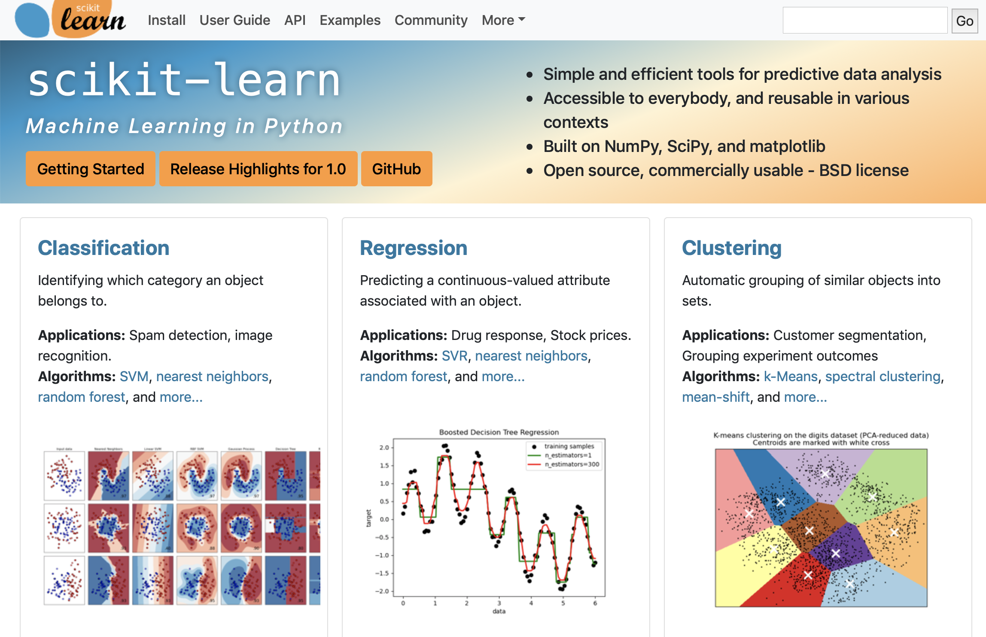

Slide 17
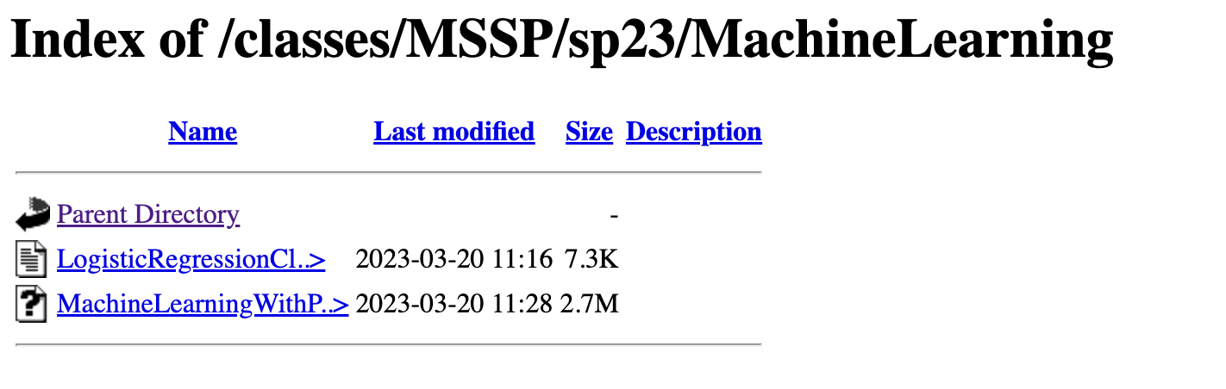
Link to Jupyter Notebook material
http://rcs.bu.edu/classes/MSSP/sp23/MachineLearning/
LogisticRegressionClassifier.ipynb

Slide 18
Split dataset into training $(X_{train}, y_{train})$ and test sets $(X_{test}, y_{test})$
Split dataset into training (𝑋_𝑡𝑟𝑎𝑖𝑛, 𝑦_𝑡𝑟𝑎𝑖𝑛) and test sets (𝑋_𝑡𝑒𝑠𝑡, 𝑦_𝑡𝑒𝑠𝑡)
Create your classifier object: clf = LogisticRegression()
Fit the data: clf.fit($X_{train}$, $y_{train}$)
Fit the data: clf.fit(𝑋_𝑡𝑟𝑎𝑖𝑛, 𝑦_𝑡𝑟𝑎𝑖𝑛)
Predict: clf.predict($X_{test}$)
Predict: clf.predict(𝑋_𝑡𝑒𝑠𝑡)
Evaluate the model using various metrics

Slide 19
Questions?

