Slide 1
Pipelines and MLOps
Scott Ladenheim, PhD
saladenh@bu.edu
help@rcs.bu.edu

Slide 2
Outline
Data Pipelines
MLOps
MLFlow

Slide 3
Data pipelines
Data lake
ML model
Processing
Database
Streaming
Data producers
Data consumers

Slide 4
Machine learning life cycle
Gather/clean data
Train model
Evaluate model

Slide 5
Task orchestration
As size of team and solution (e.g. ML model and input data) grows so does the number of repetitive tasks
The goal is centralized, repeatable, reproducible, and efficient workflows
For software you have CI/CD tools which automatically test and deploy code called DevOps
With ML we have a more complex process and CI/CD is one component of this

Slide 6
Pipelines vs Task Orchestration
Pipeline
Task orchestration
A
A
B
B
C
D
C
E
F
D
G
E
Notes:
Pipelines are limited/simpler directed acyclic graph

Slide 7
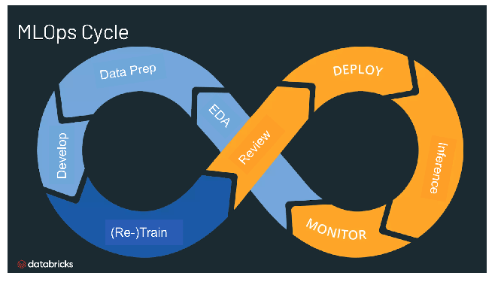
MLOps – Machine Learning Operations
A fancy task orchestration for machine learning
The idea is to streamline the process of taking machine learning models to production
Better collaboration to increase the pace of model development and deployment
Includes CI/CD but also
  Monitoring
  Validation
  governance
Notes:
Similar to DevOps – streamlining process of taking software code to production

Slide 8
Tools for task orchestration
Luigi (https://github.com/spotify/luigi) -- Spotify
Apache Airflow (https://airflow.apache.org/) – AirBnB
MLFlow (https://mlflow.org/)
Argo (https://argoproj.github.io/)
Azure MLOps (https://azure.microsoft.com/en-us/products/machine-learning/mlops/)
Amazon Sagemaker (https://aws.amazon.com/sagemaker/?nc=sn&loc=0)
https://www.datarevenue.com/en-blog/airflow-vs-luigi-vs-argo-vs-mlflow-vs-kubeflow
https://hevodata.com/learn/luigi-vs-airflow/
https://towardsdatascience.com/data-pipelines-luigi-airflow-everything-you-need-to-know-18dc741449b7

Slide 9
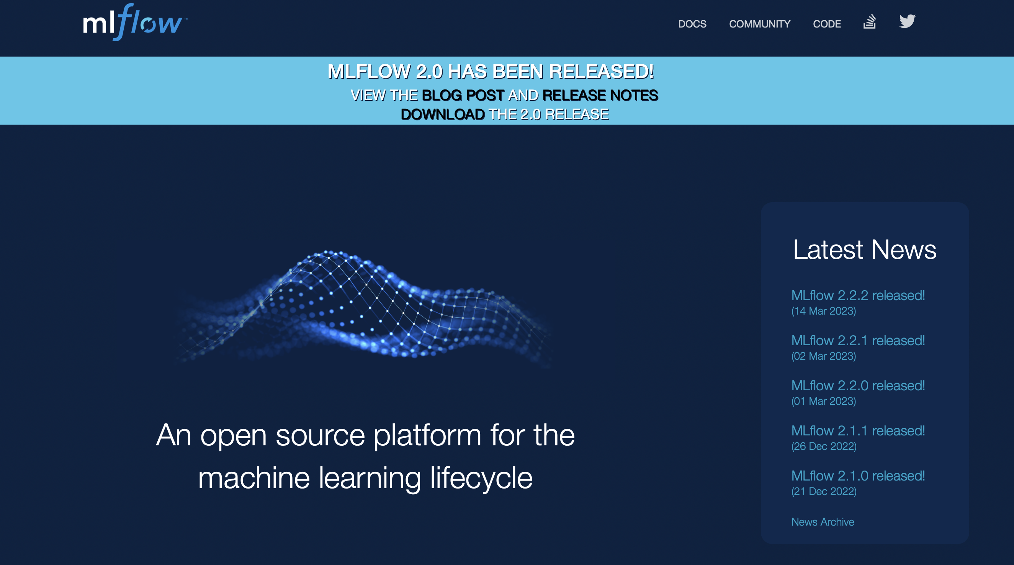
MLFlow
Track experiments to record and compare parameters and results
Packaging ML code in reusable, reproducible form in order to share with other data scientist or transfer to production
Managing and deploying models from a variety of ML libraries such as scikit-learn and pytorch
Provides a central model store to collaboratively manage the full lifecycle of an Mlflow model
Library agnostic – can be used with any programming language since all functions are accessible through a REST API
Notes:
Representational state transfer architectural style
No “official” standard, not a PROTOCOL
Flexible
Uniform interface
Client server decoupling
Statlesness
Cacheability
Layered system architecture
Code on demand

Slide 10
MLFlow to track Hyperparameter optimization
Hyperparameters – a tunable parameter in the network
  Optimization routine
    Learning rate
    Betas for Adams
  Number of epochs
  Minibatch size
We will work through an example of logging models with different hyperparameters
Notebook is `MLFlowHyperparameter.ipynb` at http://rcs.bu.edu/classes/MSSP/sp23/MLFlow/

Slide 11
Questions?

