Slide 1
Deep Learning with Pytorch
Scott Ladenheim, PhD
saladenh@bu.edu
help@rcs.bu.edu

Slide 2
Outline
Neural networks and deep learning
Pytorch implementation
Neural networks for binary classification
Multiclass classification
Using GPUs
Part 1
Part 2

Slide 3
Part 2

Slide 4














Neural networks for Multiclass classification
Forward prop
$$x_{1}$$
$$a_{1}^{[1]}$$
$$a_{1}^{[2]}$$
$${\hat{y}}_{1}$$
$$x_{2}$$
$$a_{2}^{[1]}$$
$$a_{2}^{[2]}$$
$${\hat{y}}_{2}$$
$$ℒ(\hat{y}, y)$$
$$x_{3}$$
$$a_{3}^{[1]}$$
$$a_{3}^{[2]}$$
$${\hat{y}}_{3}$$
$$x_{4}$$
Loss function
Input layer
Hidden layers
Output layer
Backward prop

Slide 5















Output layer
Multiclass classification uses the softmax function for the output layer
The formula for the softmax function is
$$\hat{y_{i}}= \frac{e^{z_{i}}}{\sum_{j}{e^{z_{j}}}}$$
$z_{ }=θ^{\left[2\right]}a^{[2]}+b^{[2]}$
$$x_{1}$$
$$a_{1}^{[1]}$$
$$a_{1}^{[2]}$$
$${\hat{y}}_{1}$$
$$x_{2}$$
$$a_{2}^{[1]}$$
$$a_{2}^{[2]}$$
$${\hat{y}}_{2}$$
$$ℒ(\hat{y}, y)$$
$$x_{3}$$
$$a_{3}^{[1]}$$
$$a_{3}^{[2]}$$
$${\hat{y}}_{3}$$
$$x_{4}$$
Input layer
Hidden layers
Output layer
Loss function

Slide 6





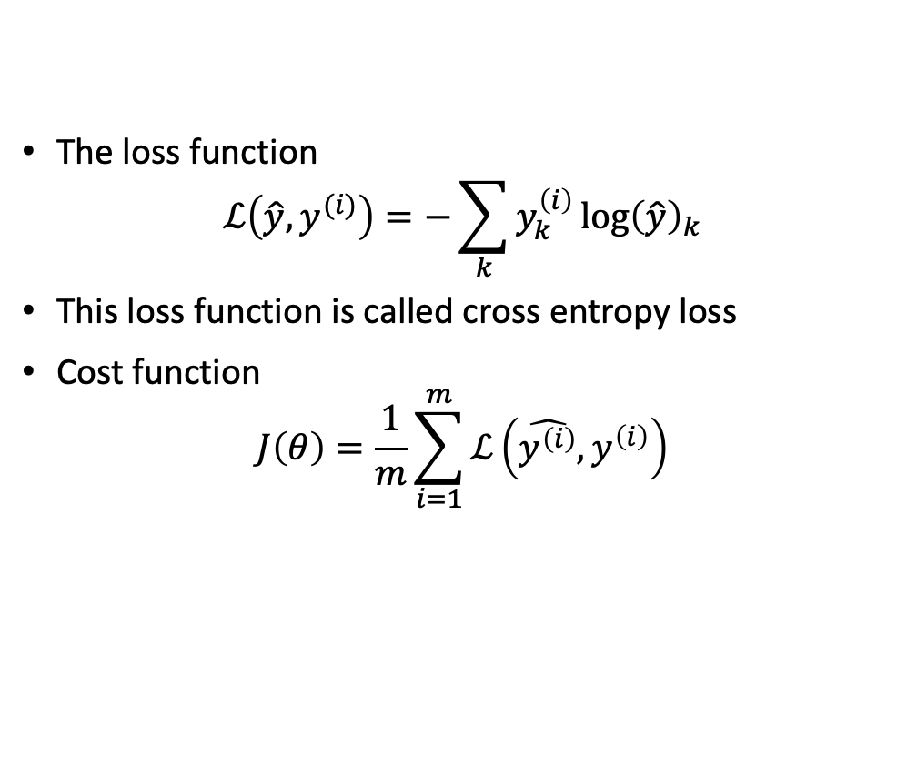









Loss function
The loss function
$$ℒ\left(\hat{y},y^{(i)}\right)=−\sum_{k}{y_{k}^{\left(i\right)}\log{{\left(\hat{y}\right)}_{k}}}$$
This loss function is called cross entropy loss
Cost function
$$J\left(θ\right)=\frac{1}{m}\sum_{i=1}^{m}{ℒ\left(\hat{y^{\left(i\right)}},y^{\left(i\right)}\right)}$$
$$x_{1}$$
$$a_{1}^{[1]}$$
$$a_{1}^{[2]}$$
$${\hat{y}}_{1}$$
$$x_{2}$$
$$a_{2}^{[1]}$$
$$a_{2}^{[2]}$$
$${\hat{y}}_{2}$$
$$ℒ(\hat{y}, y)$$
$$x_{3}$$
$$a_{3}^{[1]}$$
$$a_{3}^{[2]}$$
$${\hat{y}}_{3}$$
$$x_{4}$$
Input layer
Hidden layers
Output layer
Loss function

Slide 7
Validation set
Previously split data into
  Train
  Test
Now we introduce a new split
  Train
  Validation
  Test
The validation set is used during training.
  If the accuracy of the validation set stagnates, you are overfitting to the training data.
  Allows you to implement strategies to prevent overfitting

Slide 8
Hardware acceleration
CPU
GPU
Central processing unit
Optimized for serial tasks
Large main memory
Fast clock speeds
Small number of threads can run very quickly
Low memory bandwidth
Low performance/watt
Graphics processing unit
Optimized for parallel tasks
Offload the parallelizable
High bandwidth main memory
More compute resources
High throughput
High performance/Watt
Low memory capacity
Low per-thread performance

Slide 9
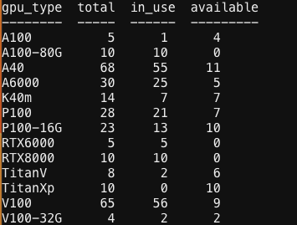
GPUs
Our previous datasets and networks were small
  Breast cancer data set ~500 rows
  Neural networks had <1000 parameters
Training models with 1M > parameters
CNN, LLMs (ChatGPT) can easily have billions of parameters
GPU resources on the SCC

Slide 10

Requesting a GPU on the SCC via OnDemand
Go to scc-ondemand.bu.edu
Select Interactive Apps
Select Jupyter Notebook

Slide 11
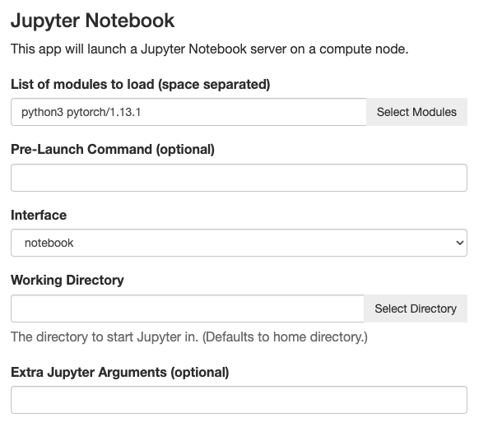
Requesting a GPU on the SCC via OnDemand
Go to scc-ondemand.bu.edu
Select Interactive Apps
Select Jupyter Notebook
Set Python and Pytorch as the modules

Slide 12
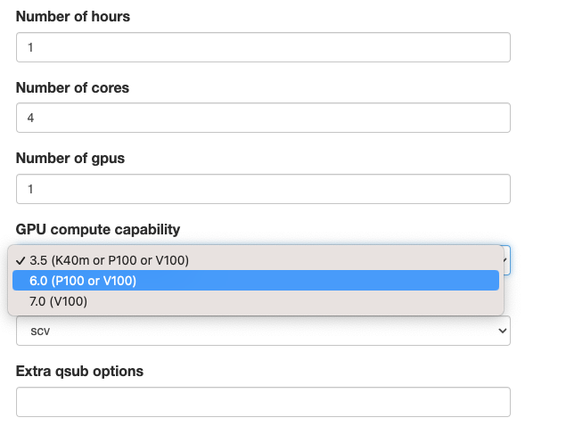
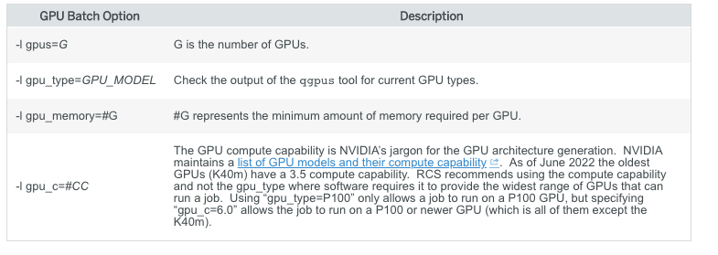
Requesting a GPU on the SCC via OnDemand
https://www.bu.edu/tech/support/research/computing-resources/tech-summary/

Slide 13
Using GPUs in Pytorch
Need to move your data and neural network to the GPU (cuda) device
To check if a GPU is available
  if torch.cuda.is_available():
  return torch.device('cuda')
  else:
  return torch.device('cpu')
To move data or model to a device
  object.to(device_name)

Slide 14
Pytorch in Practice
Open the Jupyter notebook `PytorchNeuralNetworkMultiClassifier.ipynb` in http://rcs.bu.edu/classes/MSSP/sp23/DeepLearning/

Slide 15
Questions?

Slide 16
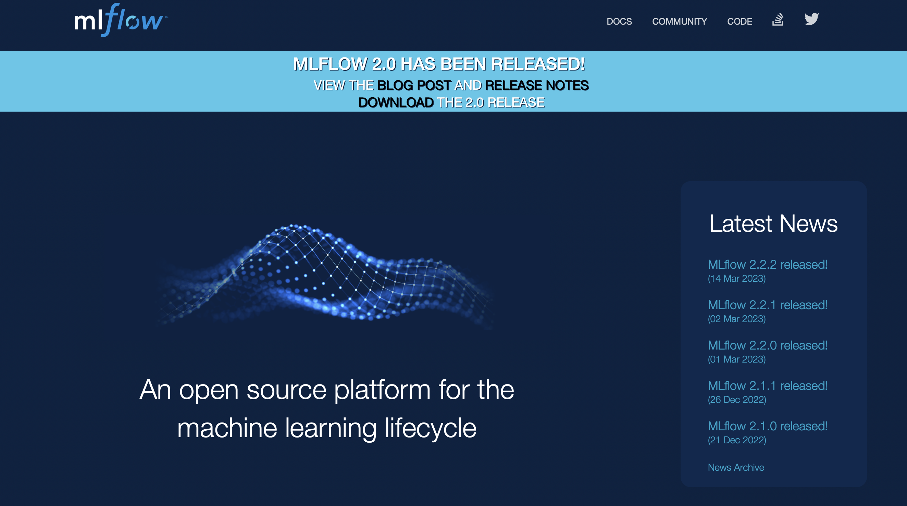
For next time
Please install MLFlow on your personal laptop
It can be installed through Anaconda

