Slide 1
Deep Learning with Pytorch
Scott Ladenheim, PhD
saladenh@bu.edu
help@rcs.bu.edu

Slide 2
Outline
Neural networks and deep learning
Pytorch implementation
Neural networks for binary classification
Multiclass classification
Using GPUs
Part 1
Part 2

Slide 3
Part 1

Slide 4
Artificial intelligence
Machine learning
Deep learning
Artificial intelligence: simulation of human intelligence by machines
Machine learning: computers learning to perform tasks based on data
Deep learning: a machine learning technique that mimics networks of neurons

Slide 5
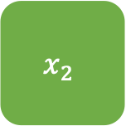
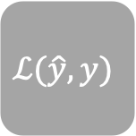

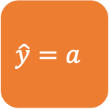
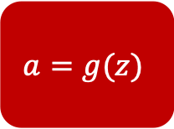
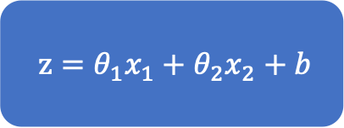
Neuron
$$x_{1}$$
$z=θ_{1}x_{1}+θ_{2}x_{2}+b$
$$a=g(z)$$
$$\hat{y}=a$$
$$ℒ(\hat{y}, y)$$
$$x_{2}$$
Inputs
Linear combination of inputs
Activation function
Output
Loss function

Slide 6
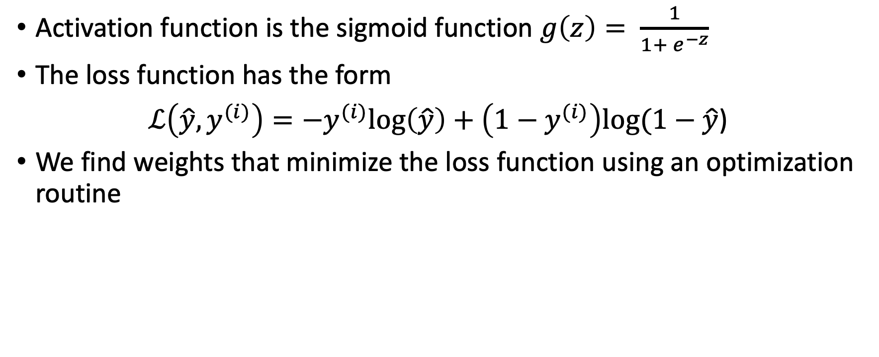
Logistic Regression
Activation function is the sigmoid function $g\left(z\right)= \frac{1}{1+ e^{−z}}$
The loss function has the form
$ℒ\left(\hat{y}, y^{(i)}\right)=−y^{(i)}log\left(\hat{y}\right)+\left(1−y^{(i)}\right)log(1−\hat{y}$)
We find weights that minimize the loss function using an optimization routine

Slide 7
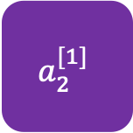
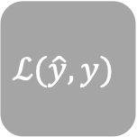
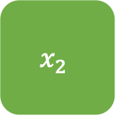
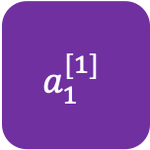
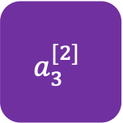


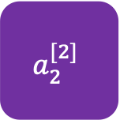

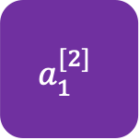

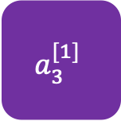
Neural Network
$$x_{1}$$
$$a_{1}^{[1]}$$
$$a_{1}^{[2]}$$
$$x_{2}$$
$$\hat{y}$$
$$ℒ(\hat{y}, y)$$
$$a_{2}^{[1]}$$
$$a_{2}^{[2]}$$
$$x_{3}$$
$$a_{3}^{[1]}$$
$$a_{3}^{[2]}$$
$$x_{4}$$
Input layer
Hidden layers
Output layer
Loss function

Slide 8












Forward propagation
The process of transforming input data to output data in the neural network
Forward propagation uses matrix-vector (tensor) operations
Activation functions are applied to each node
A loss function is calculated at the end
Forward propagation can be implemented efficiently with vectorization
$$x_{1}$$
$$a_{1}^{[1]}$$
$$a_{1}^{[2]}$$
$$x_{2}$$
$$a_{2}^{[1]}$$
$$\hat{y}$$
$$ℒ(\hat{y}, y)$$
$$a_{2}^{[2]}$$
$$x_{3}$$
$$a_{3}^{[1]}$$
$$a_{3}^{[2]}$$
$$x_{4}$$
Input layer
Hidden layers
Output layer
Loss function

Slide 9





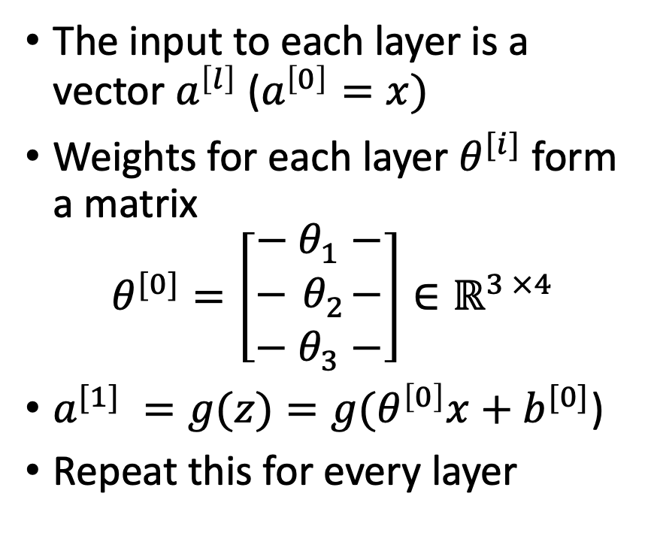







Forward propagation – Tensor operations
The input to each layer is a vector $a^{\left[l\right]}$ ($a^{\left[0\right]}=x)$
Weights for each layer $θ^{[i]}$ form a matrix
$$θ^{[0]}=\left[\begin{aligned}− θ_{1}^{ }− \\ −{ θ}_{2}^{ }− \\ − θ_{3}^{ }−\end{aligned}\right]∈ℝ^{3 ×4}$$
$a^{[1]} =g(z)=g(θ^{\left[0\right]}x+b^{[0]}$)
Repeat this for every layer
$$x_{1}$$
$$a_{1}^{[1]}$$
$$a_{1}^{[2]}$$
$$x_{2}$$
$$a_{2}^{[1]}$$
$$\hat{y}$$
$$ℒ(\hat{y}, y)$$
$$a_{2}^{[2]}$$
$$x_{3}$$
$$a_{3}^{[1]}$$
$$a_{3}^{[2]}$$
$$x_{4}$$
Input layer
Hidden layers
Output layer
Loss function

Slide 10
Activation functions
Sigmoid
ReLU
Tanh
Nonlinear
Differentiable
See the documentation for others

Slide 11
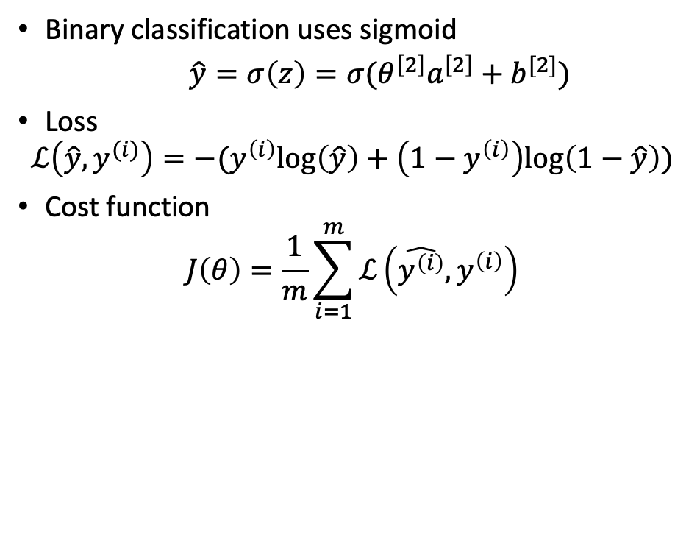
Output layer: Loss and Cost function
Binary classification uses sigmoid
  $\hat{y}=σ\left(z\right)=σ(θ^{\left[2\right]}a^{\left[2\right]}+b^{[2]})$
Loss
$$ℒ\left(\hat{y},y^{(i)}\right)=−(y^{\left(i\right)}log\left(\hat{y}\right)+\left(1−y^{\left(i\right)}\right)log\left(1−\hat{y}\right))$$
Cost function
$$J\left(θ\right)=\frac{1}{m}\sum_{i=1}^{m}{ℒ\left(\hat{y^{\left(i\right)}},y^{\left(i\right)}\right)}$$
$$x_{1}$$
$$a_{1}^{[1]}$$
$$a_{1}^{[2]}$$
$$x_{2}$$
$$a_{2}^{[1]}$$
$$\hat{y}$$
$$ℒ(\hat{y}, y)$$
$$a_{2}^{[2]}$$
$$x_{3}$$
$$a_{3}^{[1]}$$
$$a_{3}^{[2]}$$
$$x_{4}$$
Input layer
Hidden layers
Output layer
Loss function

Slide 12





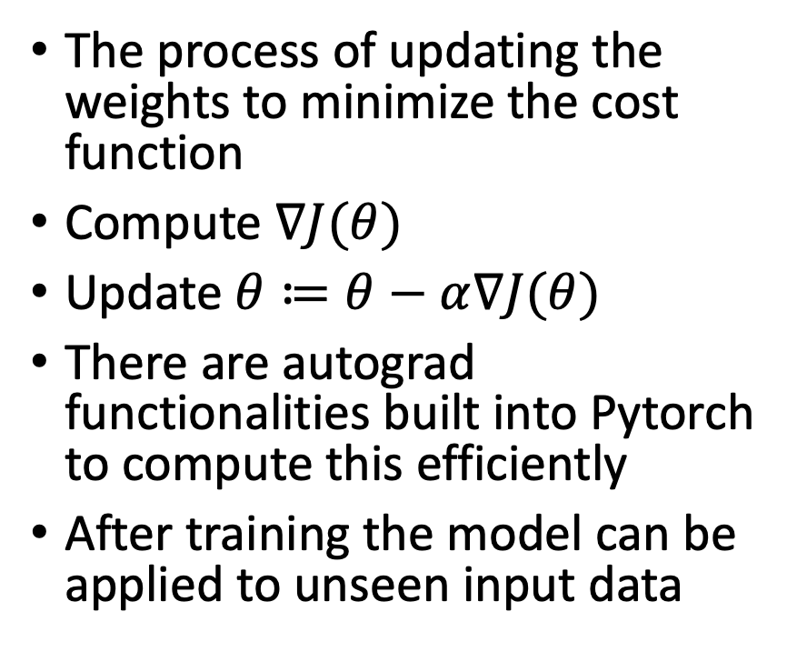







Backward propagation
The process of updating the weights to minimize the cost function
Compute $∇J(θ)$
Update $θ≔θ−α∇J(θ)$
There are autograd functionalities built into Pytorch to compute this efficiently
After training the model can be applied to unseen input data
$$x_{1}$$
$$a_{1}^{[1]}$$
$$a_{1}^{[2]}$$
$$x_{2}$$
$$a_{2}^{[1]}$$
$$\hat{y}$$
$$ℒ(\hat{y}, y)$$
$$a_{2}^{[2]}$$
$$x_{3}$$
$$a_{3}^{[1]}$$
$$a_{3}^{[2]}$$
$$x_{4}$$
Input layer
Hidden layers
Output layer
Loss function

Slide 13
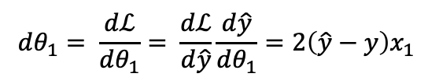

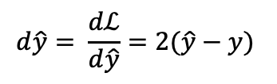
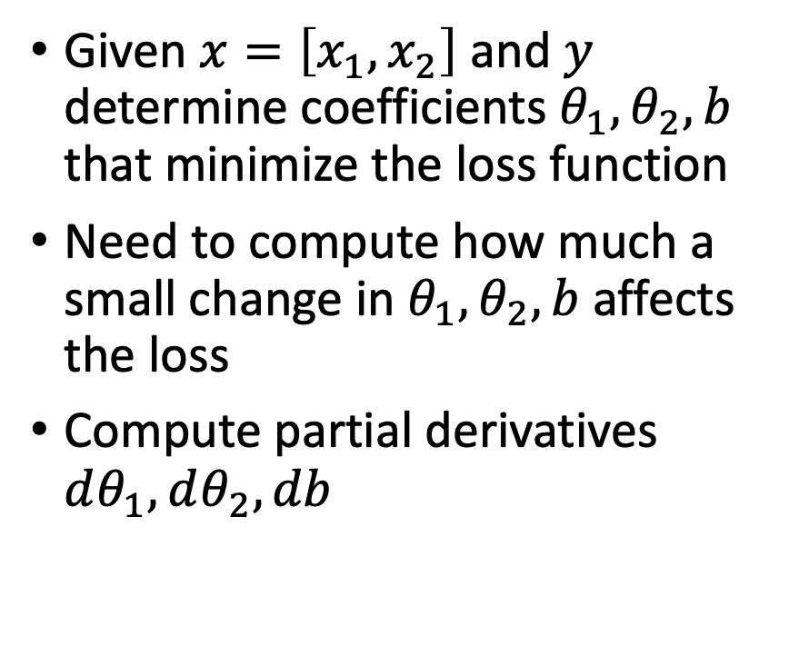


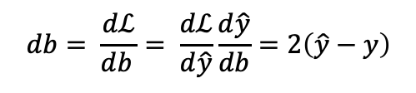

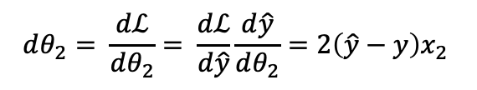
Manual backward propagation
Given $x=\left[x_{1},x_{2}\right]$ and $y$ determine coefficients $θ_{1},θ_{2},b$ that minimize the loss function
Need to compute how much a small change in $θ_{1},θ_{2},b$ affects the loss
Compute partial derivatives $dθ_{1}, dθ_{2}, db$
$$x_{1}$$
$$d\hat{y}= \frac{dℒ}{d\hat{y}}=2(\hat{y}−y)$$
$$\hat{y}=θ_{1}x_{1}+θ_{2}x_{2}+b$$
$$ℒ\left(\hat{y}, y\right)={\left(\hat{y}−y\right)}^{2}$$
$$x_{2}$$
$$dθ_{1}= \frac{dℒ}{dθ_{1}}= \frac{dℒ}{d\hat{y}}\frac{d\hat{y}}{dθ_{1}}=2\left(\hat{y}−y\right)x_{1}$$
$$dθ_{2}= \frac{dℒ}{dθ_{2}}= \frac{dℒ}{d\hat{y}}\frac{d\hat{y}}{dθ_{2}}=2\left(\hat{y}−y\right)x_{2}$$
$$db= \frac{dℒ}{db_{ }}= \frac{dℒ}{d\hat{y}}\frac{d\hat{y}}{db}=2\left(\hat{y}−y\right)$$

Slide 14
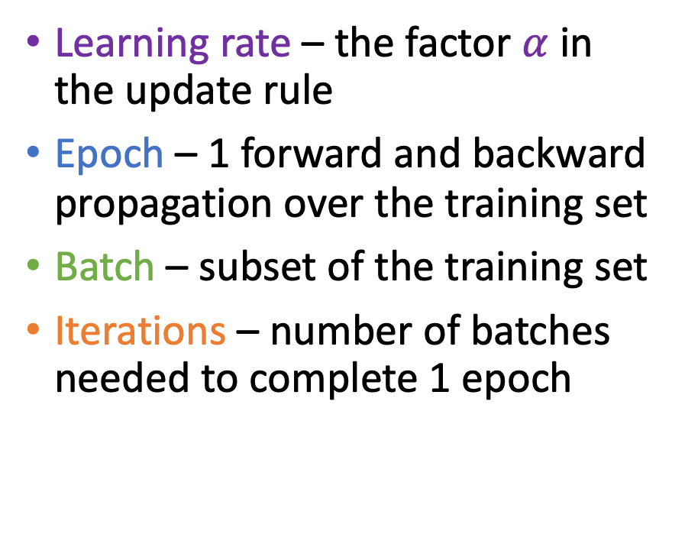
Terminology review
Learning rate – the factor $α$ in the update rule
Epoch – 1 forward and backward propagation over the training set
Batch – subset of the training set
Iterations – number of batches needed to complete 1 epoch
Suppose we have 2000 training examples.
Split the training set into batches of 400
5 batches
5 iterations to complete 1 epoch

Slide 15

Optimized tensor library for deep learning using GPUs and CPUs
Python based library but users can program in C/C++
Primary goal is usability
Secondary goal is performance
Created by Facebook AI Research Lab
Released in 2016
Open source

Slide 16
Using Pytorch
Tensors
nn.Module Class
Architecture – input, hidden, output layers
Forward propagation
Backward propagation
Dataset class
Dataloader class
Loss functions
Optimizers

Slide 17
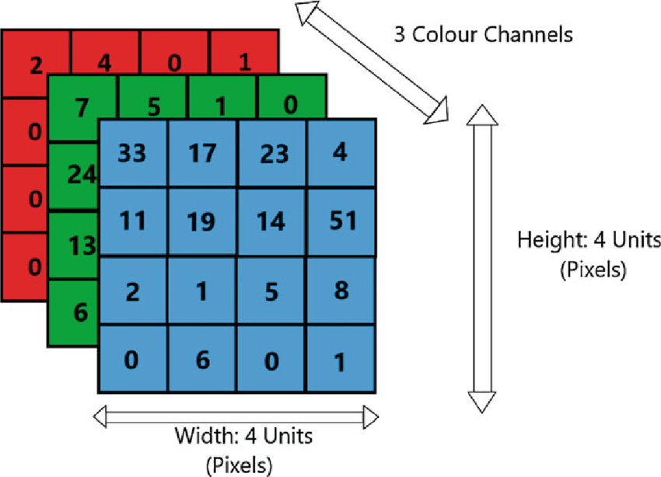


Tensors
Pytorch
Multi-dimensional arrays of data
1-D tensor is a vector
2-D tensor is a matrix
3-D tensor
N-D tensor
torch.tensor()
torch.tensor(np.array([[1, 2, 3],
  [4, 5, 6]]))
Can add, subtract, and, multiply
Defined operations for multiplying tensors with valid dimensions
Autograd capabilities make it easy to track gradients of tensors
https://pytorch.org/docs/stable/tensors.html#tensor-class-reference
$$x=[x_{1}, x_{2}, …,x_{n}]$$
$$X=\left[\begin{matrix}x_{11} & ⋯ & x_{1n} \\ ⋮ & ⋱ & ⋮ \\ x_{m1} & ⋯ & x_{mn}\end{matrix}\right]$$

Slide 18
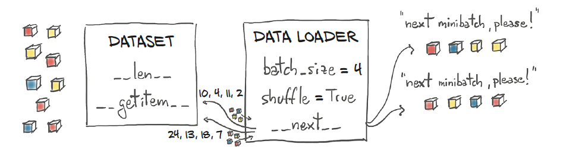
DataSet and DataLoader
For complex data, you need to create DataSet and DataLoader.
DataSet is data class, loads data one at a time.
DataLoader is the bridge between DataSet and the Optimizer.

Slide 19
DataSet Class
The Dataset retrieves our dataset’s features and labels one sample at a time.
must implement three functions: __init__, __len__, and __getitem__.
  The __init__ function is run once when instantiating the Dataset object.
  The __len__ function returns the number of samples in our dataset.
  The __getitem__ function loads and returns a sample from the dataset at the given index idx.
class dataname(Dataset):
def __init__(self, xxx, transform=None, target_transform=None):
def __len__(self):
return xxxx_len # returns the length
def __getitem__(self, idx):
return xxxx, yyyy # gets the data
https://pytorch.org/tutorials/beginner/basics/data_tutorial.html

Slide 20
DataLoader Class
DataLoader is an iterable that abstracts the complex data passing process and makes our lives easier.
  pass samples in “minibatches”,
  reshuffle the data at every epoch to reduce model overfitting
  use Python’s multiprocessing to speed up data retrieval.
from torch.utils.data import DataLoader
train_dataloader = DataLoader(training_data,
batch_size=64,
shuffle=True)
test_dataloader = DataLoader(test_data,
batch_size=64,
shuffle=True)

Slide 21
How to define a nn.Module subclass
torch.nn.Module class is how we implement the neural network
Have to implement 2 methods
  __init__(self) - where neural network layers and member data of the class are initialized
  forward(self, x) – method that defines the operations of the forward propagation, e.g., how data at each layer is manipulated
Easy to customize the neural network
Have access to all the layers that you define
Easy to view and manipulate the parameters within the layers

Slide 22
Loss functions
Choice of loss function depends on
  Activation function used in the output layer
  Task you want your model to do (e.g., regression, binary/multiclass classification)
Full list https://pytorch.org/docs/stable/nn.html#loss-functions
Regression
  Mean squared error
  nn.MSELoss
Binary classification
  Binary cross-entropy
  nn.BCELoss

Slide 23
Optimizers
torch.Optim
Package that implements various optimization algorithms
Allows you to adjust the learning rate with lr_scheduler
All optimizers are listed here https://pytorch.org/docs/stable/optim.html
Popular optimizers
  Adam
  Adamx
  RMSProp
  SGD – Stochastic Gradient descent
  LBFGS

Slide 24
Pytorch in Practice
Open the Jupyter notebook `PytorchNeuralNetworkClassifier.ipynb` in http://rcs.bu.edu/classes/MSSP/sp23/DeepLearning/

